Slide 1

Referred to last time…
https://3d.xkcd.com/435/

Slide 2
Joint Distributions and Marginal Distributions
RVs and Probability Concepts
Joint Distributions and Marginal Distributions
Independent RVs and Conditional Probability and RVs
Linearity of Expectation
Additional Info on Important Distributions
Memoryless Property of Geometric RVs
The Sum of Two Poisson RVs
Poisson as the Limit of Binomial RVs
Lecture 20, CS70 Summer 2025

Slide 3
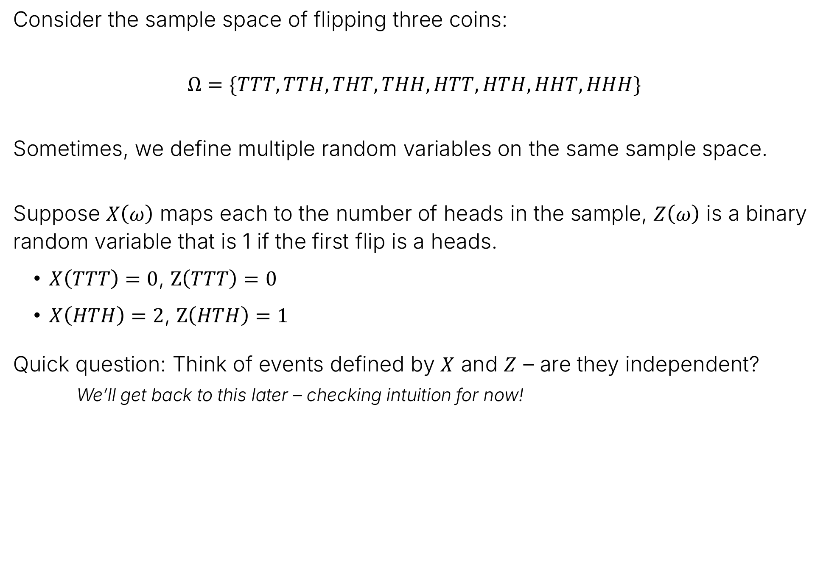
Multiple Random Variables on the Same Sample Space
Consider the sample space of flipping three coins:
$$Ω=\{TTT, TTH, THT, THH, HTT, HTH, HHT, HHH\}$$
Sometimes, we define multiple random variables on the same sample space.
Suppose $X\left(ω\right)$ maps each to the number of heads in the sample, $Z\left(ω\right)$ is a binary random variable that is 1 if the first flip is a heads.
$X\left(TTT\right)=0$, $Z\left(TTT\right)=0$
$X\left(HTH\right)=2$, $Z\left(HTH\right)=1$
Quick question: Think of events defined by $X$ and $Z$ – are they independent?
We’ll get back to this later – checking intuition for now!

Slide 4
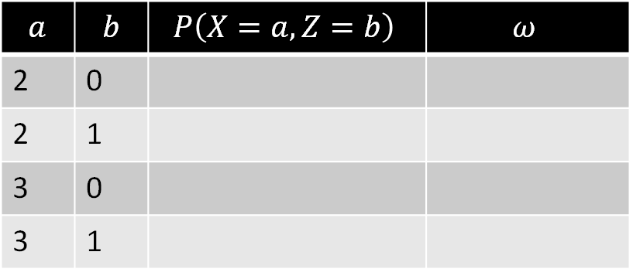
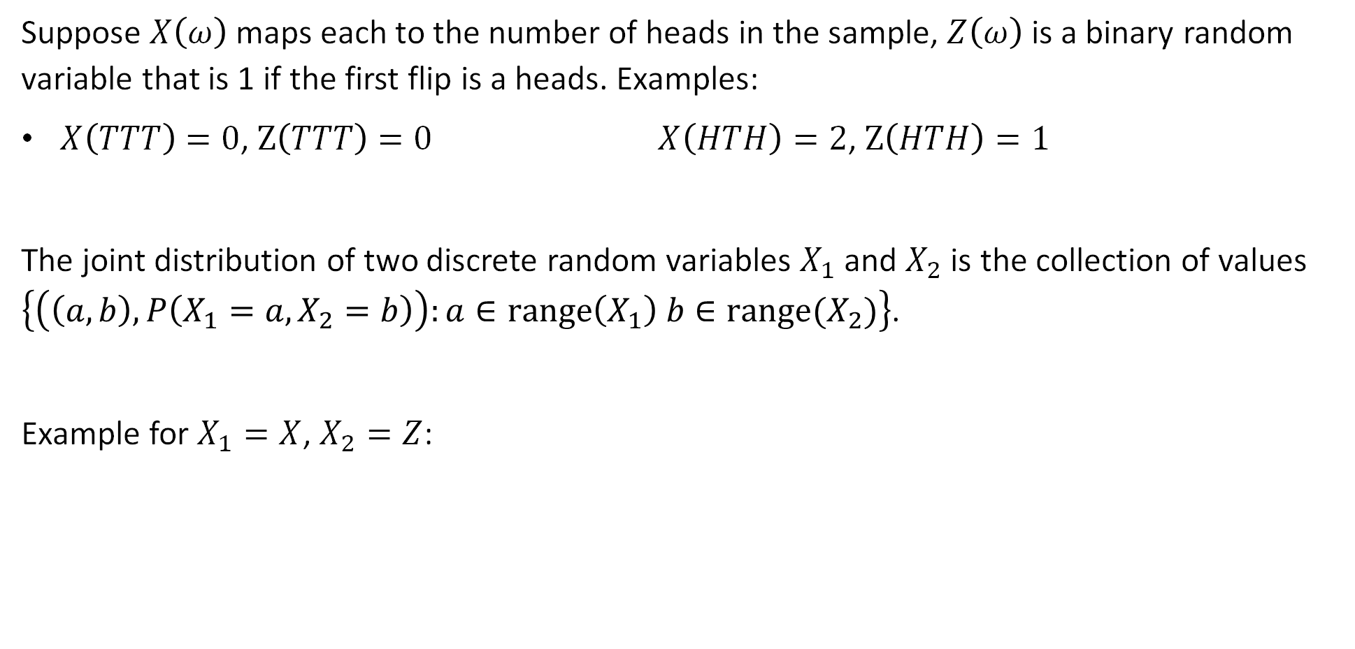
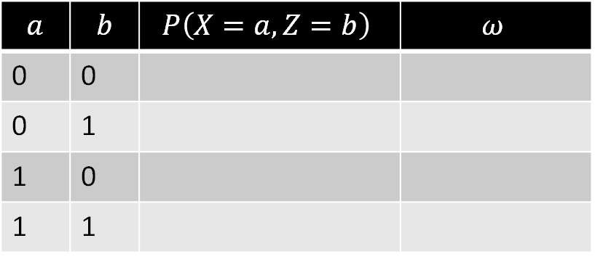
Multiple Random Variables on the Same Sample Space
Suppose $X\left(ω\right)$ maps each to the number of heads in the sample, $Z\left(ω\right)$ is a binary random variable that is 1 if the first flip is a heads. Examples:
$X\left(TTT\right)=0$, $Z\left(TTT\right)=0$ $X\left(HTH\right)=2$, $Z\left(HTH\right)=1$
The joint distribution of two discrete random variables $X_{1}$ and $X_{2}$ is the collection of values $\left\{\left(\left(a,b\right), P\left(X_{1}=a,X_{2}=b\right)\right):a∈range\left(X_{1}\right) b∈range(X_{2})\right\}$.
Example for $X_{1}=X$, $X_{2}=Z$:
$$a$$ | $$b$$ | $$P\left(X=a, Z=b\right)$$ | $$ω$$
0 | 0
0 | 1
1 | 0
1 | 1
$$a$$ | $$b$$ | $$P\left(X=a, Z=b\right)$$ | $$ω$$
2 | 0
2 | 1
3 | 0
3 | 1

Slide 5
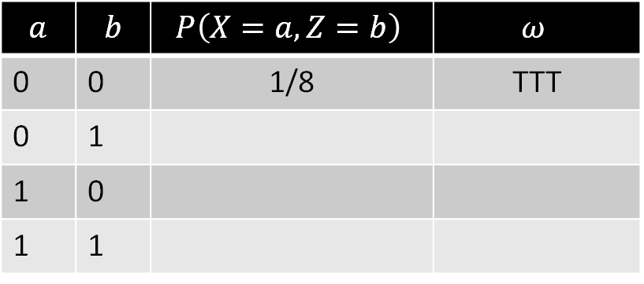
Multiple Random Variables on the Same Sample Space
Suppose $X\left(ω\right)$ maps each to the number of heads in the sample, $Z\left(ω\right)$ is a binary random variable that is 1 if the first flip is a heads. Examples:
$X\left(TTT\right)=0$, $Z\left(TTT\right)=0$ $X\left(HTH\right)=2$, $Z\left(HTH\right)=1$
The joint distribution of two discrete random variables $X_{1}$ and $X_{2}$ is the collection of values $\left\{\left(\left(a,b\right), P\left(X_{1}=a,X_{2}=b\right)\right):a∈range\left(X_{1}\right) b∈range(X_{2})\right\}$.
Example for $X_{1}=X$, $X_{2}=Z$:
$$a$$ | $$b$$ | $$P\left(X=a, Z=b\right)$$ | $$ω$$
0 | 0 | 1/8 | TTT
0 | 1
1 | 0
1 | 1
$$a$$ | $$b$$ | $$P\left(X=a, Z=b\right)$$ | $$ω$$
2 | 0
2 | 1
3 | 0
3 | 1

Slide 6
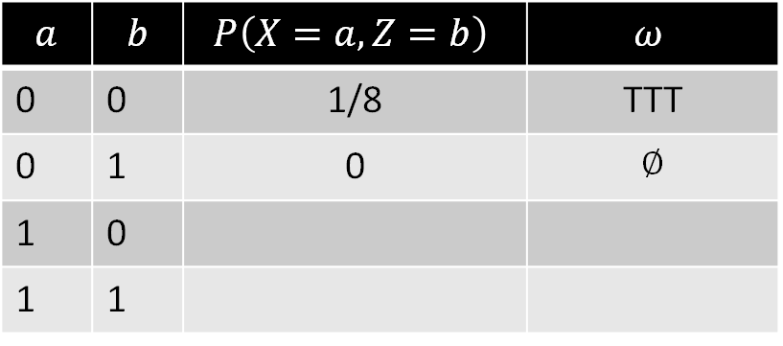
Multiple Random Variables on the Same Sample Space
Suppose $X\left(ω\right)$ maps each to the number of heads in the sample, $Z\left(ω\right)$ is a binary random variable that is 1 if the first flip is a heads. Examples:
$X\left(TTT\right)=0$, $Z\left(TTT\right)=0$ $X\left(HTH\right)=2$, $Z\left(HTH\right)=1$
The joint distribution of two discrete random variables $X_{1}$ and $X_{2}$ is the collection of values $\left\{\left(\left(a,b\right), P\left(X_{1}=a,X_{2}=b\right)\right):a∈range\left(X_{1}\right) b∈range(X_{2})\right\}$.
Example for $X_{1}=X$, $X_{2}=Z$:
$$a$$ | $$b$$ | $$P\left(X=a, Z=b\right)$$ | $$ω$$
0 | 0 | 1/8 | TTT
0 | 1 | 0 | ∅
1 | 0
1 | 1
$$a$$ | $$b$$ | $$P\left(X=a, Z=b\right)$$ | $$ω$$
2 | 0
2 | 1
3 | 0
3 | 1

Slide 7

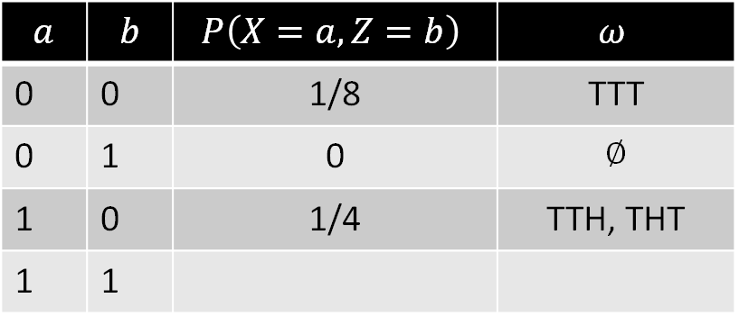
Multiple Random Variables on the Same Sample Space
Suppose $X\left(ω\right)$ maps each to the number of heads in the sample, $Z\left(ω\right)$ is a binary random variable that is 1 if the first flip is a heads. Examples:
$X\left(TTT\right)=0$, $Z\left(TTT\right)=0$ $X\left(HTH\right)=2$, $Z\left(HTH\right)=1$
The joint distribution of two discrete random variables $X_{1}$ and $X_{2}$ is the collection of values $\left\{\left(\left(a,b\right), P\left(X_{1}=a,X_{2}=b\right)\right):a∈range\left(X_{1}\right) b∈range(X_{2})\right\}$.
Example for $X_{1}=X$, $X_{2}=Z$:
What other $(a, b)$has probability 1/4?
$$a$$ | $$b$$ | $$P\left(X=a, Z=b\right)$$ | $$ω$$
0 | 0 | 1/8 | TTT
0 | 1 | 0 | ∅
1 | 0 | 1/4 | TTH, THT
1 | 1
$$a$$ | $$b$$ | $$P\left(X=a, Z=b\right)$$ | $$ω$$
2 | 0
2 | 1
3 | 0
3 | 1

Slide 8
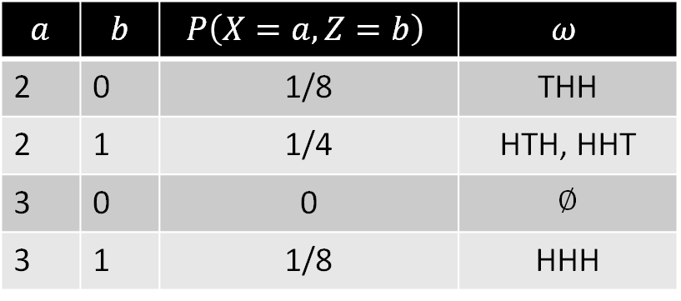
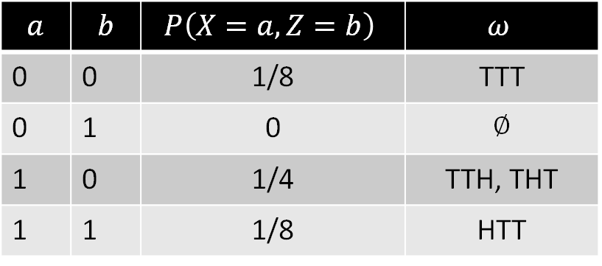
Multiple Random Variables on the Same Sample Space
Suppose $X\left(ω\right)$ maps each to the number of heads in the sample, $Z\left(ω\right)$ is a binary random variable that is 1 if the first flip is a heads. Examples:
$X\left(TTT\right)=0$, $Z\left(TTT\right)=0$ $X\left(HTH\right)=2$, $Z\left(HTH\right)=1$
The joint distribution of two discrete random variables $X_{1}$ and $X_{2}$ is the collection of values $\left\{\left(\left(a,b\right), P\left(X_{1}=a,X_{2}=b\right)\right):a∈range\left(X_{1}\right) b∈range(X_{2})\right\}$.
Example for $X_{1}=X$, $X_{2}=Z$:
$$a$$ | $$b$$ | $$P\left(X=a, Z=b\right)$$ | $$ω$$
0 | 0 | 1/8 | TTT
0 | 1 | 0 | ∅
1 | 0 | 1/4 | TTH, THT
1 | 1 | 1/8 | HTT
$$a$$ | $$b$$ | $$P\left(X=a, Z=b\right)$$ | $$ω$$
2 | 0 | 1/8 | THH
2 | 1 | 1/4 | HTH, HHT
3 | 0 | 0 | ∅
3 | 1 | 1/8 | HHH

Slide 9
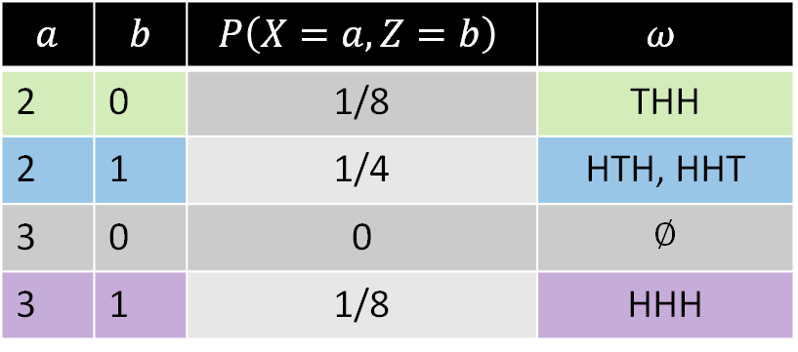

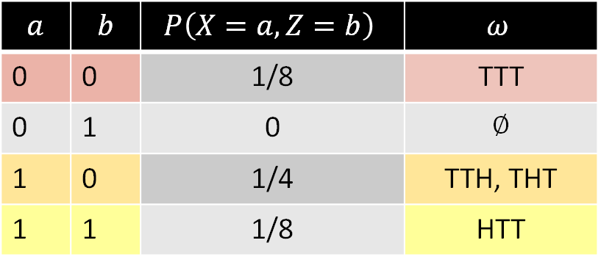
Joint Random Variables and Partitions
Joint random variables (also) partition a sample space.
TTT TTH
THT THH
HTT HTH
HHT HHH
$$Ω=$$
$$a$$ | $$b$$ | $$P\left(X=a, Z=b\right)$$ | $$ω$$
0 | 0 | 1/8 | TTT
0 | 1 | 0 | ∅
1 | 0 | 1/4 | TTH, THT
1 | 1 | 1/8 | HTT
$$a$$ | $$b$$ | $$P\left(X=a, Z=b\right)$$ | $$ω$$
2 | 0 | 1/8 | THH
2 | 1 | 1/4 | HTH, HHT
3 | 0 | 0 | ∅
3 | 1 | 1/8 | HHH

Slide 10

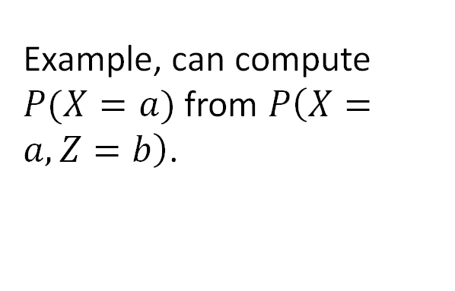

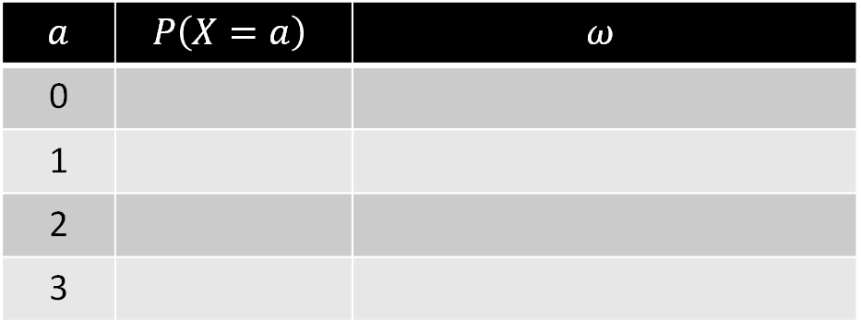
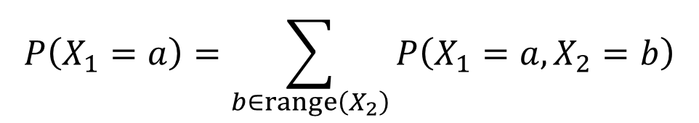
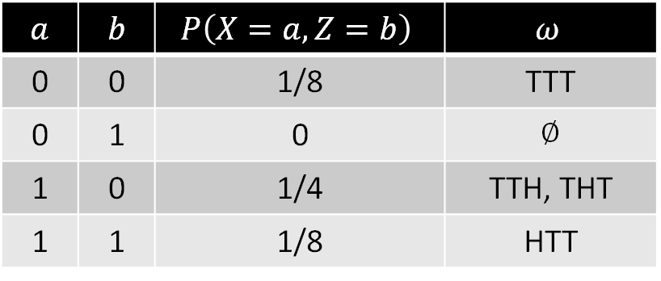
Marginal Probability
Given a joint distribution $P\left(X_{1}=a,X_{2}=b\right)$, the distribution $P\left(X_{1}=a\right)$ of $X_{1}$ is called the marginal distribution of $X_{1}$. We can compute the marginal distribution by summing over all values of $X_{2}$.
$$P\left(X_{1}=a\right)=\sum_{b∈range\left(X_{2}\right)}{P\left(X_{1}=a,X_{2}=b\right)}$$
$$a$$ | $$b$$ | $$P\left(X=a, Z=b\right)$$ | $$ω$$
0 | 0 | 1/8 | TTT
0 | 1 | 0 | ∅
1 | 0 | 1/4 | TTH, THT
1 | 1 | 1/8 | HTT
$$a$$ | $$b$$ | $$P\left(X=a, Z=b\right)$$ | $$ω$$
2 | 0 | 1/8 | THH
2 | 1 | 1/4 | HTH, HHT
3 | 0 | 0 | ∅
3 | 1 | 1/8 | HHH
$$a$$ | $$P\left(X=a\right)$$ | $$ω$$
0
1
2
3
Example, can compute $P(X=a)$ from $P\left(X=a, Z=b\right)$.

Slide 11
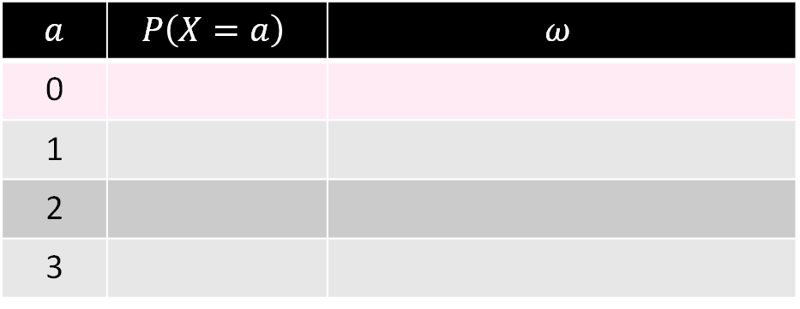
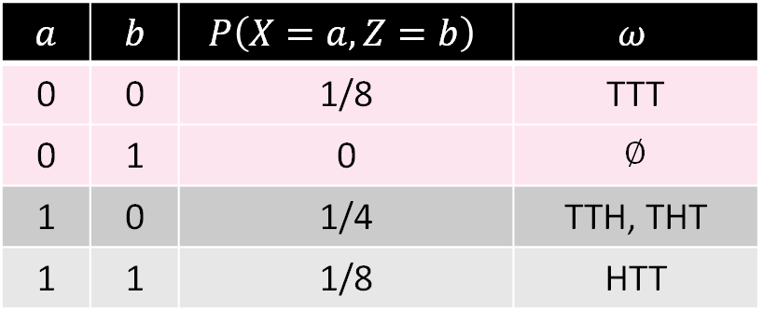
Marginal Probability
Given a joint distribution $P\left(X_{1}=a,X_{2}=b\right)$, the distribution $P\left(X_{1}=a\right)$ of $X_{1}$ is called the marginal distribution of $X_{1}$. We can compute the marginal distribution by summing over all values of $X_{2}$.
$$P\left(X_{1}=a\right)=\sum_{b∈range\left(X_{2}\right)}{P\left(X_{1}=a,X_{2}=b\right)}$$
$$a$$ | $$b$$ | $$P\left(X=a, Z=b\right)$$ | $$ω$$
0 | 0 | 1/8 | TTT
0 | 1 | 0 | ∅
1 | 0 | 1/4 | TTH, THT
1 | 1 | 1/8 | HTT
$$a$$ | $$b$$ | $$P\left(X=a, Z=b\right)$$ | $$ω$$
2 | 0 | 1/8 | THH
2 | 1 | 1/4 | HTH, HHT
3 | 0 | 0 | ∅
3 | 1 | 1/8 | HHH
$$a$$ | $$P\left(X=a\right)$$ | $$ω$$
0
1
2
3
Example, can compute $P(X=a)$ from $P\left(X=a, Z=b\right)$.

Slide 12
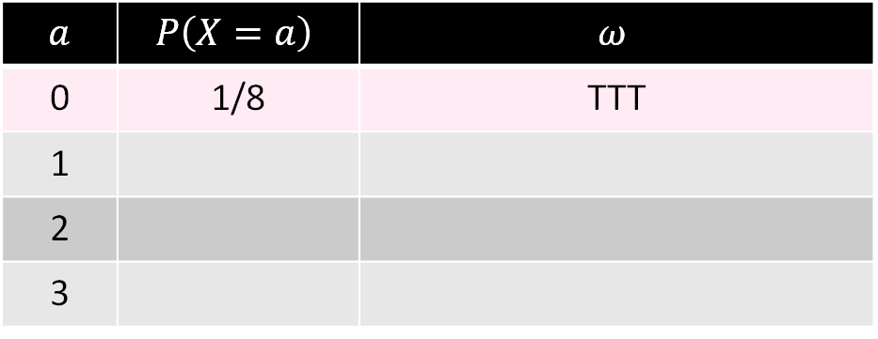
Marginal Probability
Given a joint distribution $P\left(X_{1}=a,X_{2}=b\right)$, the distribution $P\left(X_{1}=a\right)$ of $X_{1}$ is called the marginal distribution of $X_{1}$. We can compute the marginal distribution by summing over all values of $X_{2}$.
$$P\left(X_{1}=a\right)=\sum_{b∈range\left(X_{2}\right)}{P\left(X_{1}=a,X_{2}=b\right)}$$
$$a$$ | $$b$$ | $$P\left(X=a, Z=b\right)$$ | $$ω$$
0 | 0 | 1/8 | TTT
0 | 1 | 0 | ∅
1 | 0 | 1/4 | TTH, THT
1 | 1 | 1/8 | HTT
$$a$$ | $$b$$ | $$P\left(X=a, Z=b\right)$$ | $$ω$$
2 | 0 | 1/8 | THH
2 | 1 | 1/4 | HTH, HHT
3 | 0 | 0 | ∅
3 | 1 | 1/8 | HHH
$$a$$ | $$P\left(X=a\right)$$ | $$ω$$
0 | 1/8 | TTT
1
2
3
Example, can compute $P(X=a)$ from $P\left(X=a, Z=b\right)$.

Slide 13

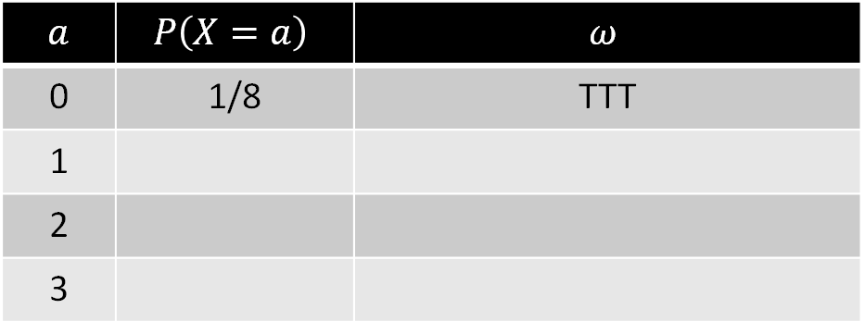
Marginal Probability
Given a joint distribution $P\left(X_{1}=a,X_{2}=b\right)$, the distribution $P\left(X_{1}=a\right)$ of $X_{1}$ is called the marginal distribution of $X_{1}$. We can compute the marginal distribution by summing over all values of $X_{2}$.
$$P\left(X_{1}=a\right)=\sum_{b∈range\left(X_{2}\right)}{P\left(X_{1}=a,X_{2}=b\right)}$$
$$a$$ | $$b$$ | $$P\left(X=a, Z=b\right)$$ | $$ω$$
0 | 0 | 1/8 | TTT
0 | 1 | 0 | ∅
1 | 0 | 1/4 | TTH, THT
1 | 1 | 1/8 | HTT
$$a$$ | $$b$$ | $$P\left(X=a, Z=b\right)$$ | $$ω$$
2 | 0 | 1/8 | THH
2 | 1 | 1/4 | HTH, HHT
3 | 0 | 0 | ∅
3 | 1 | 1/8 | HHH
$$a$$ | $$P\left(X=a\right)$$ | $$ω$$
0 | 1/8 | TTT
1
2
3
What is $P(X=1)$?
Which rows above will be pink?
Example, can compute $P(X=a)$ from $P\left(X=a, Z=b\right)$.

Slide 14
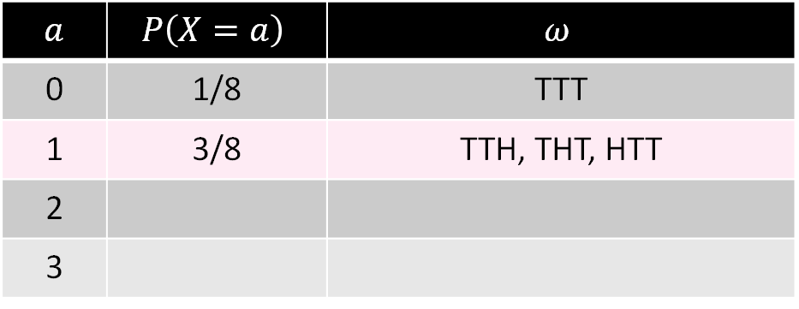
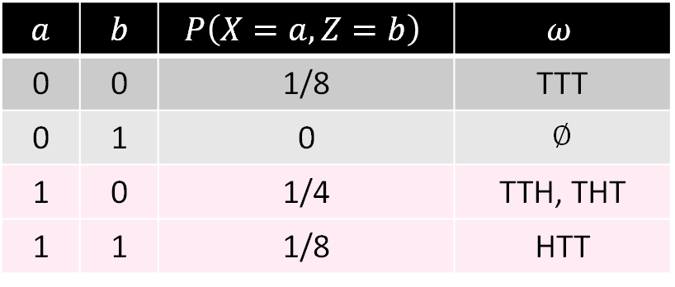
Marginal Probability
Given a joint distribution $P\left(X_{1}=a,X_{2}=b\right)$, the distribution $P\left(X_{1}=a\right)$ of $X_{1}$ is called the marginal distribution of $X_{1}$. We can compute the marginal distribution by summing over all values of $X_{2}$.
$$P\left(X_{1}=a\right)=\sum_{b∈range\left(X_{2}\right)}{P\left(X_{1}=a,X_{2}=b\right)}$$
$$a$$ | $$b$$ | $$P\left(X=a, Z=b\right)$$ | $$ω$$
0 | 0 | 1/8 | TTT
0 | 1 | 0 | ∅
1 | 0 | 1/4 | TTH, THT
1 | 1 | 1/8 | HTT
$$a$$ | $$b$$ | $$P\left(X=a, Z=b\right)$$ | $$ω$$
2 | 0 | 1/8 | THH
2 | 1 | 1/4 | HTH, HHT
3 | 0 | 0 | ∅
3 | 1 | 1/8 | HHH
$$a$$ | $$P\left(X=a\right)$$ | $$ω$$
0 | 1/8 | TTT
1 | 3/8 | TTH, THT, HTT
2
3
Example, can compute $P(X=a)$ from $P\left(X=a, Z=b\right)$.

Slide 15
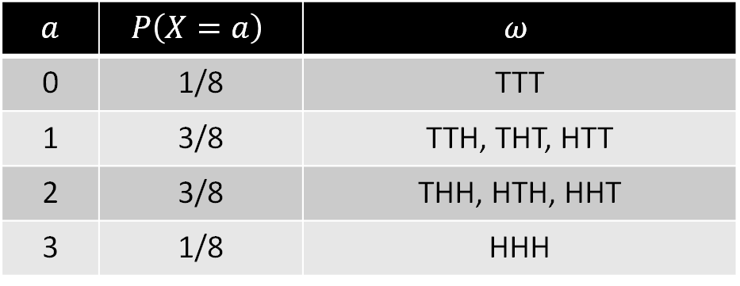
Marginal Probability
Given a joint distribution $P\left(X_{1}=a,X_{2}=b\right)$, the distribution $P\left(X_{1}=a\right)$ of $X_{1}$ is called the marginal distribution of $X_{1}$. We can compute the marginal distribution by summing over all values of $X_{2}$.
$$P\left(X_{1}=a\right)=\sum_{b∈range\left(X_{2}\right)}{P\left(X_{1}=a,X_{2}=b\right)}$$
$$a$$ | $$b$$ | $$P\left(X=a, Z=b\right)$$ | $$ω$$
0 | 0 | 1/8 | TTT
0 | 1 | 0 | ∅
1 | 0 | 1/4 | TTH, THT
1 | 1 | 1/8 | HTT
$$a$$ | $$b$$ | $$P\left(X=a, Z=b\right)$$ | $$ω$$
2 | 0 | 1/8 | THH
2 | 1 | 1/4 | HTH, HHT
3 | 0 | 0 | ∅
3 | 1 | 1/8 | HHH
$$a$$ | $$P\left(X=a\right)$$ | $$ω$$
0 | 1/8 | TTT
1 | 3/8 | TTH, THT, HTT
2 | 3/8 | THH, HTH, HHT
3 | 1/8 | HHH
Example, can compute $P(X=a)$ from $P\left(X=a, Z=b\right)$.

Slide 16
Independent RVs and Conditional Probability and RVs
RVs and Probability Concepts
Joint Distributions and Marginal Distributions
Independent RVs and Conditional Probability and RVs
Linearity of Expectation
Additional Info on Important Distributions
Memoryless Property of Geometric RVs
The Sum of Two Poisson RVs
Poisson as the Limit of Binomial RVs
Lecture 20, CS70 Summer 2025

Slide 17
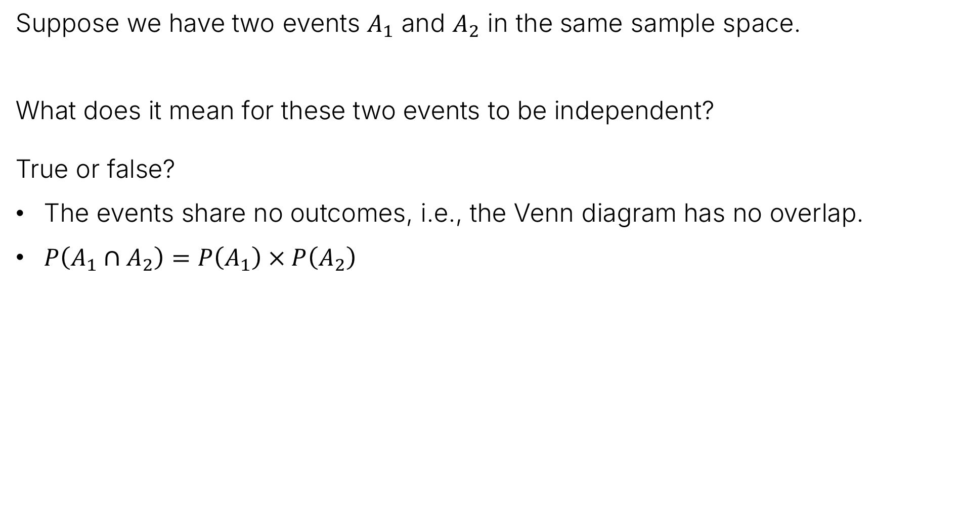
Independence and Events (review)
Suppose we have two events $A_{1}$ and $A_{2}$ in the same sample space.
What does it mean for these two events to be independent?
True or false?
The events share no outcomes, i.e., the Venn diagram has no overlap.
$P\left(A_{1}∩A_{2}\right)=P\left(A_{1}\right)×P\left(A_{2}\right)$
False!
True!

Slide 18
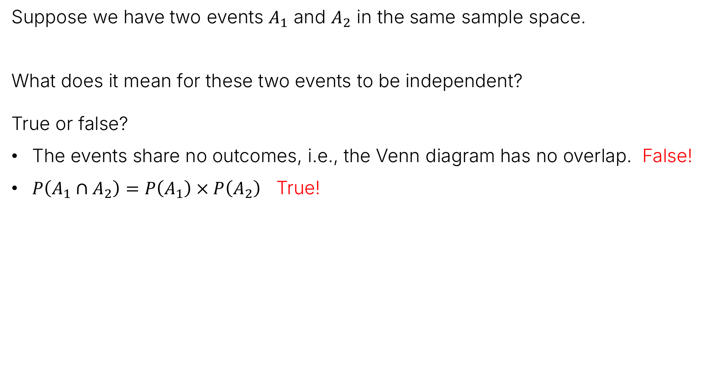
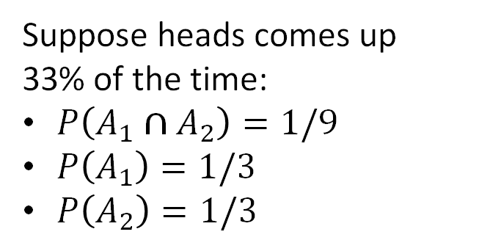

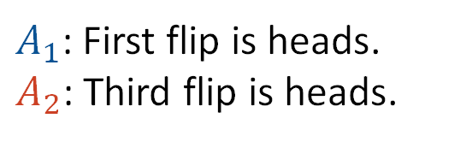

Independence and Events (review)
Suppose we have two events $A_{1}$ and $A_{2}$ in the same sample space.
What does it mean for these two events to be independent?
True or false?
The events share no outcomes, i.e., the Venn diagram has no overlap. False!
$P\left(A_{1}∩A_{2}\right)=P\left(A_{1}\right)×P\left(A_{2}\right)$ True!
TTT TTH
THT THH
HTT HTH
HHT HHH
Suppose heads comes up 33% of the time:
$P\left(A_{1}∩A_{2}\right)=1/9$
$P\left(A_{1}\right)=1/3$
$P\left(A_{2}\right)=1/3$
$A_{1}$: First flip is heads.
$A_{2}$: Third flip is heads.
$$Ω=$$
$$P\left(A_{1}∩A_{2}\right)=P\left(A_{1}\right)×P\left(A_{2}\right)$$

Slide 19
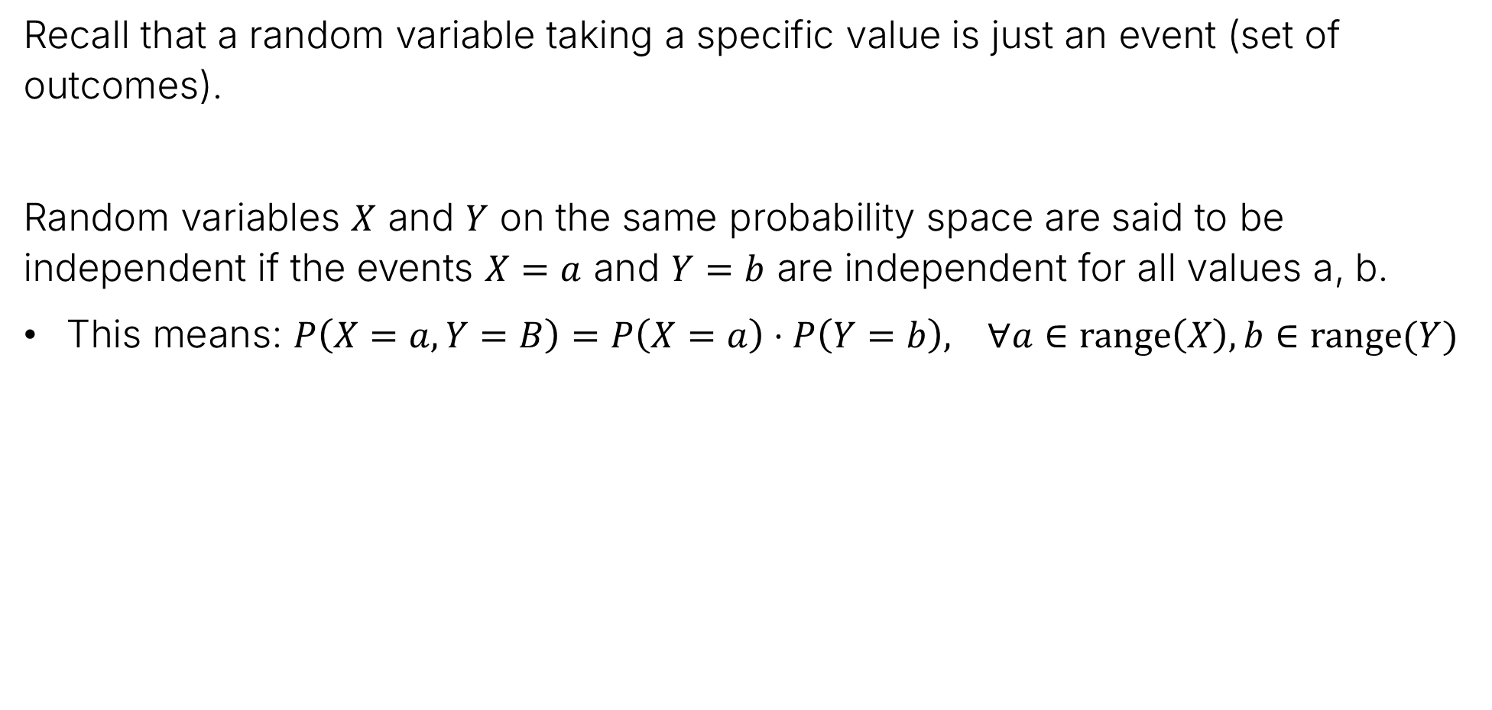
Independent Random Variables
Recall that a random variable taking a specific value is just an event (set of outcomes).
Random variables $X$ and $Y$ on the same probability space are said to be independent if the events $X=a$ and $Y=b$ are independent for all values a, b.
This means: $P\left(X=a, Y=B\right)=P\left(X=a\right)⋅P\left(Y=b\right), ∀a∈range\left(X\right), b∈range(Y)$

Slide 20
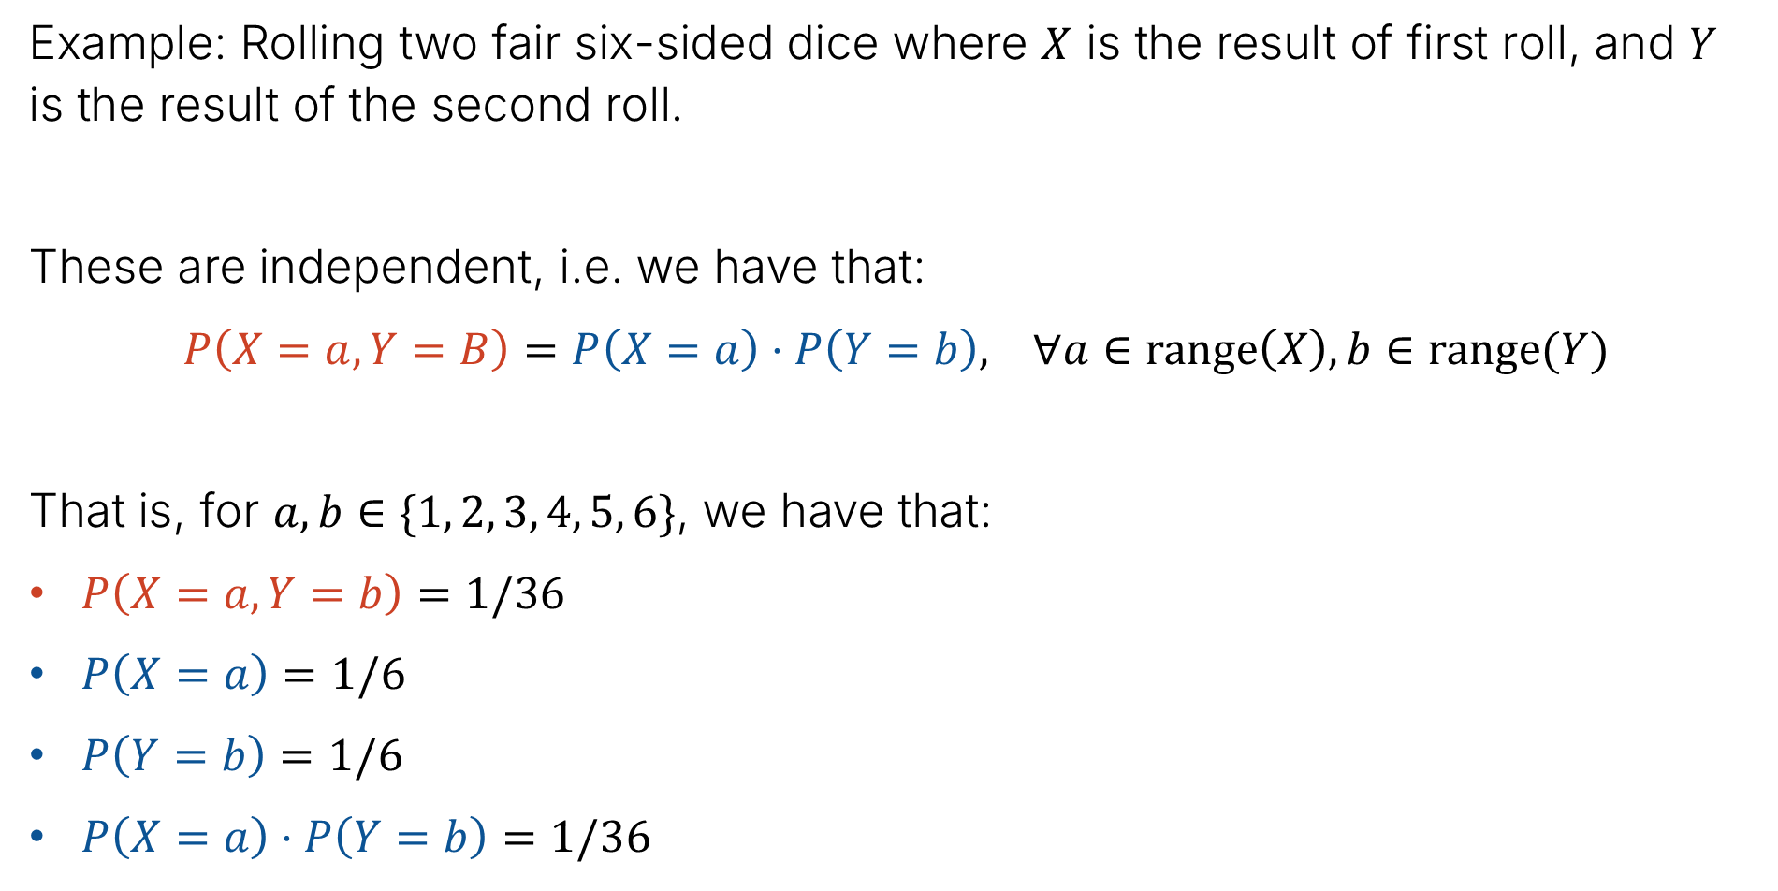
Example 1: Rolling two dice
Example: Rolling two fair six-sided dice where $X$ is the result of first roll, and $Y$ is the result of the second roll.
These are independent, i.e. we have that:
$P\left(X=a, Y=B\right)=P\left(X=a\right)⋅P\left(Y=b\right), ∀a∈range\left(X\right), b∈range(Y)$
That is, for $a,b∈\{1, 2, 3, 4, 5, 6\}$, we have that:
$P\left(X=a, Y=b\right)=1/36$
$P\left(X=a\right)=1/6$
$P\left(Y=b\right)=1/6$
$P\left(X=a\right)⋅P\left(Y=b\right)=1/36$

Slide 21

Example 2: Rolling Two Dice (again)
Example: Suppose we roll two fair six-sided dice where $X$ is the result of first roll, and $S$ is the sum of the two rolls.
Are these independent?

Slide 22
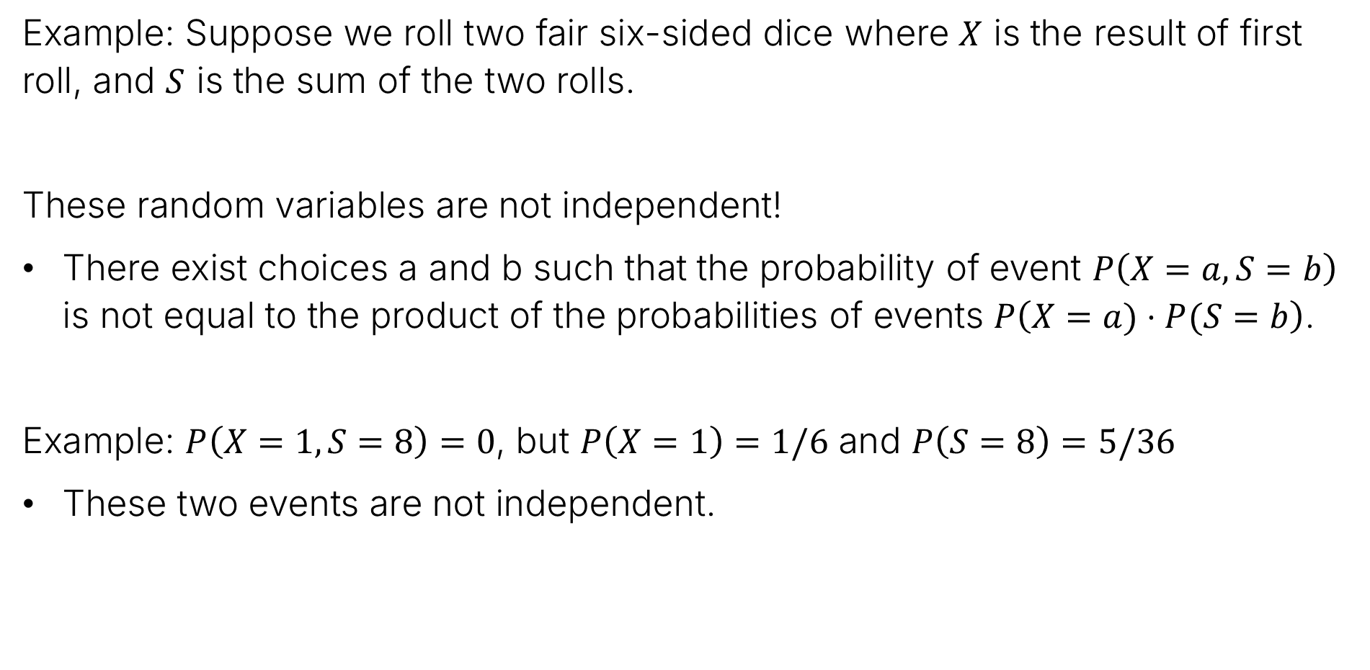
Example 2: Rolling Two Dice (again)
Example: Suppose we roll two fair six-sided dice where $X$ is the result of first roll, and $S$ is the sum of the two rolls.
These random variables are not independent!
There exist choices a and b such that the probability of event $P\left(X=a,S=b\right)$ is not equal to the product of the probabilities of events $P\left(X=a)⋅P(S=b\right)$.
Example: $P\left(X=1,S=8\right)=0$, but $P\left(X=1\right)=1/6$ and $P\left(S=8\right)=5/36$
These two events are not independent.

Slide 23
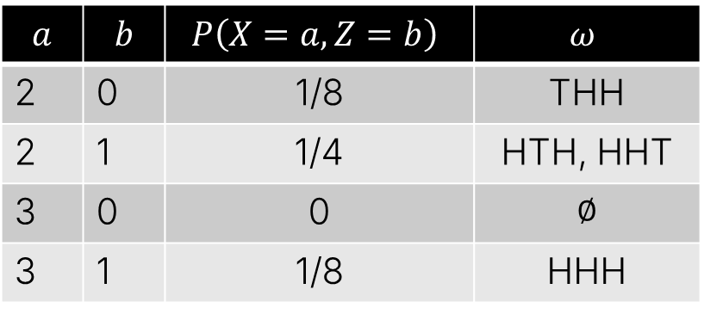
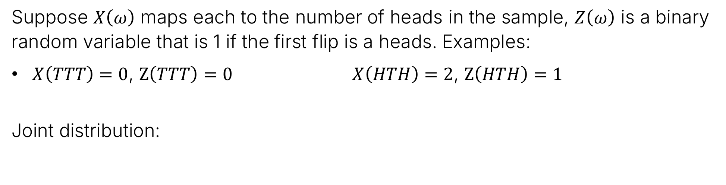
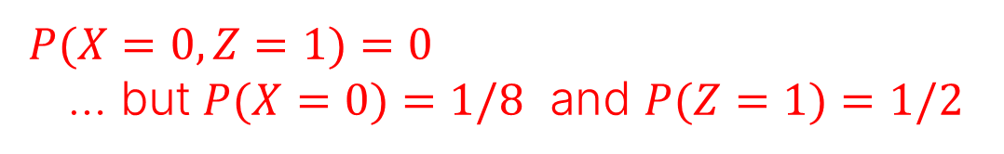
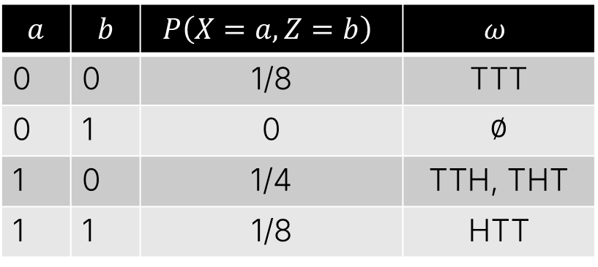
Example 3: Flipping 3 coins – our initial example
Suppose $X\left(ω\right)$ maps each to the number of heads in the sample, $Z\left(ω\right)$ is a binary random variable that is 1 if the first flip is a heads. Examples:
$X\left(TTT\right)=0$, $Z\left(TTT\right)=0$ $X\left(HTH\right)=2$, $Z\left(HTH\right)=1$
Joint distribution:
$$a$$ | $$b$$ | $$P\left(X=a, Z=b\right)$$ | $$ω$$
0 | 0 | 1/8 | TTT
0 | 1 | 0 | ∅
1 | 0 | 1/4 | TTH, THT
1 | 1 | 1/8 | HTT
$$a$$ | $$b$$ | $$P\left(X=a, Z=b\right)$$ | $$ω$$
2 | 0 | 1/8 | THH
2 | 1 | 1/4 | HTH, HHT
3 | 0 | 0 | ∅
3 | 1 | 1/8 | HHH
Independent?
Justification?
$P(X=0, Z=1)=0$
… but $P(X=0)=1/8$ and $P(Z=1)=1/2$

Slide 24
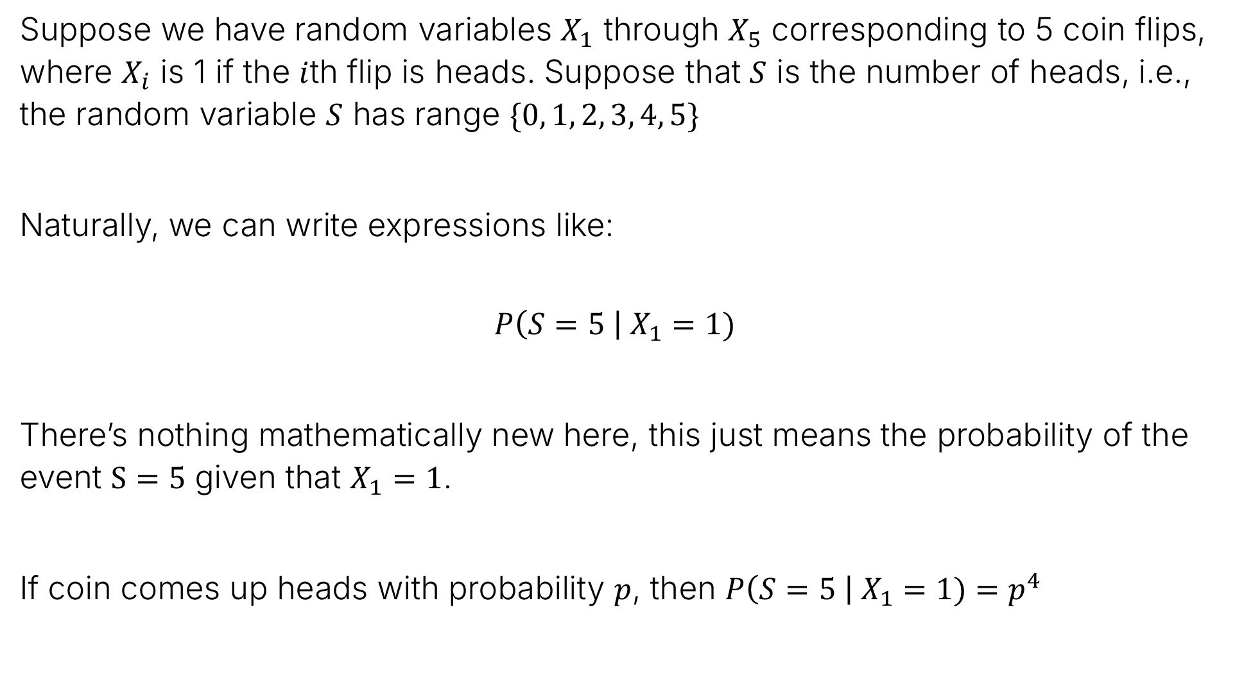
Conditional Probability of Events and Random Variables
Suppose we have random variables $X_{1}$ through $X_{5}$ corresponding to 5 coin flips, where $X_{i}$ is 1 if the $i$th flip is heads. Suppose that $S$ is the number of heads, i.e., the random variable $S$ has range $\{0, 1, 2, 3, 4, 5\}$
Naturally, we can write expressions like:
$$P\left(S=5 \right| X_{1}=1)$$
There’s nothing mathematically new here, this just means the probability of the event $S=5$ given that $X_{1}=1$.
If coin comes up heads with probability $p$, then $P\left(S=5 \right| X_{1}=1)=p^{4}$

Slide 25
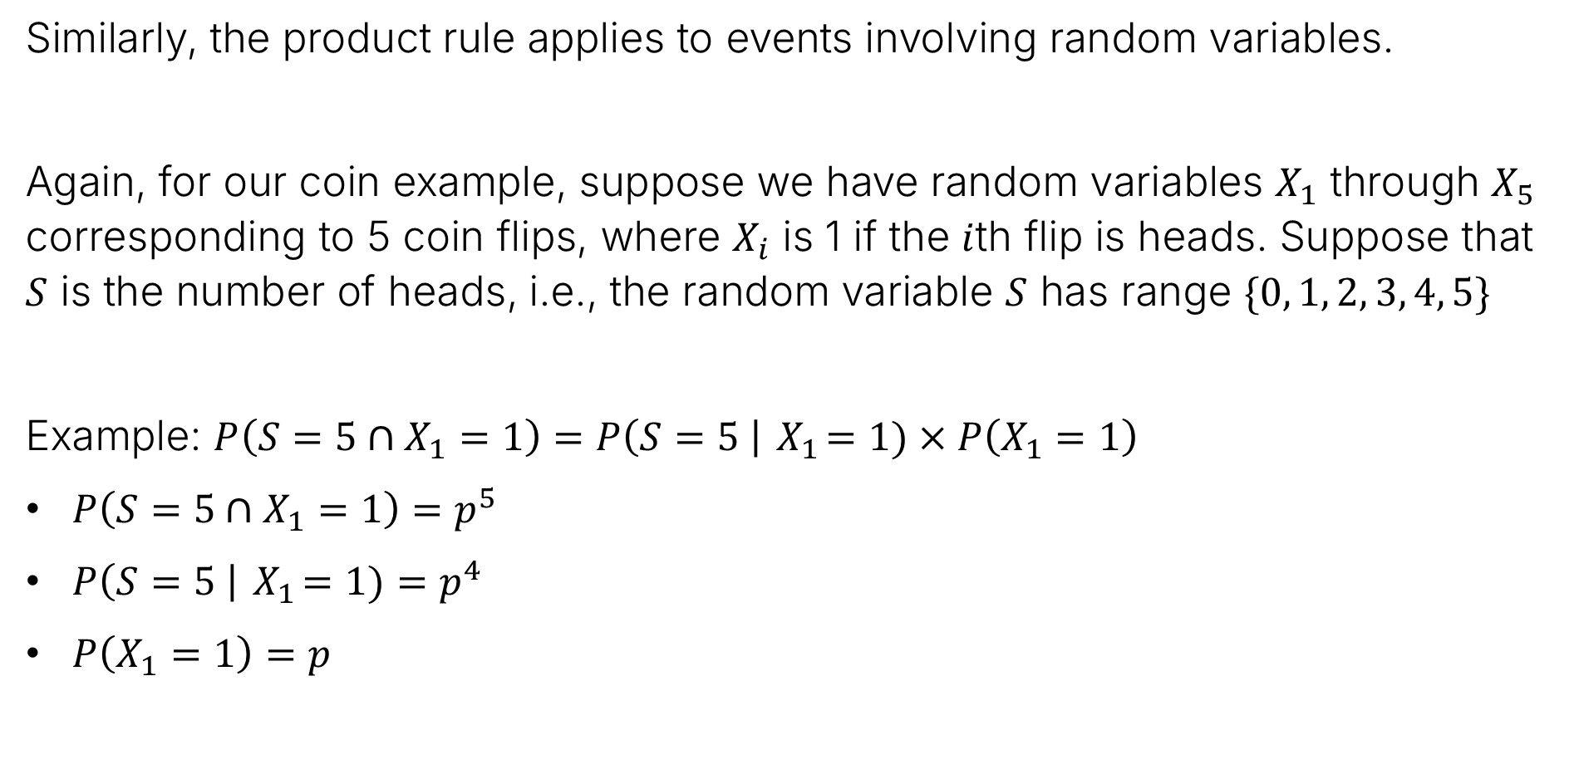
Random Variables and the Product Rule
Similarly, the product rule applies to events involving random variables.
Again, for our coin example, suppose we have random variables $X_{1}$ through $X_{5}$ corresponding to 5 coin flips, where $X_{i}$ is 1 if the $i$th flip is heads. Suppose that $S$ is the number of heads, i.e., the random variable $S$ has range $\{0, 1, 2, 3, 4, 5\}$
Example: $P\left(S=5∩X_{1}=1\right)=P\left(S=5 \right|{ X}_{1}=1)×P\left(X_{1}=1\right)$
$P\left(S=5∩X_{1}=1\right)=p^{5}$
$P\left(S=5 \right|{ X}_{1}=1)=p^{4}$
$P\left(X_{1}=1\right)=p$

Slide 26
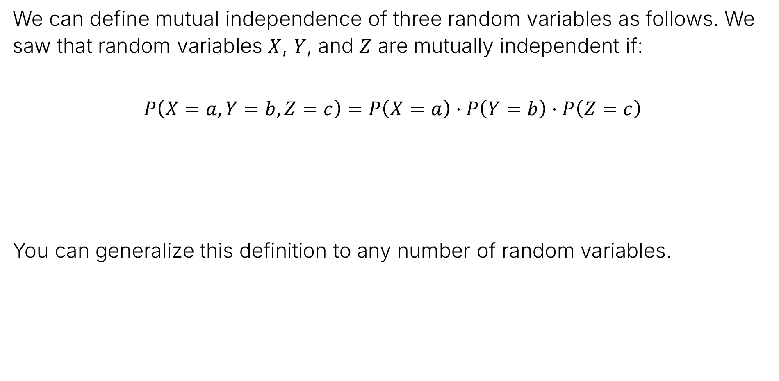
Mutual Independence
We can define mutual independence of three random variables as follows. We saw that random variables $X$, $Y$, and $Z$ are mutually independent if:
$$P\left(X=a, Y=b, Z=c\right)=P\left(X=a\right)⋅P\left(Y=b\right)⋅P\left(Z=c\right)$$
You can generalize this definition to any number of random variables.
$$∀a∈range\left(X\right), b∈range\left(Y\right), c∈range(Z)$$

Slide 27
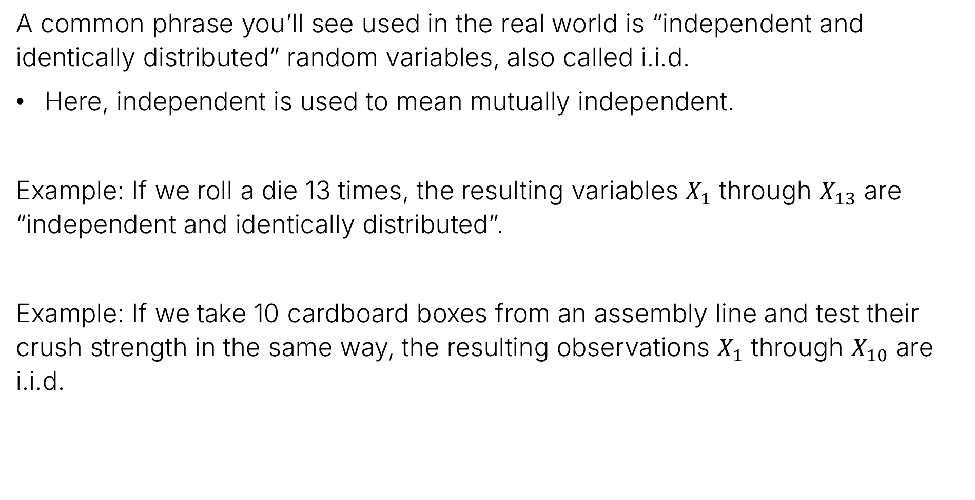
i.i.d. Variables
A common phrase you’ll see used in the real world is “independent and identically distributed” random variables, also called i.i.d.
Here, independent is used to mean mutually independent.
Example: If we roll a die 13 times, the resulting variables $X_{1}$ through $X_{13}$ are “independent and identically distributed”.
Example: If we take 10 cardboard boxes from an assembly line and test their crush strength in the same way, the resulting observations $X_{1}$ through $X_{10}$ are i.i.d.

Slide 28
Linearity of Expectation
RVs and Probability Concepts
Joint Distributions and Marginal Distributions
Independent RVs and Conditional Probability and RVs
Linearity of Expectation
Additional Info on Important Distributions
Memoryless Property of Geometric RVs
The Sum of Two Poisson RVs
Poisson as the Limit of Binomial RVs
Lecture 20, CS70 Summer 2025

Slide 29
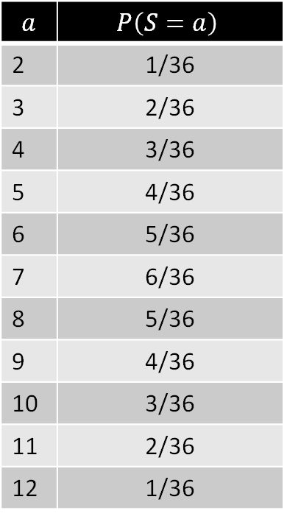

Expectation of Two Dice
Let $S=X+Y$ be the result after rolling two six-sided dice. What is $E\left[S\right]$?
6
7 | 8 | 9 | 10 | 11 | 12
6 | 7 | 8 | 9 | 10 | 11
5 | 6 | 7 | 8 | 9 | 10
4 | 5 | 6 | 7 | 8 | 9
3 | 4 | 5 | 6 | 7 | 8
2 | 3 | 4 | 5 | 6 | 7
$$a$$ | $$P\left(S=a\right)$$
2 | 1/36
3 | 2/36
4 | 3/36
5 | 4/36
6 | 5/36
7 | 6/36
8 | 5/36
9 | 4/36
10 | 3/36
11 | 2/36
12 | 1/36
5
4
3
2
1
1
2
3
4
5
6

Slide 30


Expectation of Two Dice
Let $S=X+Y$ be the result after rolling two six dided dice. What is $E\left[S\right]$?
The annoying way: $E\left[S\right]=2×\frac{1}{36}+3×\frac{2}{36}+4×\frac{3}{36}+…+11×\frac{2}{36}+12×\frac{1}{36}=7$
6
7 | 8 | 9 | 10 | 11 | 12
6 | 7 | 8 | 9 | 10 | 11
5 | 6 | 7 | 8 | 9 | 10
4 | 5 | 6 | 7 | 8 | 9
3 | 4 | 5 | 6 | 7 | 8
2 | 3 | 4 | 5 | 6 | 7
$$a$$ | $$P\left(S=a\right)$$
2 | 1/36
3 | 2/36
4 | 3/36
5 | 4/36
6 | 5/36
7 | 6/36
8 | 5/36
9 | 4/36
10 | 3/36
11 | 2/36
12 | 1/36
5
Here we’re explicitly summing over the entire range of our random variable $S$.
4
3
2
1
1
2
3
4
5
6

Slide 31
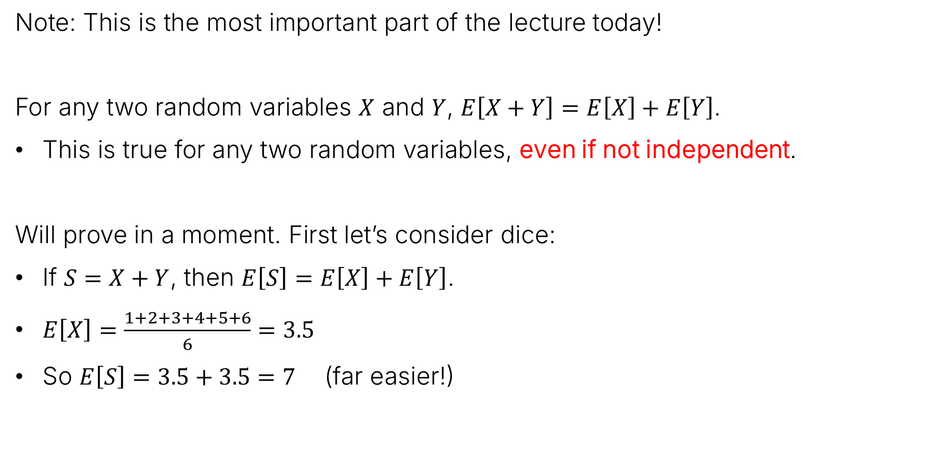
Linearity of Expectation, and Example 1: Two Dice
Note: This is the most important part of the lecture today!
For any two random variables $X$ and $Y$, $E\left[X+Y\right]=E\left[X\right]+E\left[Y\right]$.
This is true for any two random variables, even if not independent.
Will prove in a moment. First let’s consider dice:
If $S=X+Y$, then $E\left[S\right]=E\left[X\right]+E\left[Y\right]$.
$E\left[X\right]=\frac{1+2+3+4+5+6}{6}=3.5$
So $E\left[S\right]=3.5+3.5=7$ (far easier!)

Slide 32
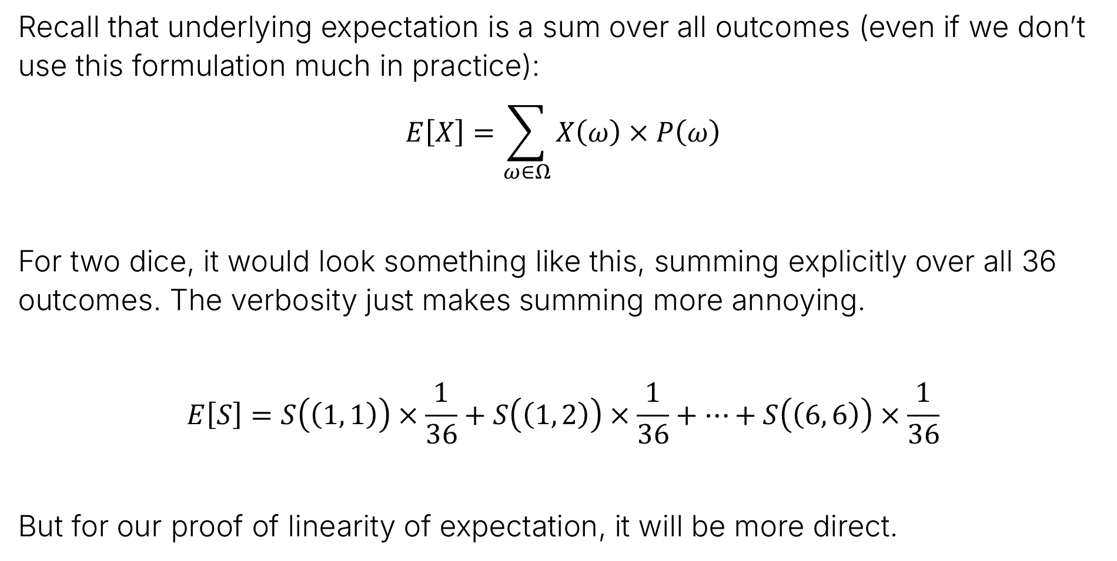
Prelude: The Mega-Verbose Form for Expectation
Recall that underlying expectation is a sum over all outcomes (even if we don’t use this formulation much in practice):
$$E\left[X\right]=\sum_{ω∈Ω}{X\left(ω\right)×P\left(ω\right)}$$
For two dice, it would look something like this, summing explicitly over all 36 outcomes. The verbosity just makes summing more annoying.
$$E\left[S\right]=S\left(\left(1, 1\right)\right)×\frac{1}{36}+S\left(\left(1, 2\right)\right)×\frac{1}{36}+…+S\left(\left(6, 6\right)\right)×\frac{1}{36}$$
But for our proof of linearity of expectation, it will be more direct.

Slide 33


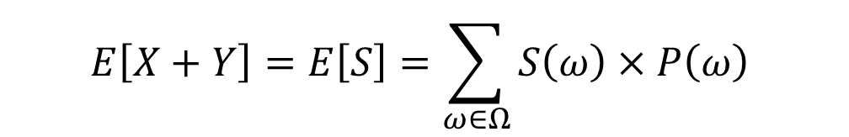
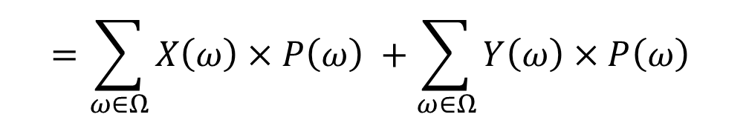
Proof of Linearity of Expectation
$$E\left[X\right]=\sum_{ω∈Ω}{X\left(ω\right)×P\left(ω\right)}$$
If $S=X+Y$, we can write $E\left[S\right]$ as:
$$E\left[X+Y\right]=E\left[S\right]=\sum_{ω∈Ω}{S\left(ω\right)×P\left(ω\right) }$$
$$=\sum_{ω∈Ω}{\left(X\left(ω\right)+Y\left(ω\right)\right)×P\left(ω\right) }$$
$$=\sum_{ω∈Ω}{X\left(ω\right)×P\left(ω\right) }+\sum_{ω∈Ω}{Y\left(ω\right)×P\left(ω\right) }$$
$$=E\left[X\right]+E\left[Y\right]$$

Slide 34
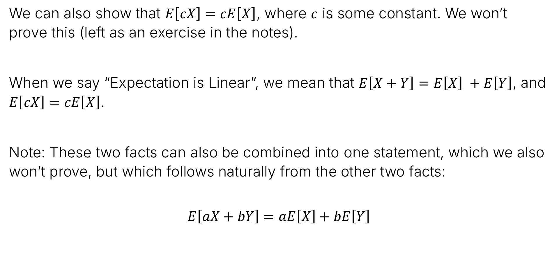
Linearity of Expectation
We can also show that $E\left[cX\right]=cE\left[X\right]$, where $c$ is some constant. We won’t prove this (left as an exercise in the notes).
When we say “Expectation is Linear”, we mean that $E\left[X+Y\right]=E\left[X\right] +E\left[Y\right]$, and $E\left[cX\right]=cE\left[X\right]$.
Note: These two facts can also be combined into one statement, which we also won’t prove, but which follows naturally from the other two facts:
$$E\left[aX+bY\right]=aE\left[X\right]+bE\left[Y\right]$$

Slide 35

Example 2: Binomial RV Expectation
Suppose we want to compute the expectation of a random variable $X\sim Binomial(n, p)$ which has a distribution given by:
$$P\left(X=i\right)=\left({n \atop i}\right)p^{i}{\left(1−p\right)}^{n−i}$$
One way is to use the usual expectation formula:
$$E\left[X\right]=\sum_{i=0}^{n}{i×\left({n \atop i}\right)p^{i}{\left(1−p\right)}^{n−i}}$$
This is tedious.

Slide 36

Example 2: Binomial RV Expectation
Suppose we want to compute the expectation of a random variable $X\sim Binomial(n, p)$ which has a distribution given by:
$$P\left(X=i\right)=\left({n \atop i}\right)p^{i}{\left(1−p\right)}^{n−i}$$
A better approach is to keep in mind that a binomial random variable is just the sum $B_{1}+B_{2}+…+B_{n}$ where $B_{i}\sim Bernoulli(p)$.
Since $E\left[B_{i}\right]=p$, we have that $E\left[X\right]=E\left[B_{1}\right]+E\left[B_{2}\right]+…+E\left[B_{n}\right]$
$$=p+p+…+p=np$$

Slide 37


Example 3: Fixed Points
In the previous lecture, we showed the distribution for shuffling 3 students homework and handing it back to them randomly is as shown in this figure.
Can compute expectation of number of students who get their own homework back as $E\left[X\right]=1×\frac{1}{2}+3×\frac{1}{6}=1$.
Let’s try to find the expectation for the case of $n$ students.

Slide 38

Example 3: Fixed Points
Let $X_{n}$ be the number of students who receive their own homework.
Let $I_{i}$ be a random variable which is 1 if a student gets their own homework, and 0 otherwise.
Note, such a random variable is often called an “indicator random variable”. It is 1 when some condition is true, and false otherwise.
Indicator random variables combined with linearity of expectation is very powerful.
Then $X_{n}=I_{1}+I_{2}+…+I_{n}$.
Note: These random variables as NOT independent. Example: If students 1 through n-1 get their own homework, then student n also gets their own homework.

Slide 39

Example 3: Fixed Points
Let $X_{n}$ be the number of students who receive their own homework.
Let $I_{i}$ be a random variable which is 1 if a student gets their own homework, and 0 otherwise.
Then $X_{n}=I_{1}+I_{2}+…+I_{n}$.
What is $E\left[X_{n}\right]$?
Hint: What is $E\left[I_{i}\right]$?

Slide 40


Example 3: Fixed Points
Let $X_{n}$ be the number of students who receive their own homework.
Let $I_{i}$ be a random variable which is 1 if a student gets their own homework, and 0 otherwise.
Then $X_{n}=I_{1}+I_{2}+…+I_{n}$.
What is $E\left[X_{n}\right]$?
Hint: What is $E\left[I_{i}\right]$?
  The chance a student gets their own homework is $1/n$. That is, each indicator variable is $I_{i}\sim Bernoulli(1/n)$. So $E\left[I_{i}\right]=1/n$
Since $E\left[X_{n}\right]=E\left[I_{1}\right]+E\left[I_{2}\right]+…+E\left[I_{n}\right]$, we have $E\left[X_{n}\right]=n×1/n=1$
Are the $I_{k}$’s independent?
No!
Does it matter?
No!

Slide 41
Memoryless Property of Geometric RVs
RVs and Probability Concepts
Joint Distributions and Marginal Distributions
Independent RVs and Conditional Probability and RVs
Linearity of Expectation
Additional Info on Important Distributions
Memoryless Property of Geometric RVs
The Sum of Two Poisson RVs
Poisson as the Limit of Binomial RVs
Lecture 20, CS70 Summer 2025

Slide 42

Geometric Random Variables
Recall that a geometric random variable $X$ has probabilities given by:
$P\left(X=i\right)={\left(1−p\right)}^{i−1}p$ for $i=1, 2,…$
A geometric random variable models the process of waiting for an event to occur for the first time:
Flipping a coin until you get heads
Operating a system until it fails
Betting until you win
  “The lottery is a tax on people who are bad at math.”

Slide 43
Geometric Random Variables and the Memoryless Property
The memoryless property
It basically means: Even if you’ve waited a long time, the chance of the event occurring soon isn’t any better.
Example: You’re flipping a coin and it came up tails 10 times in a row. The chance of the next heads isn’t better just because you had 10 tails.
Example: You’re playing poker and have gotten 5 terrible hands in a row. The chance of getting a good hand is the same, and it doesn’t matter that you’ve had 5 terrible hands.
Note: The “Gambler’s Fallacy” – and lucky (or unlucky) streaks….

Slide 44

Geometric Random Variables and the Memoryless Property
The memoryless property
It basically means: Even if you’ve waited a long time, the chance of the event occurring soon isn’t any better.
In terms of probability, we can state this as “If we’ve already tossed a coin $m$ times without getting a head, the probability that we need $n$ additional tosses is the same as if we hadn’t tossed the first $m$ coins at all.”
Or symbolically we have:
$$P\left(X>n+m | X>m\right)=P\left(X>n\right)$$

Slide 45



Geometric Random Variables and the Memoryless Property
The memoryless property
It basically means: Even if you’ve waited a long time, the chance of the event occurring soon isn’t any better.
Proof of $P\left(X>n+m | X>m\right)=P\left(X>n\right)$
Wait – isn’t this supposed to
be an intersection?
Yes… and it is… see why?
$$P\left(X>n+m | X>m\right)=\frac{P\left(X>n+m\right)}{P\left(X>m\right)}$$
$$=\frac{{\left(1−p\right)}^{n+m}}{{\left(1−p\right)}^{m}}$$
$$={\left(1−p\right)}^{n}$$
$$=P\left(X>n\right)$$

Slide 46
The Sum of Two Poisson RVs
RVs and Probability Concepts
Joint Distributions and Marginal Distributions
Independent RVs and Conditional Probability and RVs
Linearity of Expectation
Additional Info on Important Distributions
Memoryless Property of Geometric RVs
The Sum of Two Poisson RVs
Poisson as the Limit of Binomial RVs
Lecture 20, CS70 Summer 2025

Slide 47


The Poisson Random Variable
Reminder: If $X\sim Poisson\left(λ\right)$, then the distribution is given by:
$$P\left(X=i\right)=\frac{λ^{i}}{i!}e^{−λ}, for i=0, 1, 2, …$$

Slide 48

The Sum of Independent Poisson RVs
In the previous lecture, we mentioned that if $X\sim Poisson(λ_{1})$ and $Y\sim Poisson\left(λ_{2}\right)$, and $S=X+Y$, then $S\sim Poisson\left(λ_{1}+λ_{2}\right)$.
This makes intuitive sense, but let’s prove using the idea of joint distributions.
Before we start, recall the Binomial Theorem:
$${\left(a+b\right)}^{n}=\sum_{k=0}^{n}{\left({n \atop k}\right)a^{n−k}b^{k}}$$
Example: ${\left(a+b\right)}^{4}=a^{4}+4a^{3}b+6a^{2}b^{2}+4ab^{3}+b^{4}$
Or alternately: ${\left(a+b\right)}^{4}=\left({4 \atop 0}\right)a^{4}+\left({4 \atop 1}\right)a^{3}b+\left({4 \atop 2}\right)a^{2}b^{2}+\left({4 \atop 3}\right)ab^{3}+\left({4 \atop 4}\right)b^{4}$

Slide 49







The Sum of Independent Poisson RVs
In the previous lecture, we mentioned that if $X\sim Poisson(λ)$ and $Y\sim Poisson\left(μ\right)$, and $S=X+Y$, then $S\sim Poisson\left(λ+μ\right)$. For all $k∈\left\{0, 1, 2, …\right\}$, we have:
$$P\left(S=k\right)=\sum_{j=0}^{k}{P\left(X=j, Y=k−j\right)}$$
$$=\sum_{j=0}^{k}{P\left(X=j\right)⋅P\left(Y=k−j\right)}$$
$$=\sum_{j=0}^{k}{\frac{λ^{j}}{j!}e^{−λ}}$$
$$=e^{−\left(λ+μ\right)}\sum_{j=0}^{k}{\frac{λ^{j}μ^{k−j}}{j!\left(k−j\right)!}}$$
$$\frac{μ^{k−j}}{\left(k−j\right)!}e^{−μ}$$
$$=e^{−\left(λ+μ\right)}\frac{1}{k!}\sum_{j=0}^{k}{\frac{k!}{j!\left(k−j\right)!}λ^{j}μ^{k−j}}$$

Slide 50





The Sum of Independent Poisson RVs
In the previous lecture, we mentioned that if $X\sim Poisson(λ)$ and $Y\sim Poisson\left(μ\right)$, and $S=X+Y$, then $S\sim Poisson\left(λ+μ\right)$. For all $k∈\left\{0, 1, 2, …\right\}$, we have:
$$P\left(S=k\right)=\sum_{j=0}^{k}{P\left(X=j, Y=k−j\right)}$$
$$=e^{−\left(λ+μ\right)}\frac{1}{k!}\sum_{j=0}^{k}{\frac{k!}{j!\left(k−j\right)!}λ^{j}μ^{k−j}}$$
$$=e^{−\left(λ+μ\right)}\frac{1}{k!}{\left(λ+μ\right)}^{k}$$
$$=\frac{{\left(λ+μ\right)}^{k}}{k!}e^{−\left(λ+μ\right)}$$
$${\left(a+b\right)}^{n}=\sum_{k=0}^{n}{\left({n \atop k}\right)a^{n−k}b^{k}}$$
$$P\left(X=i\right)=\frac{λ^{i}}{i!}e^{−λ}, for i=0, 1, 2, …$$

Slide 51
Poisson as the Limit of Binomial RVs
RVs and Probability Concepts
Joint Distributions and Marginal Distributions
Independent RVs and Conditional Probability and RVs
Linearity of Expectation
Additional Info on Important Distributions
Memoryless Property of Geometric RVs
The Sum of Two Poisson RVs
Poisson as the Limit of Binomial RVs
Lecture 20, CS70 Summer 2025

Slide 52

Poisson Distribution
The distribution of a Poisson random variable is given by:
$$P\left(X=i\right)=\frac{λ^{i}}{i!}e^{−λ}, for i=0, 1, 2, …$$
Unlike our other RVs, we never derived this expression. Let’s derive it from scratch.
Fact from Calculus: $\lim_{n→∞}{{\left(1+\frac{1}{n}\right)}^{n}}=e ⟹ \lim_{n→∞}{{\left(1−\frac{x}{n}\right)}^{n}}=e^{−x}$

Slide 53

Modeling Calls with a Binomial Distribution
As a thought experiment, let’s imagine we want to model the number of phone calls that users of a mobile network will initiate per unit time. We have a vast number of users, any of whom can make a call.
Suppose we pick a unit time of 1 minutes. Let’s try modeling the number of calls as a binomial random variable.
$i$th coin flip is whether a call is initiated in the $i$th time interval.
$n$ is number of intervals, e.g., $n=60$, we split minute into 60 intervals of 1s each.
$p$ is the chance of a call in any interval. Assumed independent.
If a call is initiated at times 3.3s, 10.5s, 14.2s, 30.1s, 38.9s, and 48.3s we have:
10
20
30
40
50

Slide 54

Modeling Calls with a Binomial Distribution
Suppose we pick a unit time of 1 minutes. Let’s try modeling the number of calls as a binomial random variable.
$i$th coin flip is whether a call is initiated in the $i$th time interval.
$p$ is the chance of getting a call in any interval. Assumed independent.
For example, if $n=60$, we split a minute into 60 intervals of 1s each.
If a call is initiated at times 3.3s, 10.5s, 14.2s, 30.1s, 38.9s, and 48.3s we have:
Why might a Binomial random variable not work for this modeling process?
What could happen in the world that this model cannot handle?
10
20
30
40
50

Slide 55

Modeling Calls with a Binomial Distribution
Suppose we pick a unit time of 1 minutes. Let’s try modeling the number of calls as a binomial random variable.
$i$th coin flip is whether a call is initiated in the $i$th time interval.
$p$ is the chance of getting a call in any interval. Assumed independent.
For example, if $n=60$, we split a minute into 60 intervals of 1s each.
If a call is initiated at times 3.3s, 10.5s, 14.2s, 30.1s, 38.9s, and 48.3s we have:
Why might a Binomial random variable not work for this modeling process?
We might get two calls in the same interval, e.g., a call at 3.3s and 3.8s.
So what should we do about this?
10
20
30
40
50

Slide 56

Modeling Calls with a Binomial Distribution
Suppose we pick a unit time of 1 minutes. Let’s try modeling the number of calls as a binomial random variable.
$i$th coin flip is whether a call is initiated in the $i$th time interval.
$p$ is the chance of getting a call in any interval. Assumed independent.
For example, if $n=60$, we split a minute into 60 intervals of 1s each.
If a call is initiated at times 3.3s, 10.5s, 14.2s, 30.1s, 38.9s, and 48.3s we have:
Why might a Binomial random variable not work for this modeling process?
We might get two calls in the same interval, e.g., a call at 3.3s and 3.8s.
So what should we do about this? Pick a smaller interval.
10
20
30
40
50

Slide 57

Adjusting Time Intervals
Assume that we know that we receive $λ$ calls per minute on average.
If we split the minute into $n$ time intervals (e.g., $n=60$ means 1 second intervals), and we model the number of calls $X$ as a Binomial random variable, which can we say below?
$X\sim Binomial\left(n, λ\right)$
$X\sim Binomial\left(n,\frac{1}{λ}\right)$
$X\sim Binomial\left(n,\frac{λ}{n}\right)$
$X\sim Binomial\left(n,\frac{n}{λ}\right)$

Slide 58

Adjusting Time Intervals
Assume that we know that we receive $λ$ calls per minute on average.
If we split the minute into $n$ time intervals (e.g., $n=60$ means 1 second intervals), and we model the number of calls $X$ as a Binomial random variable, which can we say below?
$X\sim Binomial\left(n,\frac{λ}{n}\right)$
Chance of a call coming in during a time interval is going to be number of calls per minutes divided by number of time intervals per minute.
Example: $λ=100$ calls per minute, and $n=60,000,000$, then probability of a call in any microsecond is $p=\frac{100}{60,000,000}$.
Note: We want to pick $n$ so large that the probability of two events in one interval is negligible.

Slide 59

Example – a large $n$
We’re modeling the number of calls as $X\sim Binomial\left(n,\frac{λ}{n}\right)$.
Example: If $n=60,000,000$ time intervals and $λ=120$ calls per minute, then the probability that the number of calls in a given minute is equal to 100 is given by the binomial distribution:
$$P\left(X=100\right)=\left({60,000,000 \atop 100}\right){\left(\frac{120}{60,000,000}\right)}^{100}{\left(1−\frac{120}{60,000,000}\right)}^{60,000,000−100}$$
This is an awkward computation. Luckily:
As $n$ gets larger, the model is increasingly accurate (less likely that we get two calls being initiated in the same time interval).
In the limit as $n→∞$, this expression is simpler.

Slide 60


The Limit as $n→∞$
If $X\sim Binomial\left(n,\frac{λ}{n}\right)$, we have: $P\left(X=i\right)=\left({n \atop i}\right)⋅{\left(\frac{λ}{n}\right)}^{i}{\left(1−\frac{λ}{n}\right)}^{n−i}$
$$=\frac{n!}{i!\left(n−i\right)!}⋅{\left(\frac{λ}{n}\right)}^{i}{\left(1−\frac{λ}{n}\right)}^{n−i}$$

Slide 61



The Large N Limit
If $X\sim Binomial\left(n,\frac{λ}{n}\right)$, we have: $P\left(X=i\right)=\left({n \atop i}\right)⋅{\left(\frac{λ}{n}\right)}^{i}{\left(1−\frac{λ}{n}\right)}^{n−i}$
$$=\frac{n!}{i!\left(n−i\right)!}⋅{\left(\frac{λ}{n}\right)}^{i}{\left(1−\frac{λ}{n}\right)}^{n−i}$$
This rearrangement of terms may seem arbitrary. Rough goal: Get terms that will simplify when $n$ is large all clustered together. And remember out end-goal!
$$=\frac{λ^{i}}{i!}$$

Slide 62


The Large N Limit
If $X\sim Binomial\left(n,\frac{λ}{n}\right)$, we have: $P\left(X=i\right)=\left({n \atop i}\right)⋅{\left(\frac{λ}{n}\right)}^{i}{\left(1−\frac{λ}{n}\right)}^{n−i}$
$$=\frac{n!}{i!\left(n−i\right)!}⋅{\left(\frac{λ}{n}\right)}^{i}{\left(1−\frac{λ}{n}\right)}^{n−i}$$
This rearrangement of terms may seem arbitrary. Rough goal: Get terms that will simplify when n is large all clustered together.
$$=\frac{λ^{i}}{i!}$$
$$\left(\frac{n!}{\left(n−i\right)!}⋅\frac{1}{n^{i}}\right)$$

Slide 63


The Large N Limit
If $X\sim Binomial\left(n,\frac{λ}{n}\right)$, we have: $P\left(X=i\right)=\left({n \atop i}\right)⋅{\left(\frac{λ}{n}\right)}^{i}{\left(1−\frac{λ}{n}\right)}^{n−i}$
$$=\frac{n!}{i!\left(n−i\right)!}⋅{\left(\frac{λ}{n}\right)}^{i}{\left(1−\frac{λ}{n}\right)}^{n−i}$$
This rearrangement of terms may seem arbitrary. Rough goal: Get terms that will simplify when n is large all clustered together.
$$=\frac{λ^{i}}{i!}$$
$${⋅\left(1−\frac{λ}{n}\right)}^{n}$$
$$\left(\frac{n!}{\left(n−i\right)!}⋅\frac{1}{n^{i}}\right)$$

Slide 64


The Large N Limit
If $X\sim Binomial\left(n,\frac{λ}{n}\right)$, we have: $P\left(X=i\right)=\left({n \atop i}\right)⋅{\left(\frac{λ}{n}\right)}^{i}{\left(1−\frac{λ}{n}\right)}^{n−i}$
$$=\frac{n!}{i!\left(n−i\right)!}⋅{\left(\frac{λ}{n}\right)}^{i}{\left(1−\frac{λ}{n}\right)}^{n−i}$$
This rearrangement of terms may seem arbitrary. Rough goal: Get terms that will simplify when n is large all clustered together.
$$=\frac{λ^{i}}{i!}$$
$${⋅\left(1−\frac{λ}{n}\right)}^{n}$$
$$⋅{\left(1−\frac{λ}{n}\right)}^{−i}$$
$$\left(\frac{n!}{\left(n−i\right)!}⋅\frac{1}{n^{i}}\right)$$

Slide 65




The Large N Limit
If $X\sim Binomial\left(n,\frac{λ}{n}\right)$, we have: $P\left(X=i\right)=\left({n \atop i}\right)⋅{\left(\frac{λ}{n}\right)}^{i}{\left(1−\frac{λ}{n}\right)}^{n−i}$
$$=\frac{n!}{i!\left(n−i\right)!}⋅{\left(\frac{λ}{n}\right)}^{i}{\left(1−\frac{λ}{n}\right)}^{n−i}$$
This rearrangement of terms may seem arbitrary. Rough goal: Get terms that will simplify when n is large all clustered together.
$$=\frac{λ^{i}}{i!}$$
$${⋅\left(1−\frac{λ}{n}\right)}^{n}$$
$$⋅{\left(1−\frac{λ}{n}\right)}^{−i}$$
$$\left(\frac{n!}{\left(n−i\right)!}⋅\frac{1}{n^{i}}\right)$$
The limit of blue subexpression is:
$$\left(\frac{n!}{\left(n−i\right)!}⋅\frac{1}{n^{i}}\right)$$
$$=\frac{n⋅\left(n−1\right)⋅⋅⋅\left(n−i+1\right)⋅\left(n−i\right)!}{\left(n−i\right)!}⋅\frac{1}{n^{i}}$$
$$=\frac{n}{n}⋅\frac{n−1}{n}⋅⋅⋅\frac{\left(n−i+1\right)}{n}$$
$$→1$$

Slide 66


The Large N Limit
If $X\sim Binomial\left(n,\frac{λ}{n}\right)$, we have: $P\left(X=i\right)=\left({n \atop i}\right)⋅{\left(\frac{λ}{n}\right)}^{i}{\left(1−\frac{λ}{n}\right)}^{n−i}$
$$=\frac{n!}{i!\left(n−i\right)!}⋅{\left(\frac{λ}{n}\right)}^{i}{\left(1−\frac{λ}{n}\right)}^{n−i}$$
This rearrangement of terms may seem arbitrary. Rough goal: Get terms that will simplify when n is large all clustered together.
$$=\frac{λ^{i}}{i!}$$
$${⋅\left(1−\frac{λ}{n}\right)}^{n}$$
$$⋅{\left(1−\frac{λ}{n}\right)}^{−i}$$
$$\left(\frac{n!}{\left(n−i\right)!}⋅\frac{1}{n^{i}}\right)$$
The limit of blue subexpression is 1.
What is the limit of the gold?
$${\left(1−\frac{λ}{n}\right)}^{n}$$
$$→e^{−λ}$$
Calculus fact from beginning of analysis…

Slide 67

The Large N Limit
If $X\sim Binomial\left(n,\frac{λ}{n}\right)$, we have: $P\left(X=i\right)=\left({n \atop i}\right)⋅{\left(\frac{λ}{n}\right)}^{i}{\left(1−\frac{λ}{n}\right)}^{n−i}$
$$=\frac{n!}{i!\left(n−i\right)!}⋅{\left(\frac{λ}{n}\right)}^{i}{\left(1−\frac{λ}{n}\right)}^{n−i}$$
This rearrangement of terms may seem arbitrary. Rough goal: Get terms that will simplify when n is large all clustered together.
$$=\frac{λ^{i}}{i!}$$
$${⋅\left(1−\frac{λ}{n}\right)}^{n}$$
$$⋅{\left(1−\frac{λ}{n}\right)}^{−i}$$
$$\left(\frac{n!}{\left(n−i\right)!}⋅\frac{1}{n^{i}}\right)$$
The limit of blue subexpression is 1, and the limit of the gold is $e^{−λ}$.
What is the limit of the purple?
$${\left(1−\frac{λ}{n}\right)}^{−i}$$
$$→{\left(1−0\right)}^{−i}=1$$

Slide 68


The Large N Limit
If $X\sim Binomial\left(n,\frac{λ}{n}\right)$, we have: $P\left(X=i\right)=\left({n \atop i}\right)⋅{\left(\frac{λ}{n}\right)}^{i}{\left(1−\frac{λ}{n}\right)}^{n−i}$
$$=\frac{n!}{i!\left(n−i\right)!}⋅{\left(\frac{λ}{n}\right)}^{i}{\left(1−\frac{λ}{n}\right)}^{n−i}$$
This rearrangement of terms may seem arbitrary. Rough goal: Get terms that will simplify when n is large all clustered together.
$$=\frac{λ^{i}}{i!}$$
$${⋅\left(1−\frac{λ}{n}\right)}^{n}$$
$$⋅{\left(1−\frac{λ}{n}\right)}^{−i}$$
$$\left(\frac{n!}{\left(n−i\right)!}⋅\frac{1}{n^{i}}\right)$$
The limit of blue subexpression is 1, the limit of the gold is $e^{−λ}$, limit of purple is 1.
Plugging these in we have:
$→\frac{λ^{i}}{i!}$ $e^{−λ}$

Slide 69


Poisson Distribution
If $X\sim Binomial\left(n,\frac{λ}{n}\right)$, we have: $P\left(X=i\right)=\left({n \atop i}\right)⋅{\left(\frac{λ}{n}\right)}^{i}{\left(1−\frac{λ}{n}\right)}^{n−i}$.
In the limit as $n→∞$, this becomes $X\sim Poisson\left(λ\right)$, i.e.,
$P\left(X=i\right)=\frac{λ^{i}}{i!}$ $e^{−λ}$

Slide 70


Binomial vs Poisson Distribution (Call Center Example)
If $X\sim Binomial\left(n,\frac{λ}{n}\right)$, we have: $P\left(X=i\right)=\left({n \atop i}\right)⋅{\left(\frac{λ}{n}\right)}^{i}{\left(1−\frac{λ}{n}\right)}^{n−i}$.
In the limit as $n→∞$, this becomes $X\sim Poisson\left(λ\right)$, i.e.,
Example: For our call center example, we had $X\sim Binomial\left(60,000,000,\frac{120}{60,000,000}\right)$
If instead we model as $X\sim Poisson(120)$, we have:
$P\left(X=i\right)=\frac{λ^{i}}{i!}$ $e^{−λ}$
$$P\left(X=100\right)=\left({60,000,000 \atop 100}\right){\left(\frac{120}{60,000,000}\right)}^{100}{\left(1−\frac{120}{60,000,000}\right)}^{60,000,000−100}$$
These two values are close if you compute them! We won’t.
$$P\left(X=100\right)=\frac{{120}^{100}}{100!}e^{−120}$$

Slide 71

Summary of the Poisson Distribution
A Poisson random variable tells you the number of events that occur per unit time.
The critical assumptions to be Poisson are:
Knowing the number of events in one time interval does not provide any information about any other disjoint time interval.
The number of events that occur per unit time are some average constant $λ$.
The specific modeling choice that yields the Poisson distribution is to model the number of occurrences over a sequence of very short time intervals as a binomial.
If $n$ is sufficiently large / $p$ is sufficiently small, the Binomial distribution can be approximated by the Poisson distribution with parameter $λ=np$.

