Slide 1
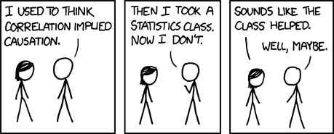
Correlation
https://xkcd.com/552/

Slide 2
Covariance and Correlation
Covariance and Correlation
Conditional Expectation
Prediction
Lecture 22, CS70 Summer 2025

Slide 3
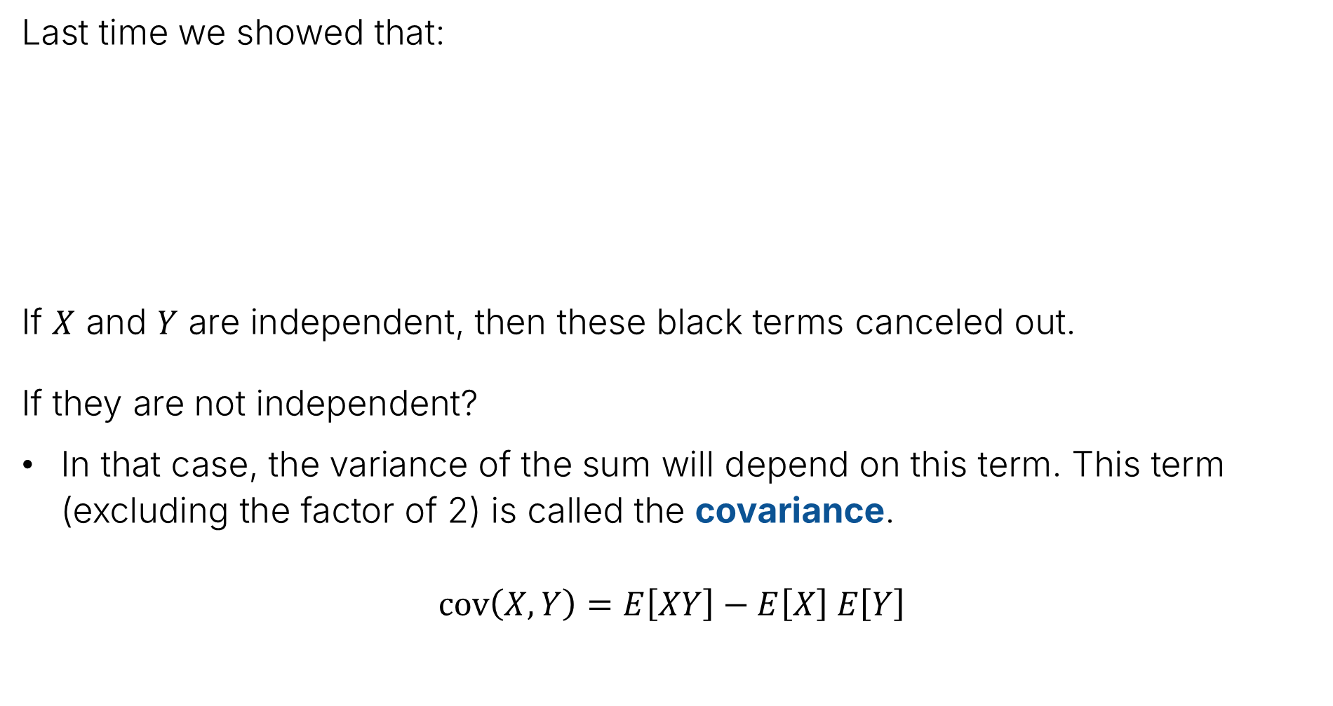
Review – Covariance
Last time we showed that:
If $X$ and $Y$ are independent, then these black terms canceled out.
If they are not independent?
In that case, the variance of the sum will depend on this term. This term (excluding the factor of 2) is called the covariance.
$$cov\left(X, Y\right)=E\left[XY\right]−E\left[X\right] E\left[Y\right]$$
$$Var\left(X+Y\right)=E\left[{\left(X+Y\right)}^{2}\right]−{\left(E\left[X+Y\right]\right)}^{2}$$
$$=Var\left(X\right)+2E\left[XY\right]−2E\left[X\right]E\left[Y\right]+Var(Y)$$

Slide 4
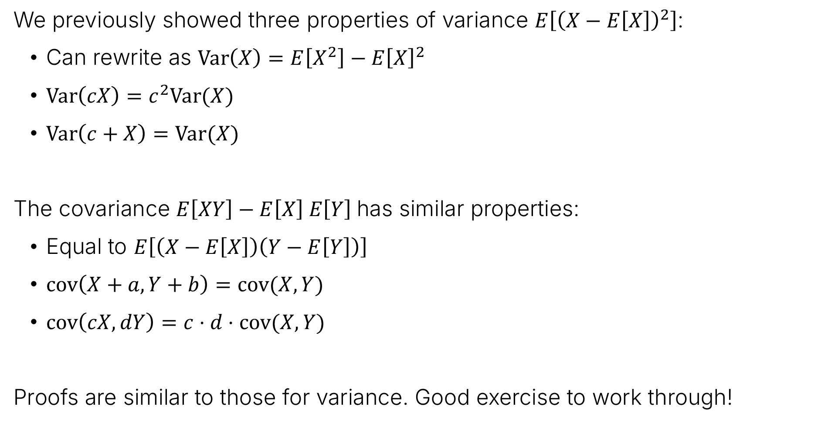
Covariance Properties
We previously showed three properties of variance $E\left[{\left(X−E\left[X\right]\right)}^{2}\right]$:
Can rewrite as $Var\left(X\right)=E\left[X^{2}\right]−E{\left[X\right]}^{2}$
$Var\left(cX\right)=c^{2}Var(X)$
$Var\left(c+X\right)=Var(X)$
The covariance $E\left[XY\right]−E\left[X\right] E\left[Y\right]$has similar properties:
Equal to $E\left[\left(X−E\left[X\right]\right)\left(Y−E\left[Y\right]\right)\right]$
$cov\left(X+a, Y+b\right)=cov(X,Y)$
$cov\left(cX, dY\right)=c⋅d⋅cov(X,Y)$
Proofs are similar to those for variance. Good exercise to work through!

Slide 5

Extra Slide: Proof of First Useful Property
$cov\left(X, Y\right)=𝔼\left[XY\right]−𝔼\left[X\right]𝔼\left[Y\right]$:
Can also be written as $𝔼\left[\left(X−𝔼\left[X\right]\right)\left(Y−𝔼\left[Y\right]\right)\right]$
Proof: For conciseness of notation, let $μ_{x}=𝔼\left[X\right]$ and $μ_{y}=𝔼\left[Y\right]$.
$$𝔼\left[\left(X−𝔼\left[X\right]\right)\left(Y−𝔼\left[Y\right]\right)\right]$$
$$=𝔼\left[\left(X−μ_{X}\right)\left(Y−μ_{y}\right)\right]$$
$$=𝔼\left[XY−μ_{Y}X−μ_{X}Y+μ_{X}μ_{Y}\right]$$
$$=𝔼\left[XY\right]−μ_{Y}𝔼\left[X\right]−μ_{X}𝔼\left[Y\right]+μ_{X}μ_{Y}$$
$$=𝔼\left[XY\right]−μ_{X}μ_{Y}−μ_{X}μ_{Y}+μ_{X}μ_{Y}$$
$$=𝔼\left[XY\right]−μ_{X}μ_{Y}$$

Slide 6
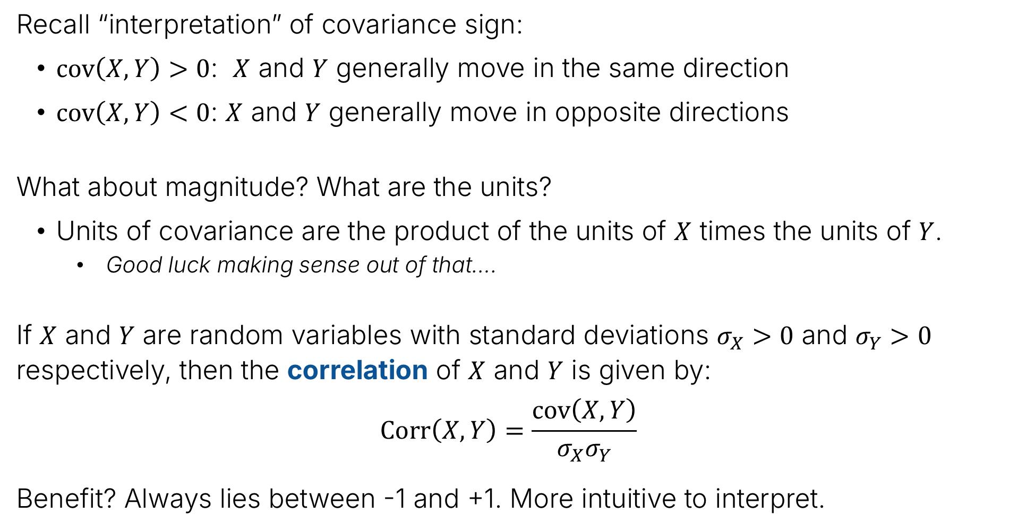
Correlation
Recall “interpretation” of covariance sign:
$cov\left(X,Y\right)>0$: $X$ and $Y$ generally move in the same direction
$cov\left(X,Y\right)<0$: $X$ and $Y$ generally move in opposite directions
What about magnitude? What are the units?
Units of covariance are the product of the units of $X$ times the units of $Y$.
  Good luck making sense out of that….
If $X$ and $Y$ are random variables with standard deviations $σ_{X}>0$ and $σ_{Y}>0$ respectively, then the correlation of $X$ and $Y$ is given by:
$$Corr\left(X,Y\right)=\frac{cov\left(X,Y\right)}{σ_{X}σ_{Y}}$$
Benefit? Always lies between -1 and +1. More intuitive to interpret.

Slide 7
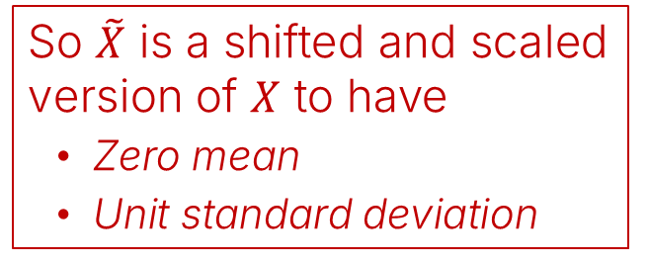
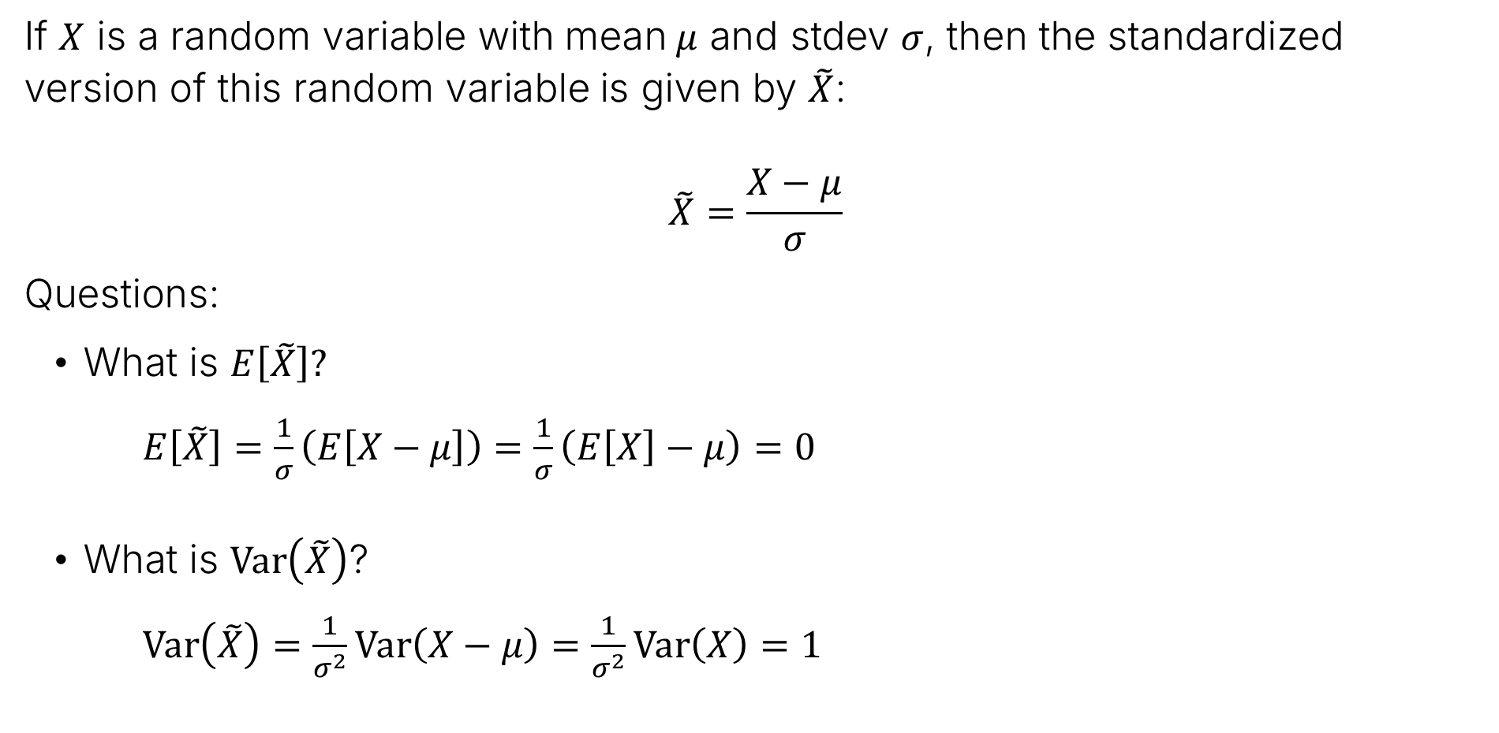

Related concept: Standardizing a Random Variable
If $X$ is a random variable with mean $μ$ and stdev $σ$, then the standardized version of this random variable is given by $\tilde{X}$:
$$\tilde{X}=\frac{X−μ}{σ}$$
Questions:
What is $E\left[\tilde{X}\right]?$
$E\left[\tilde{X}\right]=\frac{1}{σ}\left(E\left[X−μ\right]\right)=\frac{1}{σ}\left(E\left[X\right]−μ\right)=0$
What is $Var\left(\tilde{X}\right)$?
$Var\left(\tilde{X}\right)=\frac{1}{σ^{2}}Var\left(X−μ\right)=\frac{1}{σ^{2}}Var\left(X\right)=1$
So $\tilde{X}$ is a shifted and scaled
version of $X$ to have
Zero mean
Unit standard deviation
Note: “Standardizing” is the idea behind using “z-Scores” for exam grades!

Slide 8
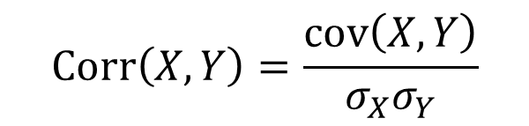


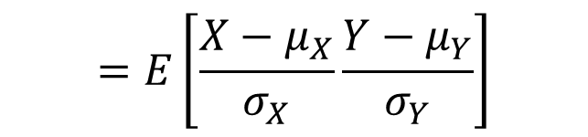
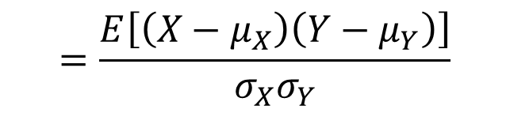
Proof of Correlation Range
Claim: The correlation is always between -1 and 1.
$$−1≤Corr\left(X,Y\right)=\frac{cov\left(X,Y\right)}{σ_{X}σ_{Y}}≤+1$$
Lemma: Let $E\left[X\right]=μ_{X}$, $E\left[Y\right]=μ_{Y}$. Let $\tilde{X}$ and $\tilde{Y}$ be the standardized versions of $X$ and $Y$. Then $Corr\left(X,Y\right)=E\left[\tilde{X}\tilde{Y}\right]$
Proof of Lemma:
$$Corr\left(X,Y\right)=\frac{cov\left(X,Y\right)}{σ_{X}σ_{Y}}$$
$$=\frac{E\left[\left(X−μ_{X}\right)\left(Y−μ_{Y}\right)\right]}{σ_{X}σ_{Y}}$$
$$=E\left[\frac{X−μ_{X}}{σ_{X}}\frac{Y−μ_{Y}}{σ_{Y}}\right]$$
$$=E\left[\tilde{X}\tilde{Y}\right]$$

Slide 9




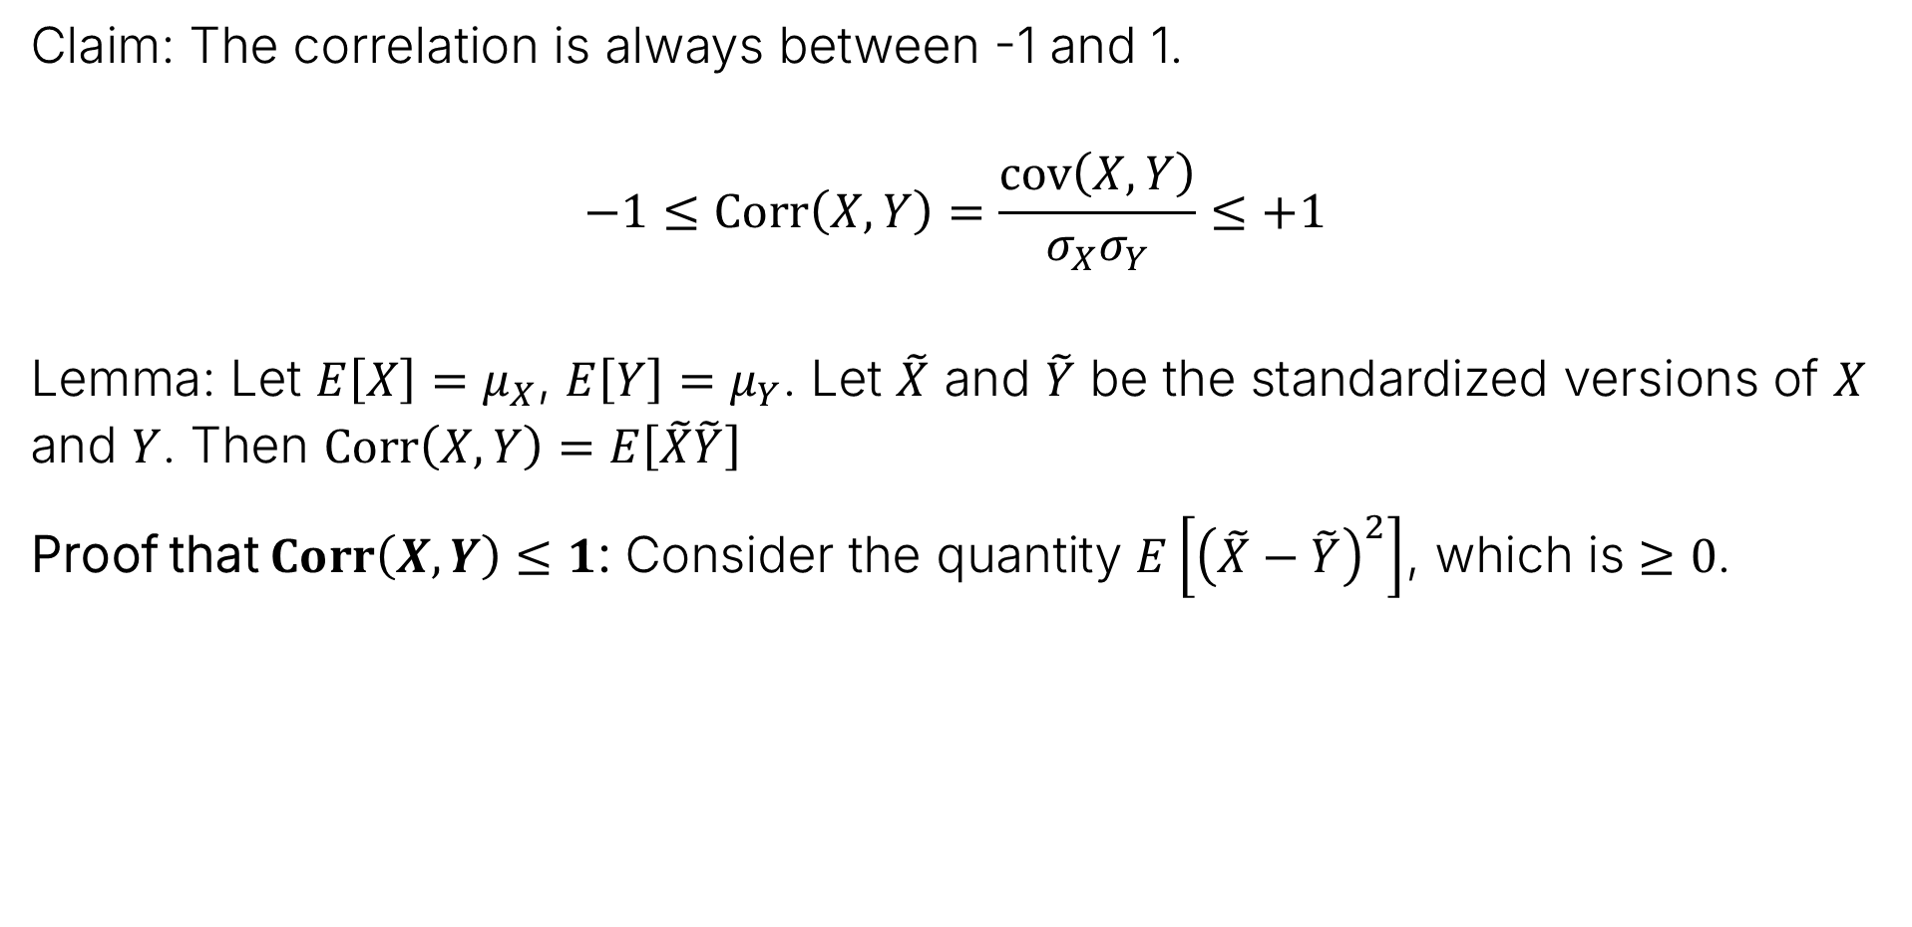
Proof of Correlation Range
Claim: The correlation is always between -1 and 1.
$$−1≤Corr\left(X,Y\right)=\frac{cov\left(X,Y\right)}{σ_{X}σ_{Y}}≤+1$$
Lemma: Let $E\left[X\right]=μ_{X}$, $E\left[Y\right]=μ_{Y}$. Let $\tilde{X}$ and $\tilde{Y}$ be the standardized versions of $X$ and $Y$. Then $Corr\left(X,Y\right)=E\left[\tilde{X}\tilde{Y}\right]$
Proof that $Corr\left(X,Y\right)≤1$: Consider the quantity $E\left[{\left(\tilde{X}−\tilde{Y}\right)}^{2}\right]$, which is $≥0$.
$$E\left[{\left(\tilde{X}−\tilde{Y}\right)}^{2}\right]$$
$$=E\left[{\tilde{X}}^{2}\right]−2E\left[\tilde{X}\tilde{Y}\right]+E\left[{\tilde{Y}}^{2}\right]$$
$$=1−2E\left[\tilde{X}\tilde{Y}\right]+1$$
$$=2−2Corr\left(X, Y\right)=2\left(1−Corr\left(X,Y\right)\right)≥0$$
Thus, $1−Corr\left(X, Y\right)≥0$
So: $Corr\left(X, Y\right)≤1$

Slide 10



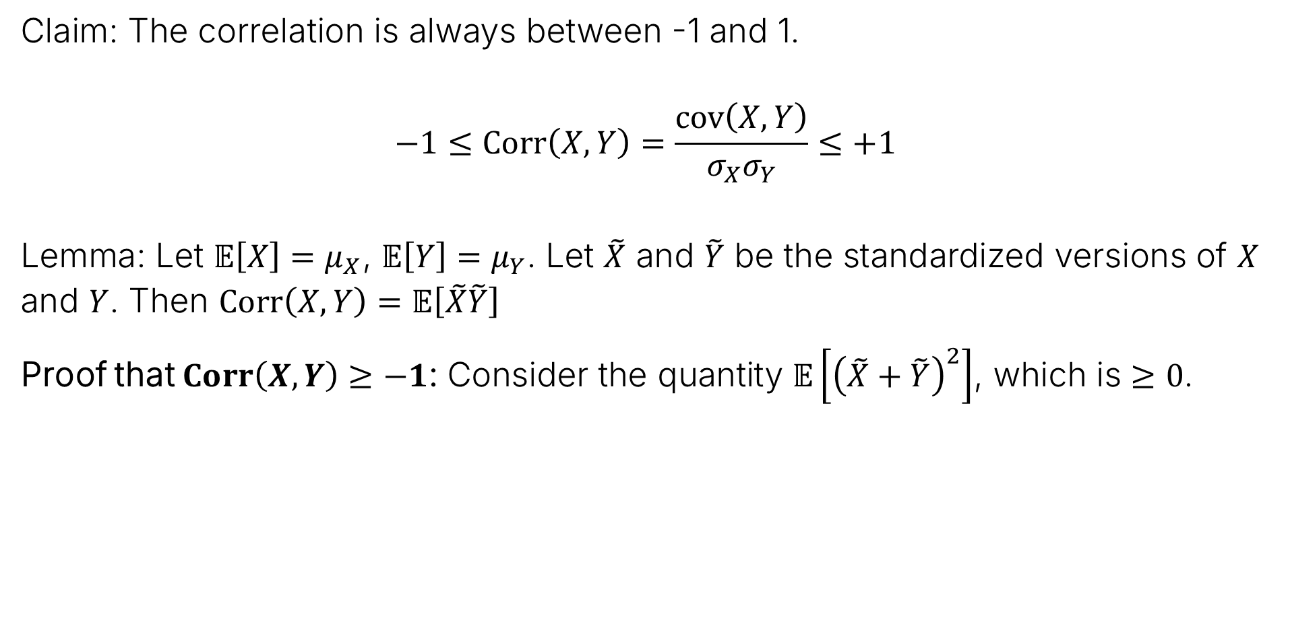
Proof of Correlation Range
Claim: The correlation is always between -1 and 1.
$$−1≤Corr\left(X,Y\right)=\frac{cov\left(X,Y\right)}{σ_{X}σ_{Y}}≤+1$$
Lemma: Let $𝔼\left[X\right]=μ_{X}$, $𝔼\left[Y\right]=μ_{Y}$. Let $\tilde{X}$ and $\tilde{Y}$ be the standardized versions of $X$ and $Y$. Then $Corr\left(X,Y\right)=𝔼\left[\tilde{X}\tilde{Y}\right]$
Proof that $Corr\left(X,Y\right)≥−1$: Consider the quantity $𝔼\left[{\left(\tilde{X}+\tilde{Y}\right)}^{2}\right]$, which is $≥0$.
$$𝔼\left[{\left(\tilde{X}+\tilde{Y}\right)}^{2}\right]$$
$$=𝔼\left[{\tilde{X}}^{2}\right]+2𝔼\left[\tilde{X}\tilde{Y}\right]+𝔼\left[{\tilde{Y}}^{2}\right]$$
$$=1+2𝔼\left[\tilde{X}\tilde{Y}\right]+1$$
$$=2+2Corr\left(X, Y\right)=2\left(1+Corr\left(X,Y\right)\right)≥0$$
Thus, $2+2Corr\left(X, Y\right)≥0$
So: $Corr\left(X, Y\right)≥−1$

Slide 11
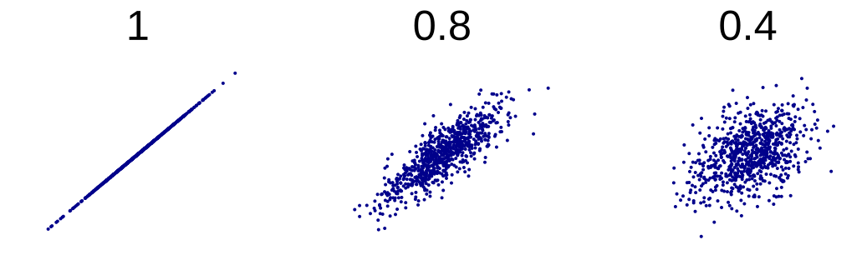
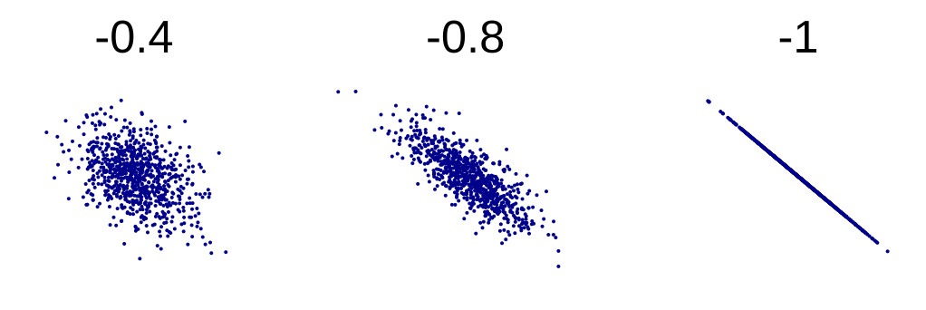

Correlation Examples
Examples of random samples of correlated random variables, $Corr\left(X, Y\right)>0$:
Examples of negative correlated random variables, $Corr\left(X, Y\right)<0$:

Slide 12
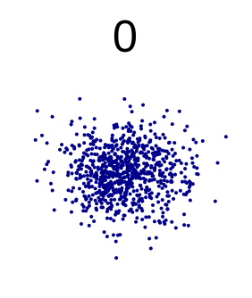
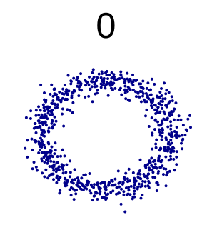

Correlation Of Zero
Examples of independent RV with $Corr\left(X, Y\right)=0$:
Example of dependent RV with $Corr\left(X, Y\right)=0$. Why are these not independent?

Slide 13
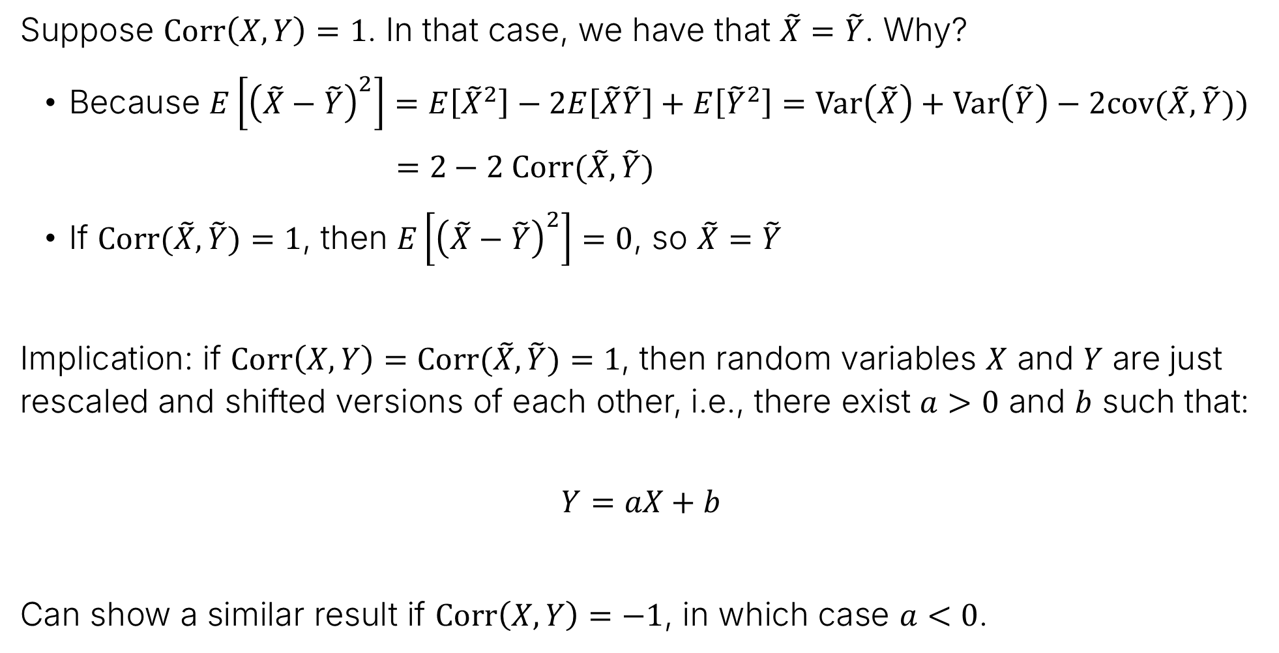
Observations about Extreme Cases
Suppose $Corr\left(X, Y\right)=1$. In that case, we have that $\tilde{X}=$ $\tilde{Y}$. Why?
Because $E\left[{\left(\tilde{X}−\tilde{Y}\right)}^{2}\right]=E\left[{\tilde{X}}^{2}\right]−2E\left[\tilde{X}\tilde{Y}\right]+E\left[{\tilde{Y}}^{2}\right]=Var\left(\tilde{X}\right)+Var\left(\tilde{Y}\right)−2cov(\tilde{X},\tilde{Y}))$
$=2−2 Corr(\tilde{X},\tilde{Y})$
If $Corr(\tilde{X},\tilde{Y})=1$, then $E\left[{\left(\tilde{X}−\tilde{Y}\right)}^{2}\right]=0$, so $\tilde{X}=\tilde{Y}$
Implication: if $Corr\left(X, Y\right)=Corr(\tilde{X},\tilde{Y})=1$, then random variables $X$ and $Y$ are just rescaled and shifted versions of each other, i.e., there exist $a>0$ and $b$ such that:
$$Y=aX+b$$
Can show a similar result if $Corr\left(X,Y\right)=−1$, in which case $a<0$.

Slide 14
Conditional Expectation
Covariance and Correlation
Conditional Expectation
Prediction
Lecture 22, CS70 Summer 2025

Slide 15
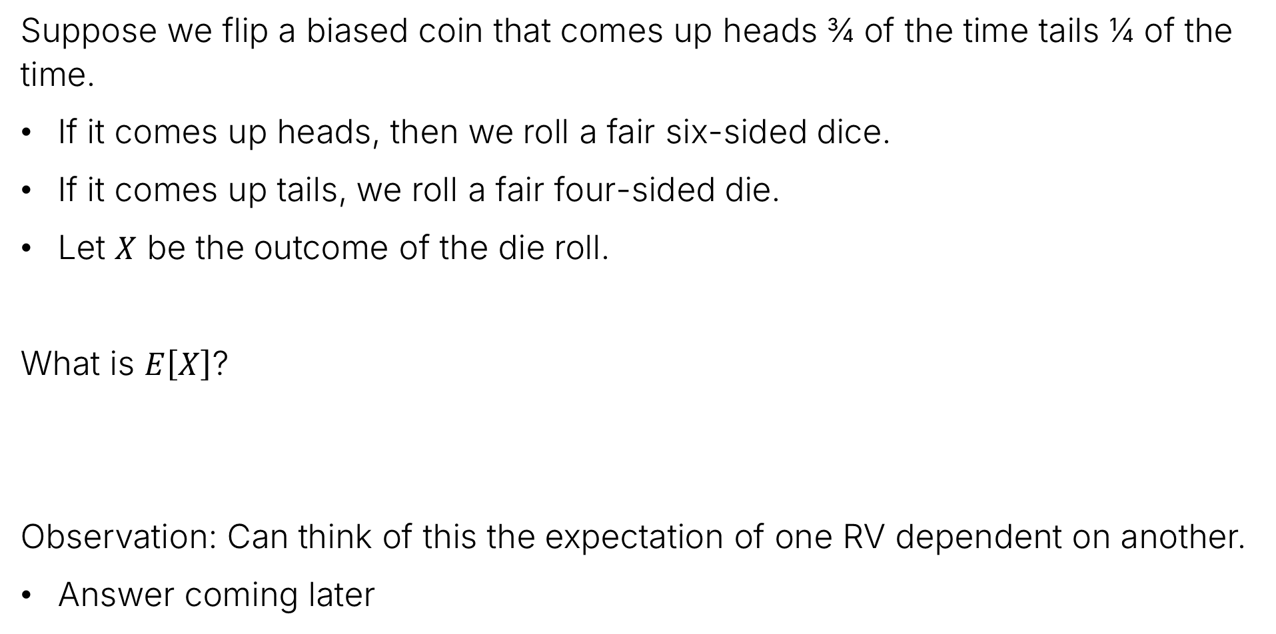
Intuitive Question
Suppose we flip a biased coin that comes up heads ¾ of the time tails ¼ of the time.
If it comes up heads, then we roll a fair six-sided dice.
If it comes up tails, we roll a fair four-sided die.
Let $X$ be the outcome of the die roll.
What is $E\left[X\right]$?
Observation: Can think of this the expectation of one RV dependent on another.
Answer coming later

Slide 16
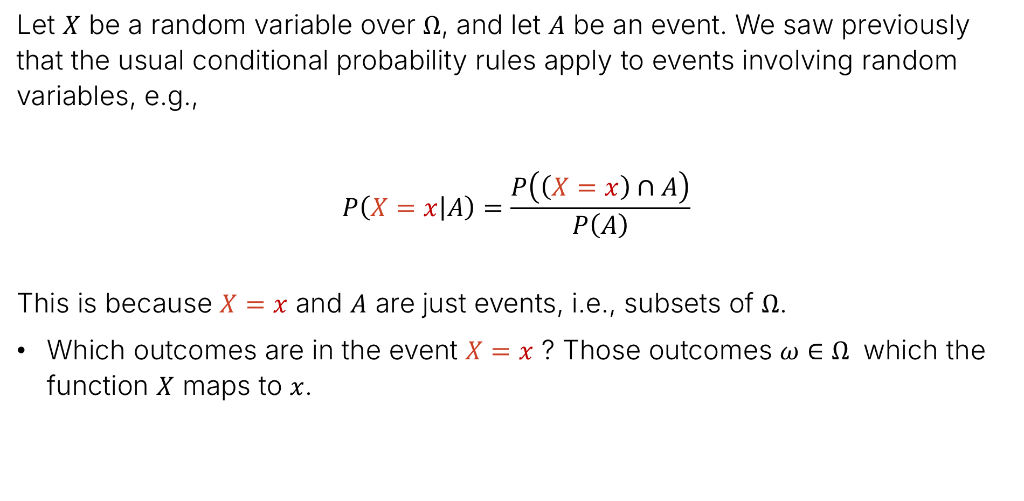
Conditional Probability and Events
Let $X$ be a random variable over $Ω$, and let $A$ be an event. We saw previously that the usual conditional probability rules apply to events involving random variables, e.g.,
$$P\left(X=x | A\right)=\frac{P\left(\left(X=x\right)∩A\right)}{P\left(A\right)}$$
This is because $X=x$ and $A$ are just events, i.e., subsets of $Ω$.
Which outcomes are in the event $X=x$ ? Those outcomes $ω∈Ω$ which the function $X$ maps to $x$.

Slide 17
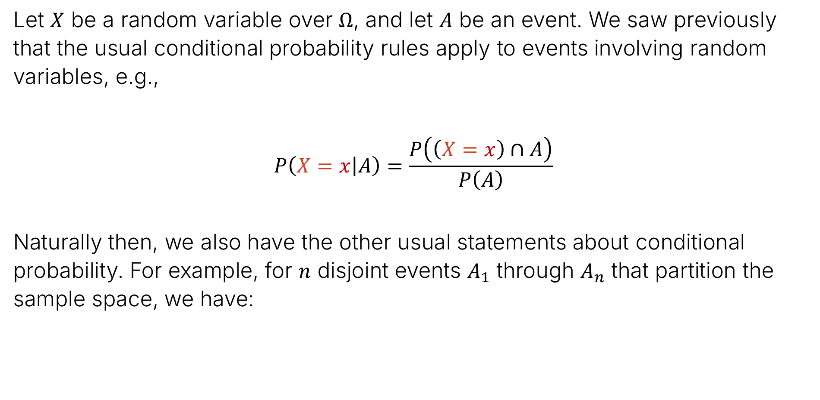
Conditional Probability and Events
Let $X$ be a random variable over $Ω$, and let $A$ be an event. We saw previously that the usual conditional probability rules apply to events involving random variables, e.g.,
$$P\left(X=x | A\right)=\frac{P\left(\left(X=x\right)∩A\right)}{P\left(A\right)}$$
Naturally then, we also have the other usual statements about conditional probability. For example, for $n$ disjoint events $A_{1}$ through $A_{n}$ that partition the sample space, we have:
$$P\left(X=x\right)=P\left(\left(X=x\right)∩A_{1}\right)+…+P\left(\left(X=x\right)∩A_{n}\right)$$
$$P\left(X=x\right)=P\left(A_{1}\right)⋅P\left(\left(X=x\right)|A_{1}\right)+…+P\left(A_{n}\right)⋅P\left(\left(X=x\right)|A_{n}\right)$$

Slide 18
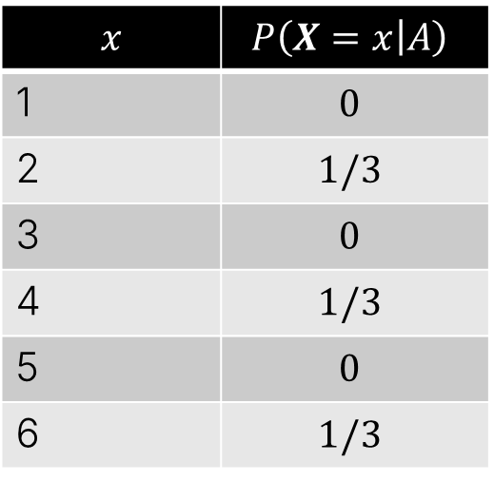
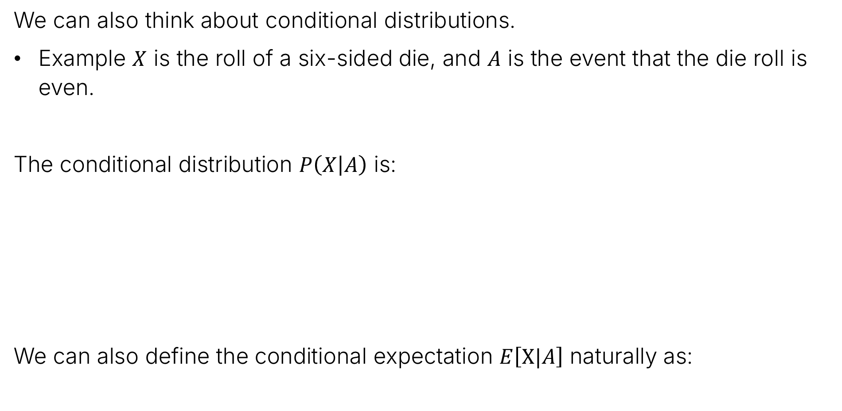

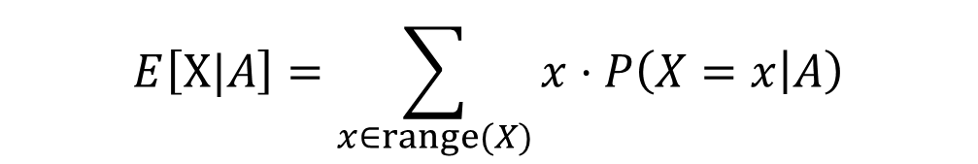
Conditional Distributions and Expectations
We can also think about conditional distributions.
Example $X$ is the roll of a six-sided die, and $A$ is the event that the die roll is even.
The conditional distribution $P\left(X | A\right)$ is:
We can also define the conditional expectation $E\left[X|A\right]$ naturally as:
$$x$$ | $$P\left(X=x | A\right)$$
1 | $$0$$
2 | $$1/3$$
3 | $$0$$
4 | $$1/3$$
5 | $$0$$
6 | $$1/3$$
$$E\left[X | A\right]=4$$
$$E\left[X|A\right]=\sum_{x∈range(X)}{x⋅P\left(X=x | A\right)}$$

Slide 19

Law of Total Expectation (Binary Event)
For a binary event, we also have:
$$E\left[X\right]=P\left(A\right)⋅E\left[X|A\right]+P\left(\overline{A}\right)⋅E\left[X|\overline{A}\right]$$
Note: This is intuitive but we haven’t proven this. We will at the end of this section.
Let’s see how we can use this to more formally solve our dice and coin problem.

Slide 20

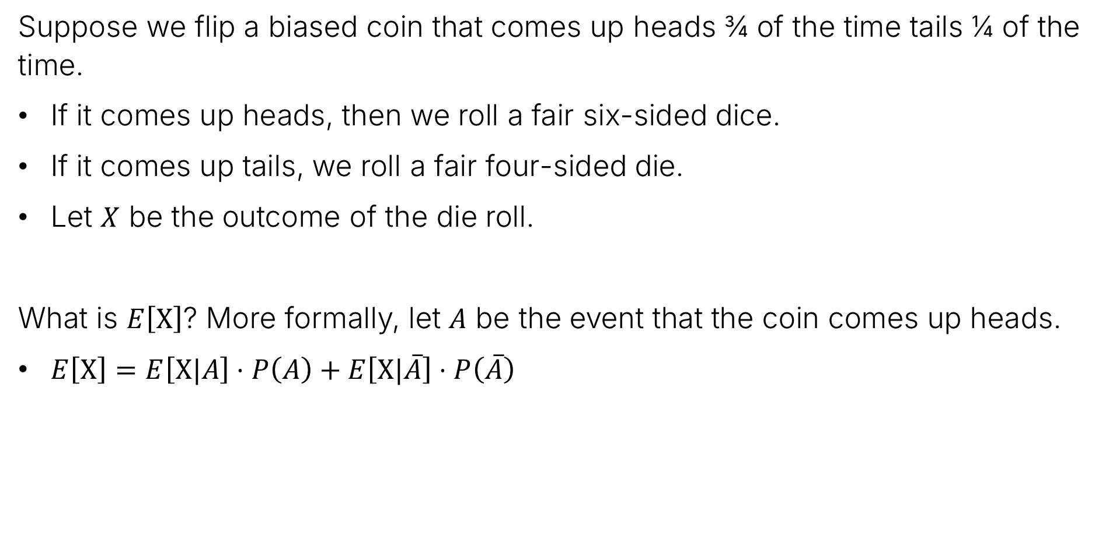


More Formal Answer to Intuitive Question
Suppose we flip a biased coin that comes up heads ¾ of the time tails ¼ of the time.
If it comes up heads, then we roll a fair six-sided dice.
If it comes up tails, we roll a fair four-sided die.
Let $X$ be the outcome of the die roll.
What is $E\left[X\right]$? More formally, let $A$ be the event that the coin comes up heads.
$E\left[X\right]=$ $E\left[X|A\right]⋅P\left(A\right)+E\left[X|\overline{A}\right]⋅P\left(\overline{A}\right)$
$$=\frac{7}{2}⋅\frac{3}{4}+\frac{5}{2}⋅\frac{1}{4}$$
$$=\frac{26}{8}=\frac{13}{4}$$
$$=3.25$$

Slide 21
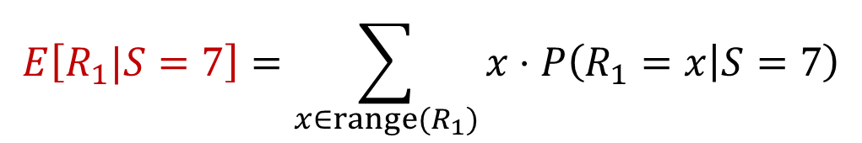
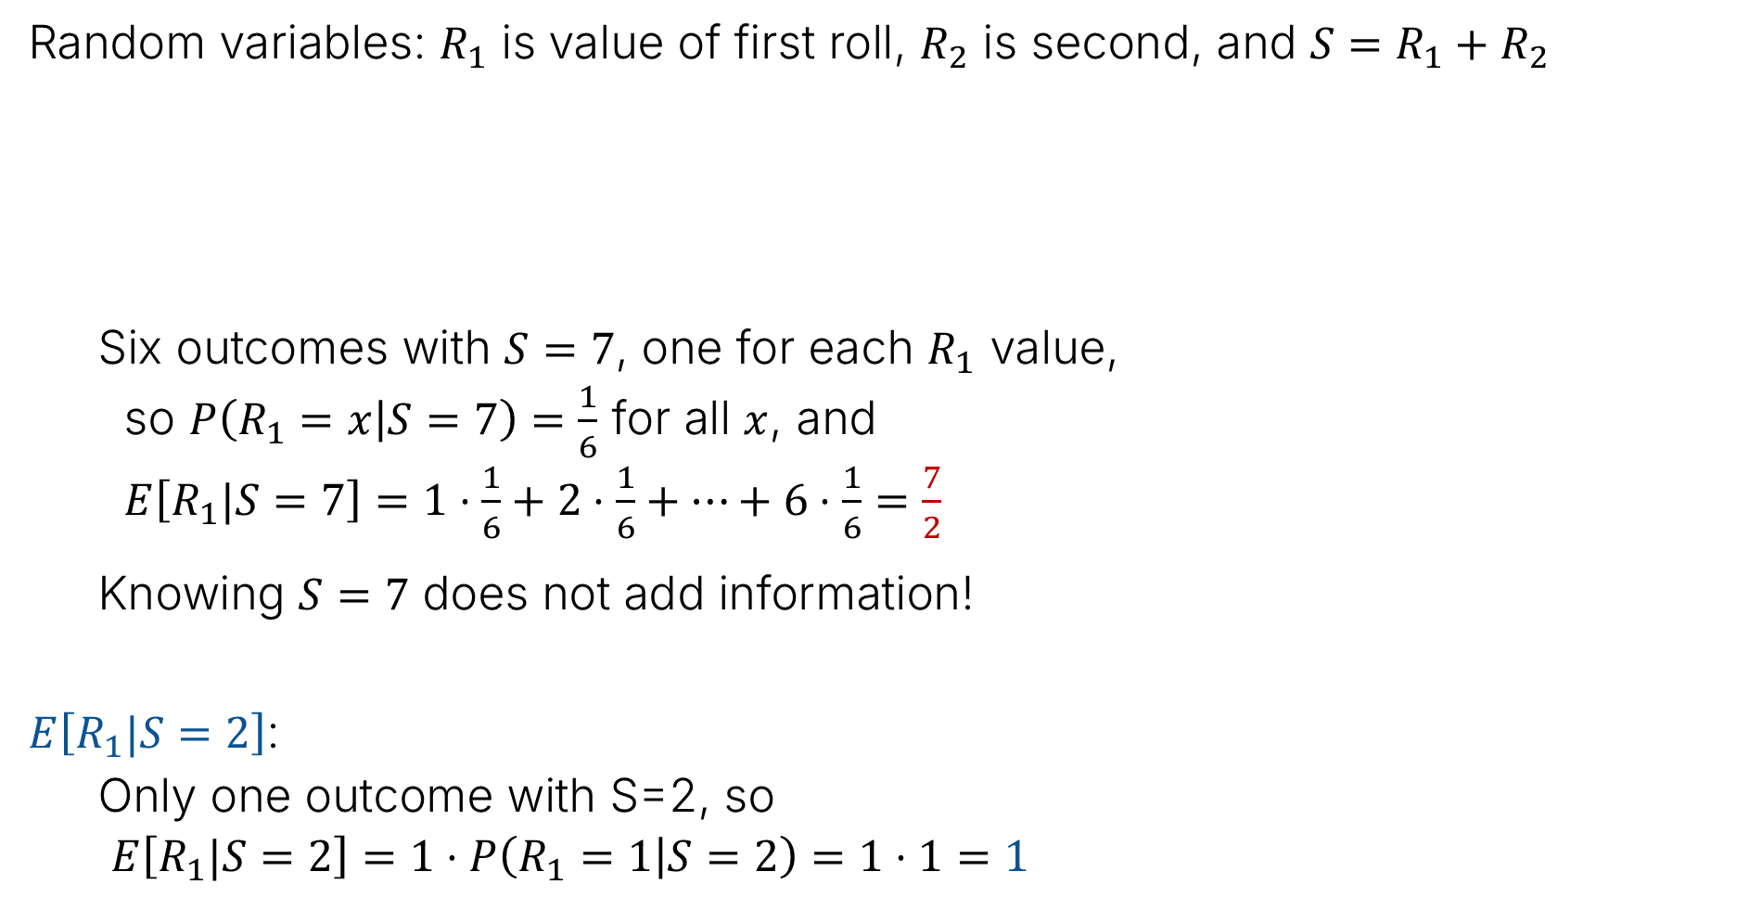
Example 2 – Rolling A Six-Side Die Twice
Random variables: $R_{1}$ is value of first roll, $R_{2}$ is second, and ${S=R}_{1}+R_{2}$
  Six outcomes with $S=7$, one for each $R_{1}$ value,
  so $P\left(R_{1}=x | S=7\right)=\frac{1}{6}$ for all $x$, and
  $E\left[R_{1}|S=7\right]=1⋅\frac{1}{6}+2⋅\frac{1}{6}+…+6⋅\frac{1}{6}=\frac{7}{2}$
  Knowing $S=7$ does not add information!
$E\left[R_{1}|S=2\right]$:
  Only one outcome with S=2, so
  $E\left[R_{1}|S=2\right]=1⋅P\left(R_{1}=1 | S=2\right)=1⋅1=1$
$$E\left[R_{1}|S=7\right]=\sum_{x∈range(R_{1})}{x⋅P\left(R_{1}=x | S=7\right)}$$
6
7 | 8 | 9 | 10 | 11 | 12
6 | 7 | 8 | 9 | 10 | 11
5 | 6 | 7 | 8 | 9 | 10
4 | 5 | 6 | 7 | 8 | 9
3 | 4 | 5 | 6 | 7 | 8
2 | 3 | 4 | 5 | 6 | 7
5
4
3
2
1
1
2
3
4
5
6

Slide 22

Less Trivial Example: Expectation of a Geometric Random Variable
Let $X\sim Geometric(p)$. Let $A$ be the event that the first flip is heads. Let’s see how we can use conditional expectation to (for a third time) compute $E\left[X\right]$.
What is $P\left(A\right)⋅E\left[X | A\right]$?
$$E\left[X\right]=P\left(A\right)⋅E\left[X | A\right]+P\left(\overline{A}\right)⋅E\left[X|\overline{A} \right]$$

Slide 23

Less Trivial Example: Expectation of a Geometric Random Variable
Let $X\sim Geometric(p)$. Let $A$ be the event that the first flip is heads. Let’s see how we can use conditional expectation to (for a third time) compute $E\left[X\right]$.
What is $P\left(A\right)⋅E\left[X | A\right]$?
$P\left(A\right)=p$
And if $A$ is true, $X=1$, so $E\left[X | A\right]=1$.
Answer: $p⋅1=p$
$$E\left[X\right]=P\left(A\right)⋅E\left[X | A\right]+P\left(\overline{A}\right)⋅E\left[X|\overline{A} \right]$$

Slide 24
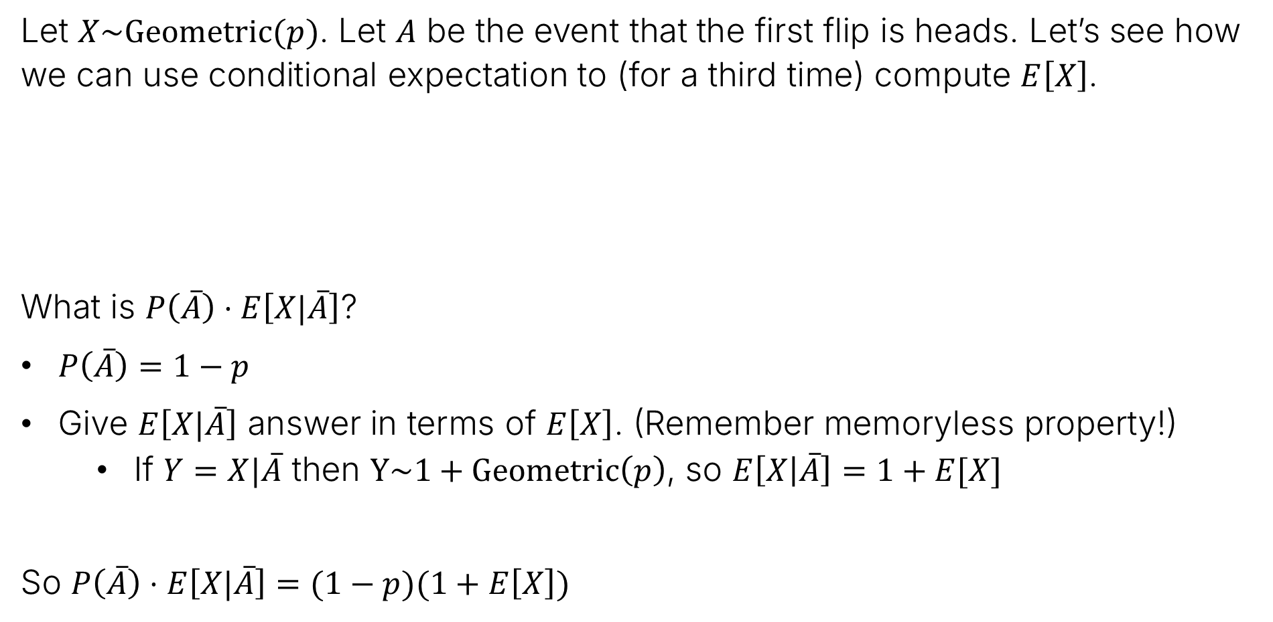
Less Trivial Example: Expectation of a Geometric Random Variable
Let $X\sim Geometric(p)$. Let $A$ be the event that the first flip is heads. Let’s see how we can use conditional expectation to (for a third time) compute $E\left[X\right]$.
What is $P\left(\overline{A}\right)⋅E\left[X|\overline{A}\right]$?
$P\left(\overline{A}\right)=1−p$
Give $E\left[X|\overline{A}\right]$ answer in terms of $E\left[X\right]$. (Remember memoryless property!)
  If $Y=X|\overline{A}$ then $Y\sim 1+Geometric\left(p\right)$, so $E\left[X | \overline{A}\right]=1+E[X]$
So $P\left(\overline{A}\right)⋅E\left[X|\overline{A}\right]=(1−p)(1+E\left[X\right])$
$$E\left[X\right]=p+P\left(\overline{A}\right)⋅E\left[X|\overline{A}\right]$$

Slide 25



Less Trivial Example: Expectation of a Geometric Random Variable
Let $X\sim Geometric(p)$. Let $A$ be the event that the first flip is heads. Let’s see how we can use conditional expectation to (for a third time) compute $E\left[X\right]$.
Now we can solve for $E\left[X\right]$:
$$E\left[X\right]=p+\left(1−p\right)⋅\left(1+E\left[X\right]\right)$$
$$E\left[X\right]=p+1+E \left[X\right]−p−p E\left[X\right]$$
$$=1+E\left[X\right]−p E\left[X\right]$$
$$p E\left[X\right]=1$$
$$E\left[X\right]=\frac{1}{p}$$

Slide 26




Law of Total Expectation Proof
More general version: Let $X$ be a random variable over $Ω$. Let $A_{1},…,A_{n}$ be disjoint events that partition $Ω$. Then:
$$E\left[X\right]=\sum_{i=1}^{n}{P\left(A_{i}\right)⋅E\left[X|A_{i}\right]}$$
Proof:
$$E\left[X\right]=\sum_{x∈range\left(X\right)}{x⋅P\left(X=x\right)}$$
$$=\sum_{x∈range\left(X\right)}{x}\sum_{i=1}^{n}{P\left(A_{i}\right)⋅P\left(X=x | A_{i}\right)}$$
$$=\sum_{i=1}^{n}{P\left(A_{i}\right)⋅\sum_{x∈range\left(X\right)}{x}P\left(X=x | A_{i}\right)}$$
$$E\left[X|A_{i}\right]$$

Slide 27
Prediction
Covariance and Correlation
Conditional Expectation
Prediction
Lecture 22, CS70 Summer 2025

Slide 28
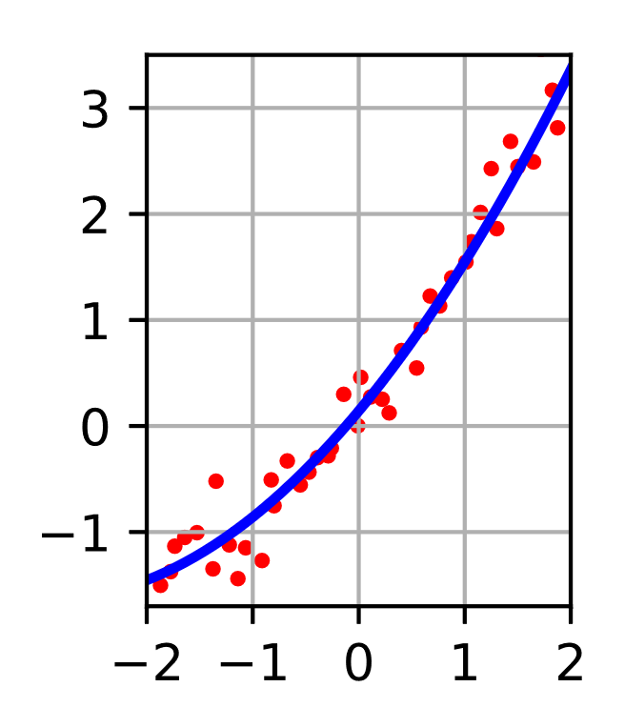
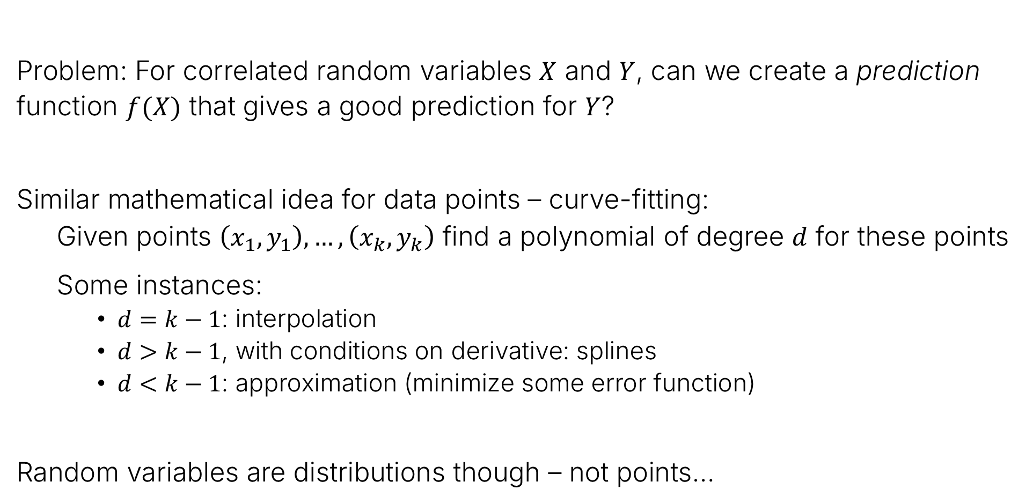
Prediction
Problem: For correlated random variables $X$ and $Y$, can we create a prediction function $f(X)$ that gives a good prediction for $Y$?
Similar mathematical idea for data points – curve-fitting:
  Given points $\left(x_{1},y_{1}\right),…,\left(x_{k},y_{k}\right)$ find a polynomial of degree $d$ for these points
  Some instances:
  $d=k−1$: interpolation
  $d>k−1$, with conditions on derivative: splines
  $d<k−1$: approximation (minimize some error function)
Random variables are distributions though – not points…

Slide 29
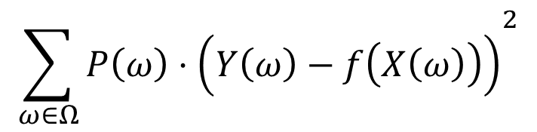
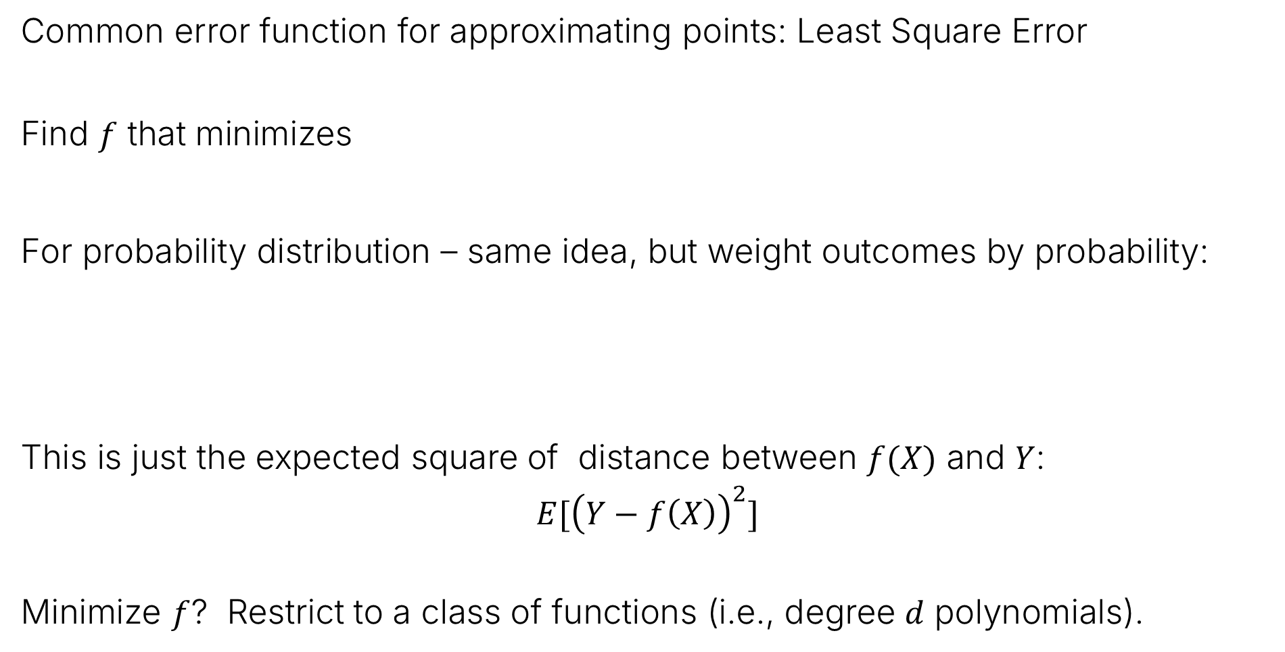
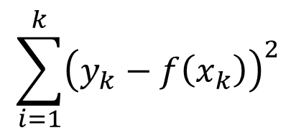
For Random Variables
Common error function for approximating points: Least Square Error
Find $f$ that minimizes
For probability distribution – same idea, but weight outcomes by probability:
This is just the expected square of distance between $f(X)$ and $Y$:
$$E[{\left(Y−f\left(X\right)\right)}^{2}]$$
Minimize $f$? Restrict to a class of functions (i.e., degree $d$ polynomials).
$$\sum_{i=1}^{k}{{\left(y_{k}−f\left(x_{k}\right)\right)}^{2}}$$
$${\sum_{ω∈Ω}{P\left(ω\right)⋅\left(Y\left(ω\right)−f\left(X\left(ω\right)\right)\right)}}^{2}$$

Slide 30
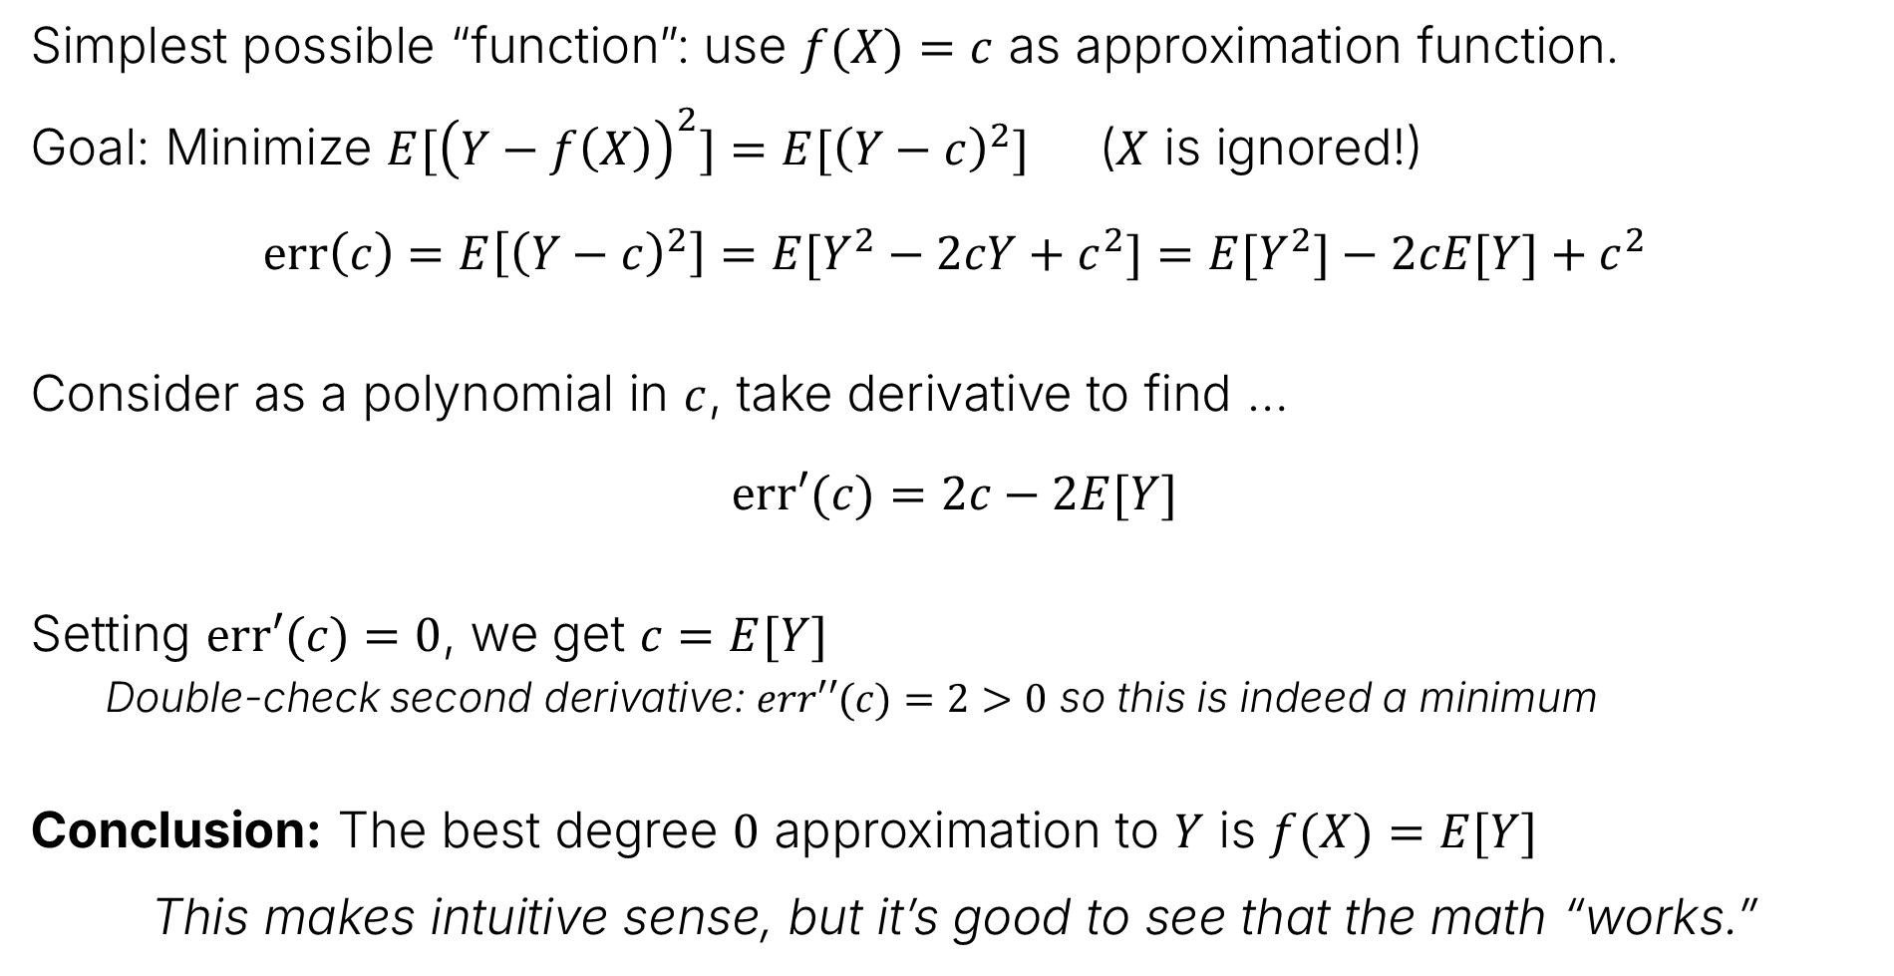
Degree 0: Constant approximation
Simplest possible “function”: use $f(X)=c$ as approximation function.
Goal: Minimize $E[{\left(Y−f\left(X\right)\right)}^{2}]=E[{\left(Y−c\right)}^{2}]$ ($X$ is ignored!)
$$err\left(c\right)=E\left[{\left(Y−c\right)}^{2}\right]=E[Y^{2}−2cY+c^{2}]=E[Y^{2}]−2cE[Y]+c^{2}$$
Consider as a polynomial in $c$, take derivative to find …
$$err′(c)=2c−2E[Y]$$
Setting $err′(c)=0$, we get $c=E[Y]$
  Double-check second derivative: $err′′(c)=2>0$ so this is indeed a minimum
Conclusion: The best degree $0$ approximation to $Y$ is $f(X)=E[Y]$
This makes intuitive sense, but it’s good to see that the math “works.”

Slide 31

Using knowledge of a correlated variable – two six-sided die rolls
Random variables: $R_{1}$ is value of first roll, $R_{2}$ is second, and ${S=R}_{1}+R_{2}$
Given a value $s$ for $S$ and want the best degree-0 (constant) predictor for $R_{1}$.
What do you think this is?

Slide 32
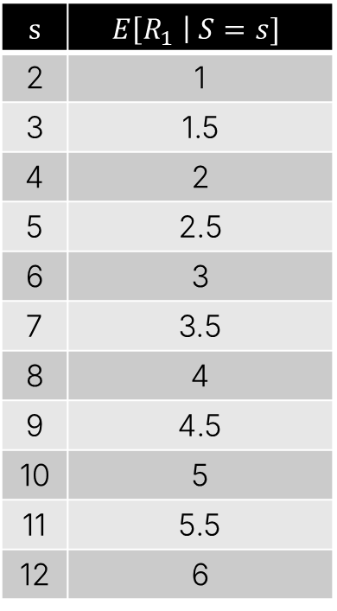
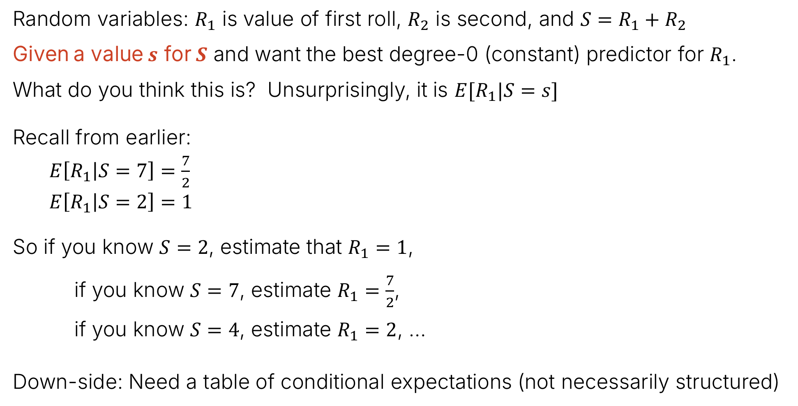
Using knowledge of a correlated variable – two six-sided die rolls
Random variables: $R_{1}$ is value of first roll, $R_{2}$ is second, and ${S=R}_{1}+R_{2}$
Given a value $s$ for $S$ and want the best degree-0 (constant) predictor for $R_{1}$.
What do you think this is? Unsurprisingly, it is $E[R_{1}|S=s]$
Recall from earlier:
  $E\left[R_{1} | S=7\right]=\frac{7}{2}$
  $E\left[R_{1} | S=2\right]=1$
So if you know $S=2$, estimate that $R_{1}=1$,
if you know $S=7$, estimate $R_{1}=\frac{7}{2}$,
if you know $S=4$, estimate $R_{1}=2$, …
Down-side: Need a table of conditional expectations (not necessarily structured)
$$s$$ | $$E\left[R_{1} \right| S=s]$$
2 | 1
3 | 1.5
4 | 2
5 | 2.5
6 | 3
7 | 3.5
8 | 4
9 | 4.5
10 | 5
11 | 5.5
12 | 6

Slide 33
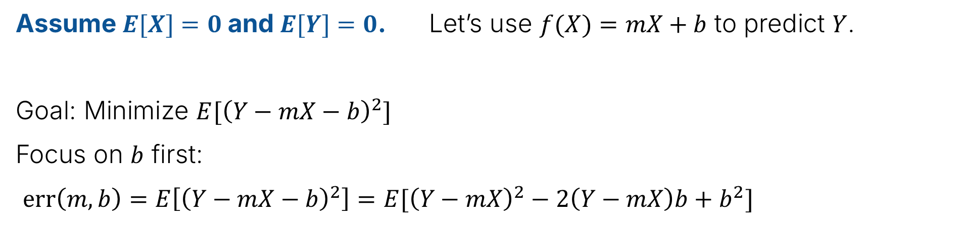
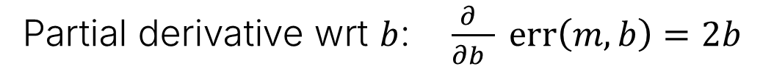

Degree 1 with mean-zero random variables – Part 1
Assume $E[X]=0$ and $E[Y]=0$. Let’s use $f(X)=mX+b$ to predict $Y$.
Goal: Minimize $E[{\left(Y−mX−b\right)}^{2}]$
Focus on $b$ first:
$err\left(m,b\right)=E\left[{\left(Y−mX−b\right)}^{2}\right]=E[{\left(Y−mX\right)}^{2}−2\left(Y−mX\right)b+b^{2}]$
$$=E{[\left(Y−mX\right)}^{2}]−2bE\left[Y\right]+2mbE\left[X\right]+b^{2}$$
These are 0 since we assume mean-zero for X and Y
$$=E{[\left(Y−mX\right)}^{2}] +b^{2}$$
Partial derivative wrt $b$: $\frac{∂ }{∂b } err\left(m,b\right)=2b$
Set to $0$ $⟹$ $b=0$ … so to minimize error, don’t shift!

Slide 34

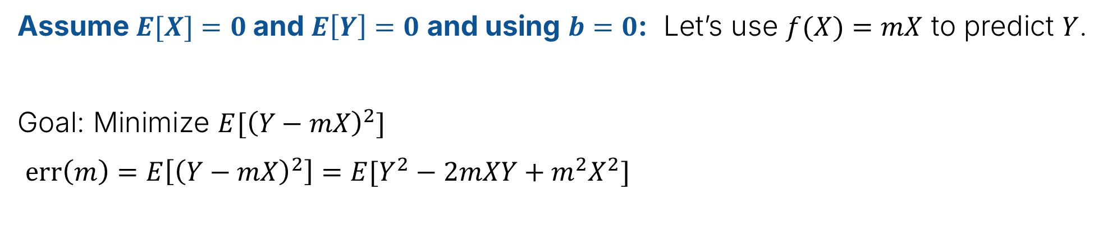
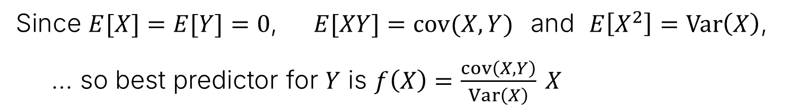
Degree 1 with mean-zero random variables – Part 2
Assume $E[X]=0$ and $E\left[Y\right]=0$ and using $b=0$: Let’s use $f(X)=mX$ to predict $Y$.
Goal: Minimize $E[{\left(Y−mX\right)}^{2}]$
$err\left(m\right)=E\left[{\left(Y−mX\right)}^{2}\right]=E[Y^{2}−2mXY+m^{2}X^{2}]$
$$=E\left[Y^{2}\right]−2mE\left[XY\right]+m^{2}E[X^{2}]$$
Take derivative: $err^{′}(m)=2mE\left[X^{2}\right]−2E[XY]$
… and set to zero: $m=\frac{E\left[XY\right]}{E[X^{2}]}$ (and verify with 2nd derivative that this is a min)
Since $E[X]=E[Y]=0$, $E[XY]=cov(X,Y)$and $E\left[X^{2}\right]=Var\left(X\right)$,
… so best predictor for $Y$ is $f\left(X\right)=\frac{cov\left(X,Y\right)}{Var\left(X\right)} X$

Slide 35

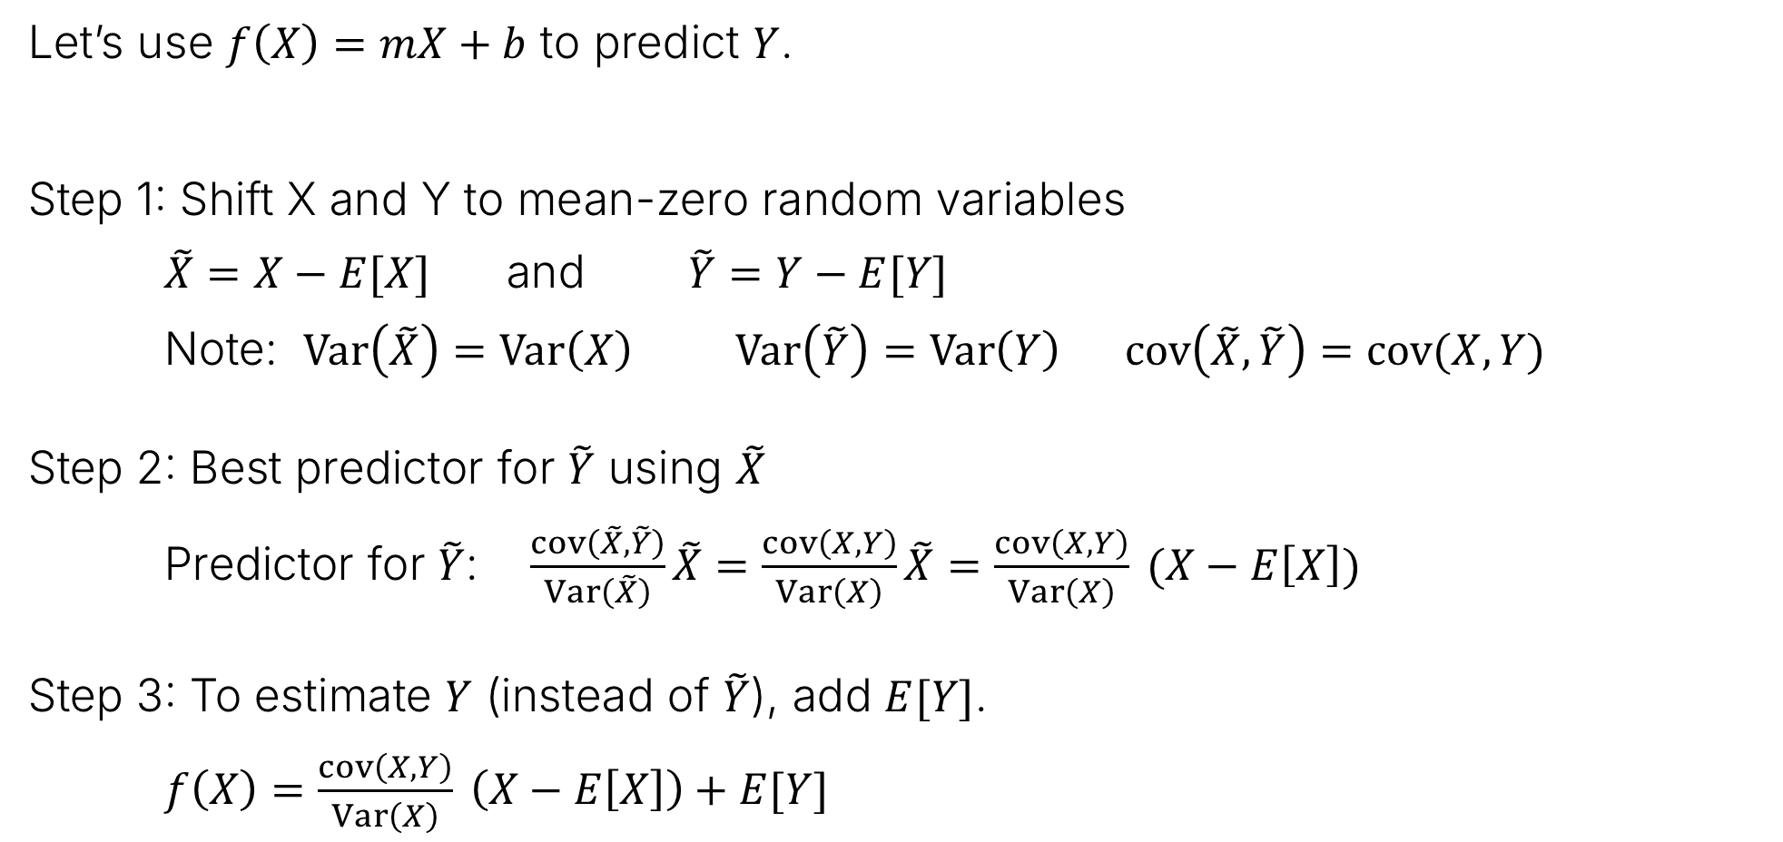
Degree 1 with arbitrary random variables
Let’s use $f\left(X\right)=mX+b$ to predict $Y$.
Step 1: Shift X and Y to mean-zero random variables
$\tilde{X}=X−E[X]$ and $\tilde{Y}=Y−E[Y]$
Note: $Var\left(\tilde{X}\right)=Var\left(X\right)$ $Var\left(\tilde{Y}\right)=Var\left(Y\right)$ $cov\left(\tilde{X},\tilde{Y}\right)=cov(X,Y)$
Step 2: Best predictor for $\tilde{Y}$ using $\tilde{X}$
Predictor for $\tilde{Y}$: $\frac{cov\left(\tilde{X},\tilde{Y}\right)}{Var\left(\tilde{X}\right)}\tilde{X}=\frac{cov\left(X,Y\right)}{Var\left(X\right)}\tilde{X}=\frac{cov\left(X,Y\right)}{Var\left(X\right)} (X−E\left[X\right])$
Step 3: To estimate $Y$ (instead of $\tilde{Y}$), add $E[Y]$.
$f\left(X\right)=\frac{cov\left(X,Y\right)}{Var\left(X\right)} \left(X−E\left[X\right]\right)+E[Y]$
Called the Linear Least Squares Estimate (LLSE)
of $Y$ given $X$

Slide 36

Degree 1 with arbitrary random variables – sanity check!
LLSE estimator: $f\left(X\right)=\frac{cov\left(X,Y\right)}{Var\left(X\right)} \left(X−E\left[X\right]\right)+E[Y]$
Think through some cases:
If $X$ and $Y$ are not correlated:
  Then $cov(X,Y)=0$, so $f(X)=E[Y]$
  In other words: ignore $X$ and just use the expected value of $Y$
If $X=Y$:
  Then $cov(X,Y)=Var(X)$, and $E[X]=E[Y]$ so $f(X)=X$
Both make sense!

Slide 37

Summary
Correlation
Covariance sign is meaningful – magnitude has weird units
Correlation normalizes to range $−1 .. +1$: $Corr\left(X,Y\right)=\frac{cov\left(X,Y\right)}{σ_{X}σ_{Y}}$
  $Corr(X,Y)=+1$ perfect positive correlation
  $Corr\left(X,Y\right)=−1$ perfect negative correlation
Conditional expectation
Restrict attention to part of sample space (“given” condition)
Probabilities and expectations work the same here: Notation $E[A|B]$
Prediction
Idea: To predict random variable $Y$, use correlated random variable $X$
Error function: Squared error
Best linear approximator has slope $\frac{cov\left(X,Y\right)}{Var\left(X\right)}$

