Slide 1
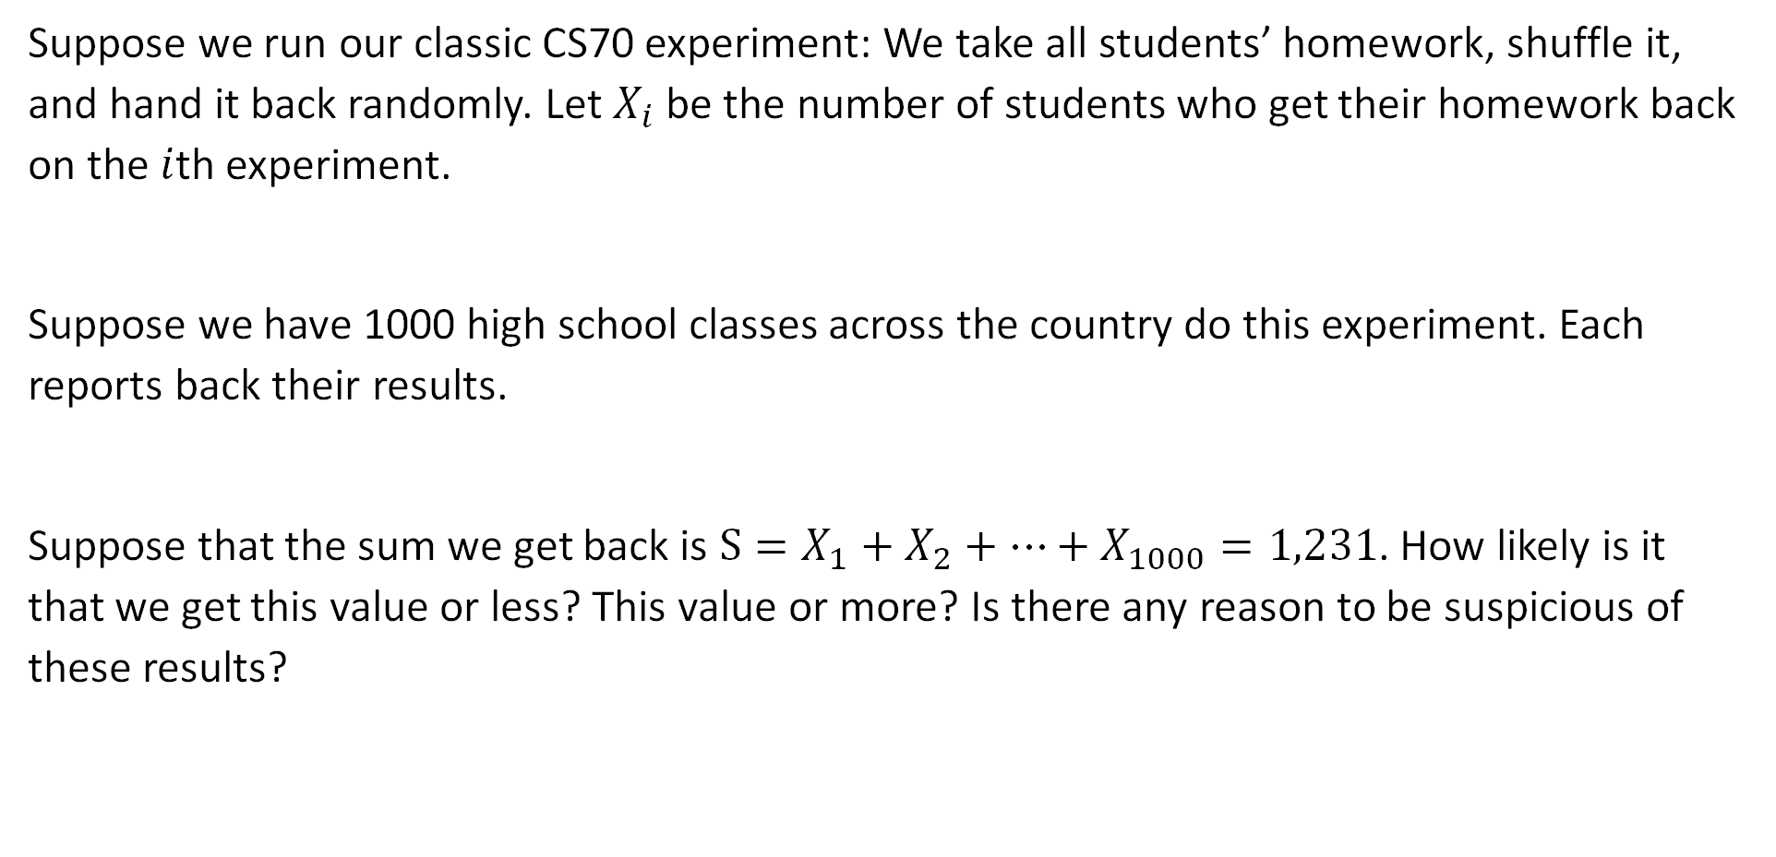
Thought Experiment #1
Suppose we run our classic CS70 experiment: We take all students’ homework, shuffle it, and hand it back randomly. Let $X_{i}$ be the number of students who get their homework back on the $i$th experiment.
Suppose we have 1000 high school classes across the country do this experiment. Each reports back their results.
Suppose that the sum we get back is $S=X_{1}+X_{2}+…+X_{1000}=1,231$. How likely is it that we get this value or less? This value or more? Is there any reason to be suspicious of these results?

Slide 2
Review: Joint Distributions
Lecture 25, CS70 Summer 2025

Slide 3
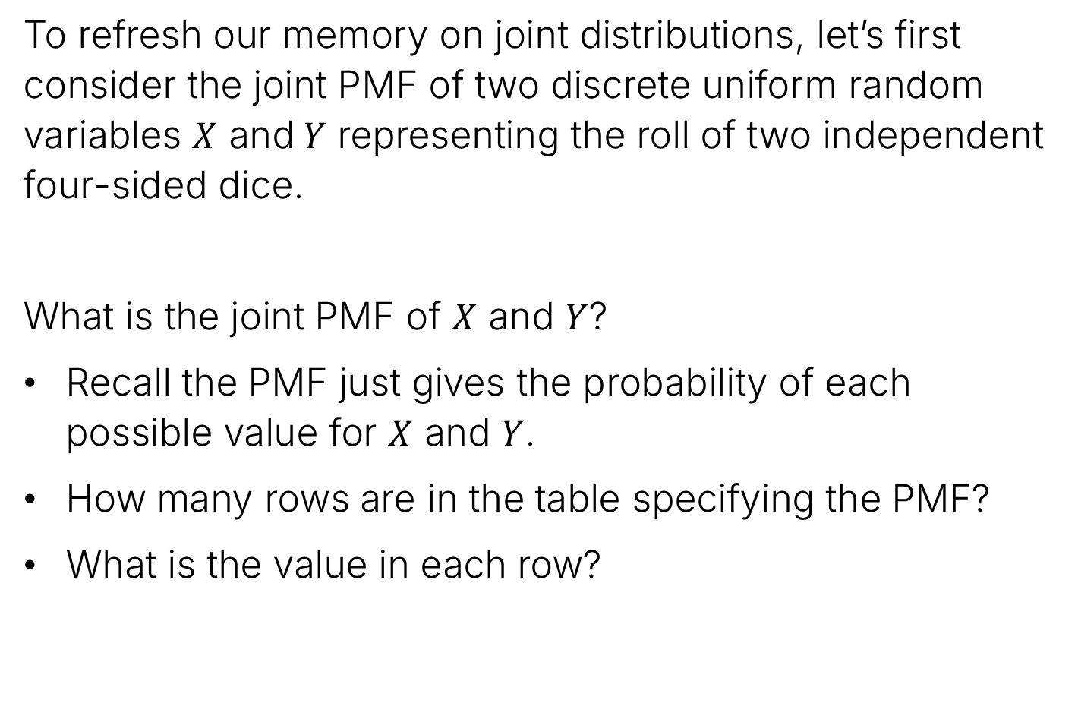
Review: Joint Distributions (Discrete)
To refresh our memory on joint distributions, let’s first consider the joint PMF of two discrete uniform random variables $X$ and$Y$ representing the roll of two independent four-sided dice.
What is the joint PMF of $X$ and $Y$?
Recall the PMF just gives the probability of each possible value for $X$ and $Y$.
How many rows are in the table specifying the PMF?
What is the value in each row?

Slide 4
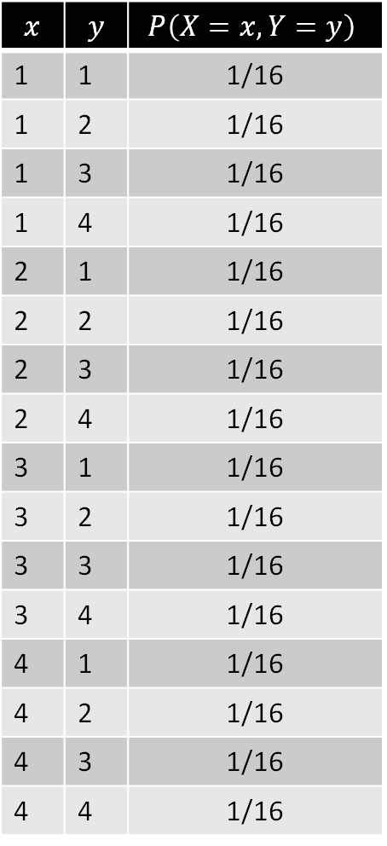
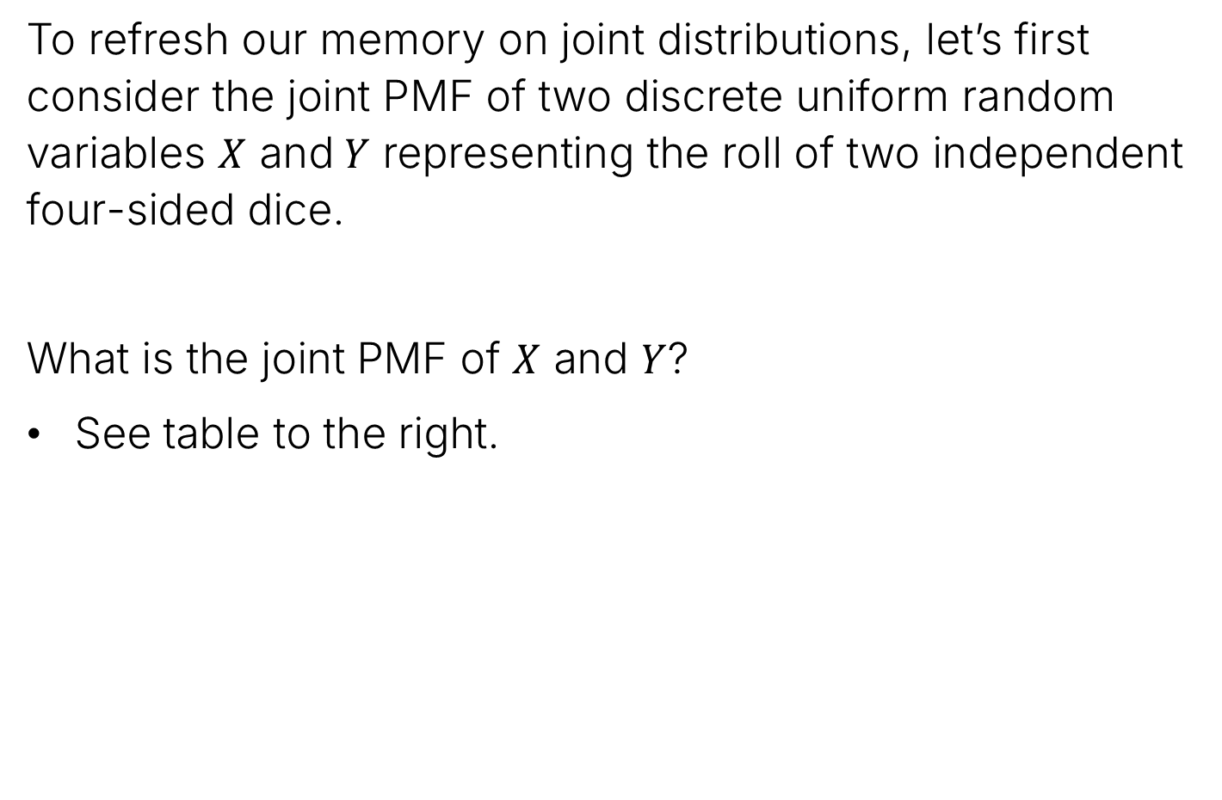
Review: Joint Distributions (Discrete)
To refresh our memory on joint distributions, let’s first consider the joint PMF of two discrete uniform random variables $X$ and$Y$ representing the roll of two independent four-sided dice.
What is the joint PMF of $X$ and $Y$?
See table to the right.
$$x$$ | $$y$$ | $$P\left(X=x,Y=y\right)$$
1 | 1 | 1/16
1 | 2 | 1/16
1 | 3 | 1/16
1 | 4 | 1/16
2 | 1 | 1/16
2 | 2 | 1/16
2 | 3 | 1/16
2 | 4 | 1/16
3 | 1 | 1/16
3 | 2 | 1/16
3 | 3 | 1/16
3 | 4 | 1/16
4 | 1 | 1/16
4 | 2 | 1/16
4 | 3 | 1/16
4 | 4 | 1/16

Slide 5
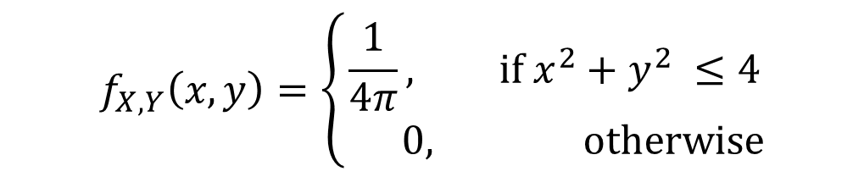

Review: Joint PDF of a Uniform Random Variables
Let’s next consider the joint PDF of two uniform random variables $X$ and$Y$ representing throwing a dart at a target. The random variables represent the $x$ and $y$ coordinates.
As we saw last time, the joint PDF of $X$ and $Y$ is:
$$f_{X,Y}\left(x,y\right)=\left\{\begin{aligned}\frac{1}{4π}, if x^{2}+y^{2} ≤4 \\ 0, otherwise\end{aligned}\right.$$
2 foot radius

Slide 6

Independent Random Variables
We saw $X$ and $Y$ are independent continuous random variables if for all $a<b$ and $c<d$.
$$P\left(a≤X≤b, c≤Y≤d\right)=P\left(a≤X≤b\right)⋅P\left(c≤Y≤d\right)$$
Or equivalently: If $f_{X, Y}\left(x,y\right)=f_{X}\left(x\right)⋅f_{Y}\left(y\right)$ for all $x, y$

Slide 7
The Gaussian Random Variable
Lecture 25, CS70 Summer 2025

Slide 8
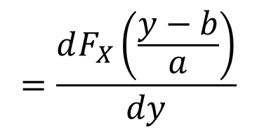

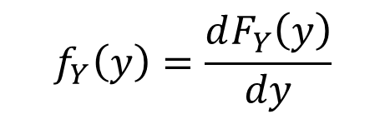
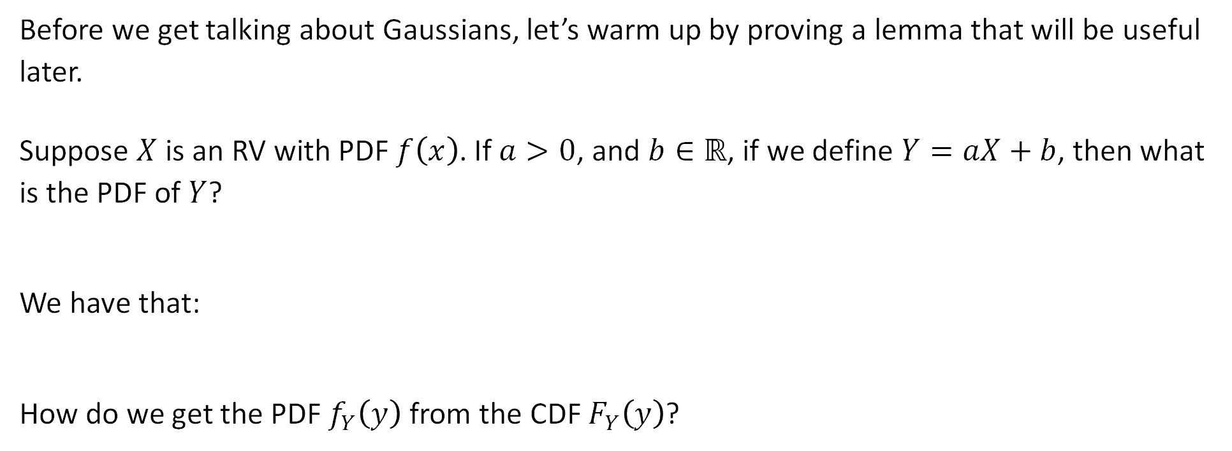
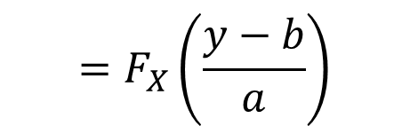
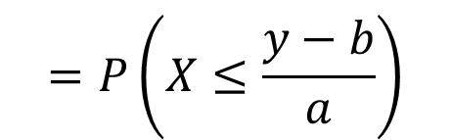
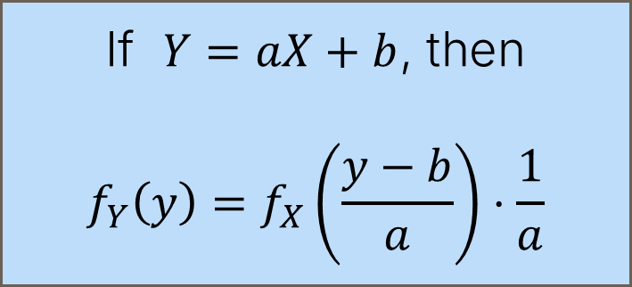

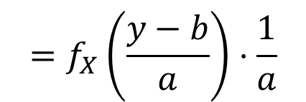
Warmup Exercise / Detour: Prove this Lemma
Before we get talking about Gaussians, let’s warm up by proving a lemma that will be useful later.
Suppose $X$ is an RV with PDF $f\left(x\right)$. If $a>0$, and $b∈ℝ$, if we define $Y=aX+b$, then what is the PDF of $Y$?
We have that:
How do we get the PDF $f_{Y}\left(y\right)$ from the CDF $F_{Y}\left(y\right)$?
$$=P\left(X≤\frac{y−b}{a}\right)$$
$$=F_{X}\left(\frac{y−b}{a}\right)$$
$$F_{Y}\left(y\right)=P\left(Y≤y\right)$$
$$=P\left(aX+b≤y\right)$$
Differentiate!
If $Y=aX+b$, then
$$f_{Y}\left(y\right)=f_{X}\left(\frac{y−b}{a}\right)⋅\frac{1}{a}$$
$$=\frac{dF_{X}\left(\frac{y−b}{a}\right)}{dy}$$
$$f_{Y}\left(y\right)=\frac{dF_{Y}\left(y\right)}{dy}$$
$$=f_{X}\left(\frac{y−b}{a}\right)⋅\frac{1}{a}$$

Slide 9
The Gaussian Distribution
The Gaussian distribution is probably the most famous continuous distribution.
Arises naturally in many theoretical contexts.
Useful for modeling real world phenomena.
Has very convenient mathematical properties.

Slide 10
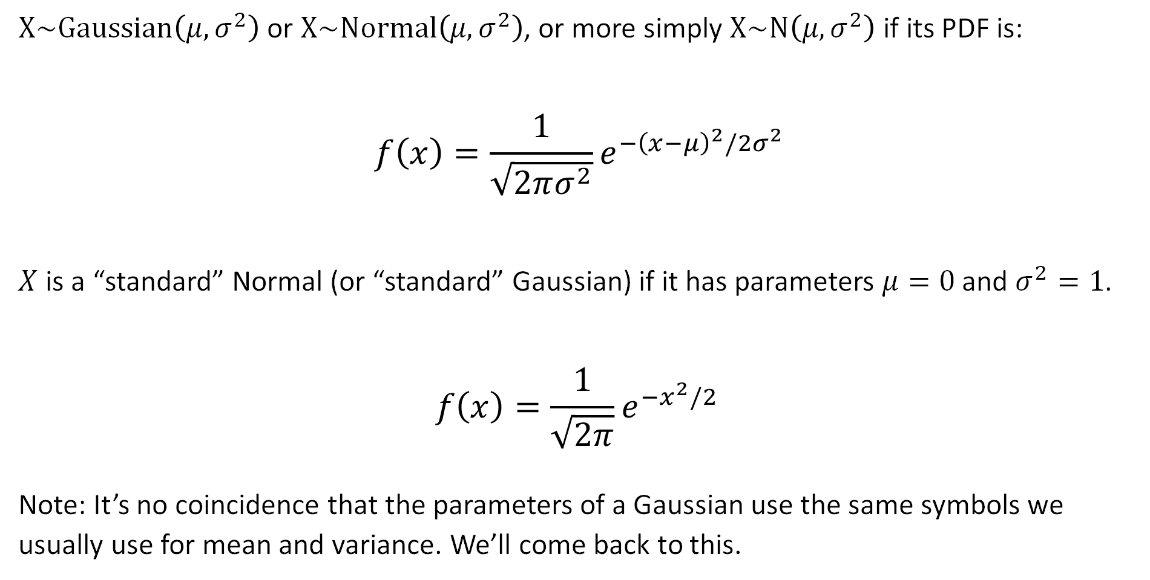
Normal (Gaussian) Distribution
$X\sim Gaussian\left(μ, σ^{2}\right)$ or $X\sim Normal\left(μ, σ^{2}\right)$, or more simply $X\sim N\left(μ, σ^{2}\right)$ if its PDF is:
$$f\left(x\right)=\frac{1}{\sqrt{2πσ^{2}}}e^{{−\left(x−μ\right)}^{2}/2σ^{2}}$$
$X$ is a “standard” Normal (or “standard” Gaussian) if it has parameters $μ=0$ and $σ^{2}=1$.
$$f\left(x\right)=\frac{1}{\sqrt{2π}}e^{{−x}^{2}/2 }$$
Note: It’s no coincidence that the parameters of a Gaussian use the same symbols we usually use for mean and variance. We’ll come back to this.

Slide 11
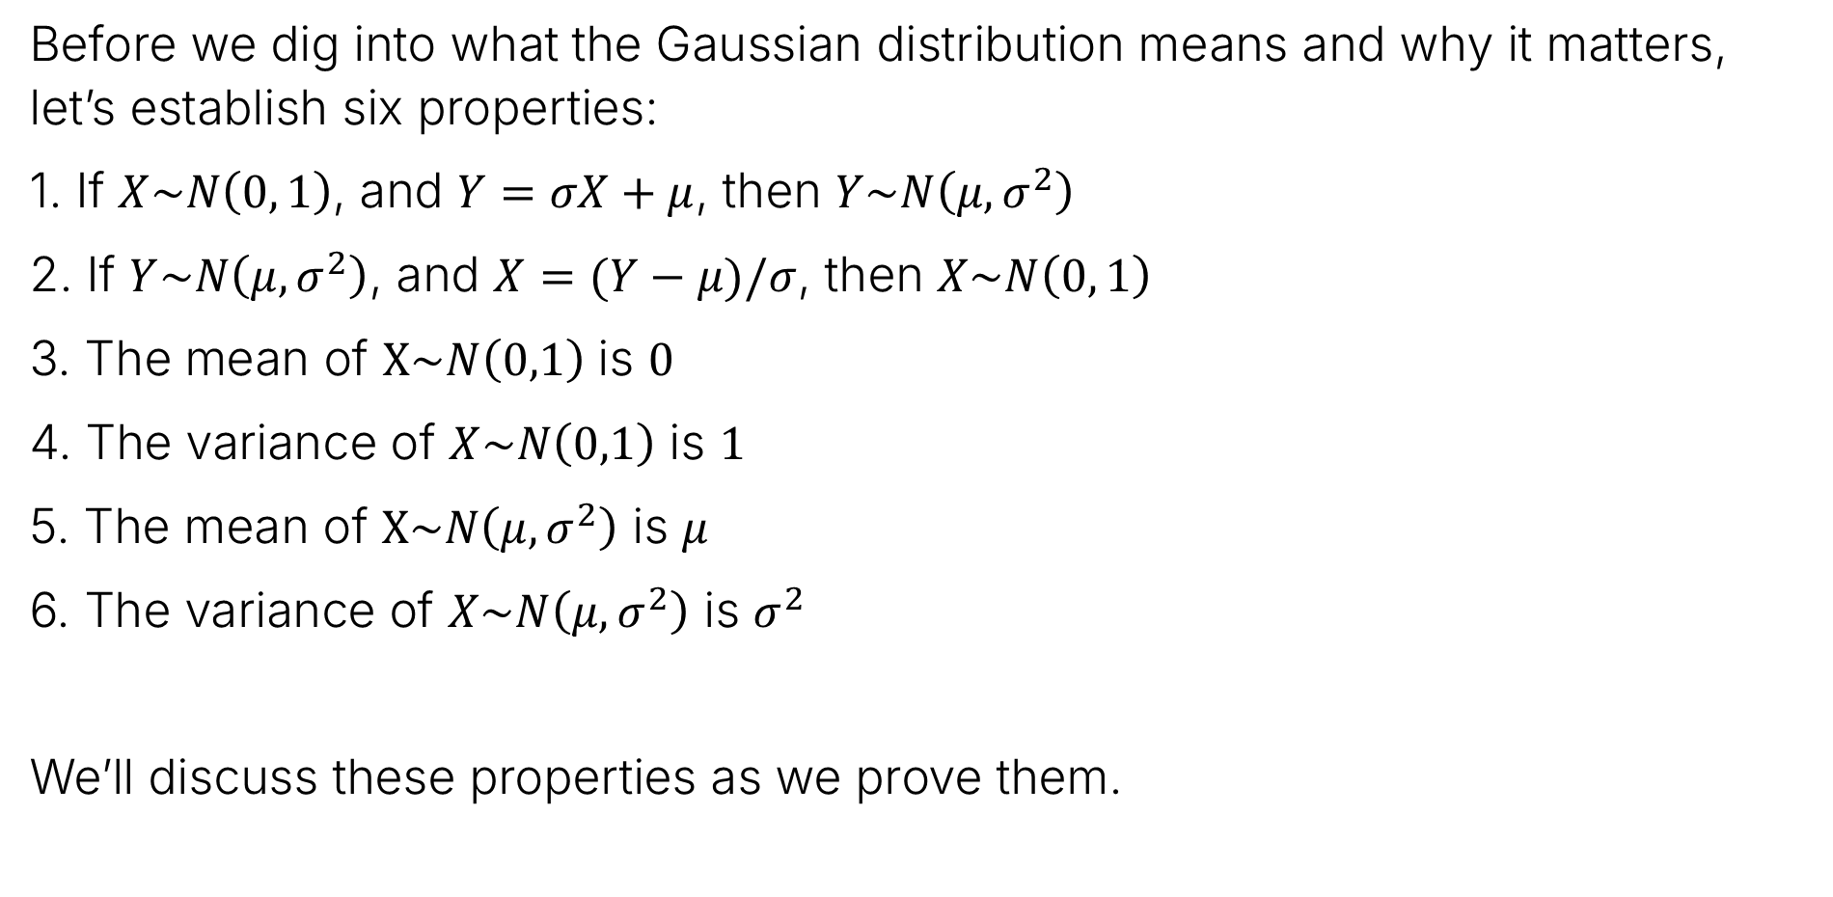
Gaussian
Before we dig into what the Gaussian distribution means and why it matters, let’s establish six properties:
1. If $X\sim N\left(0, 1\right)$, and $Y=σX+μ$, then $Y\sim N\left(μ, σ^{2}\right)$
2. If $Y\sim N\left(μ,σ^{2}\right)$, and $X=(Y−μ)/σ$, then $X\sim N\left(0, 1\right)$
3. The mean of $X\sim N\left(0,1\right)$ is $0$
4. The variance of $X\sim N\left(0,1\right)$ is $1$
5. The mean of $X\sim N\left(μ,σ^{2}\right)$ is $μ$
6. The variance of $X\sim N\left(μ,σ^{2}\right)$ is $σ^{2}$
We’ll discuss these properties as we prove them.

Slide 12
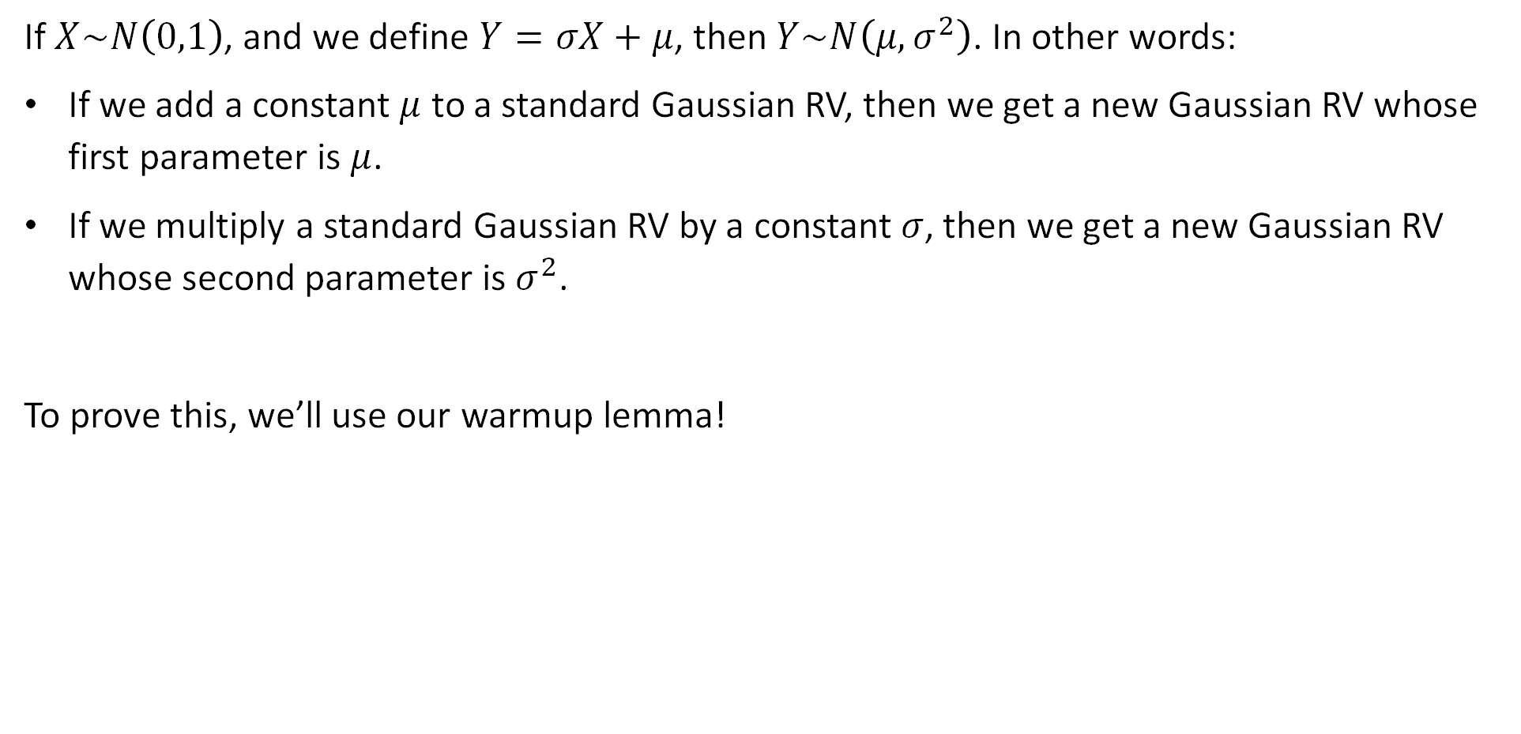
Property 1
If $X\sim N\left(0,1\right)$, and we define $Y=σX+μ$, then $Y\sim N\left(μ, σ^{2}\right)$. In other words:
If we add a constant $μ$ to a standard Gaussian RV, then we get a new Gaussian RV whose first parameter is $μ$.
If we multiply a standard Gaussian RV by a constant $σ$, then we get a new Gaussian RV whose second parameter is $σ^{2}$.
To prove this, we’ll use our warmup lemma!
Warmup Lemma
If $Y=aX+b$, then
$$f_{Y}\left(y\right)=f_{X}\left(\frac{y−b}{a}\right)⋅\frac{1}{a}$$

Slide 13
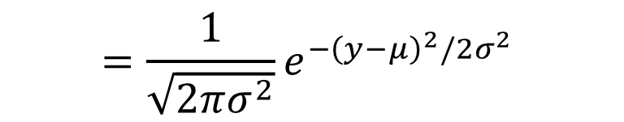


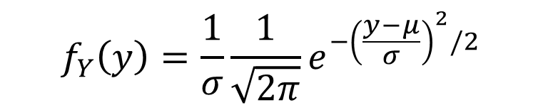
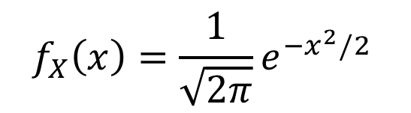
Property 1
If $X\sim N\left(0,1\right)$, and we define $Y=σX+μ$, then $Y\sim N\left(μ, σ^{2}\right)$
Proof: We have that
$$f_{X}\left(x\right)=\frac{1}{\sqrt{2π}}e^{−x^{2}/2 }$$
$$f_{Y}\left(y\right)=\frac{1}{σ}\frac{1}{\sqrt{2π}}e^{{−\left(\frac{y−μ}{σ}\right)}^{2}/2 }$$
$$=\frac{1}{\sqrt{2πσ^{2}}}e^{{−\left(y−μ\right)}^{2}/2σ^{2} }$$
Warmup Lemma
This is the PDF for $N\left(μ, σ^{2}\right)$
If $Y=aX+b$, then
$$f_{Y}\left(y\right)=f_{X}\left(\frac{y−b}{a}\right)⋅\frac{1}{a}$$

Slide 14


Property 2
We’ve shown that if $X\sim N\left(0,1\right)$, and define $Y=σX+μ$, then $Y\sim N\left(μ, σ^{2}\right)$.
Naturally, if $Y\sim N\left(μ,σ^{2}\right)$, we can do the reverse transformation to recover the original $X$. That is, if $Y\sim N\left(μ, σ^{2}\right)$, then:
$$X=\frac{Y−μ}{σ}\sim N(0, 1)$$

Slide 15

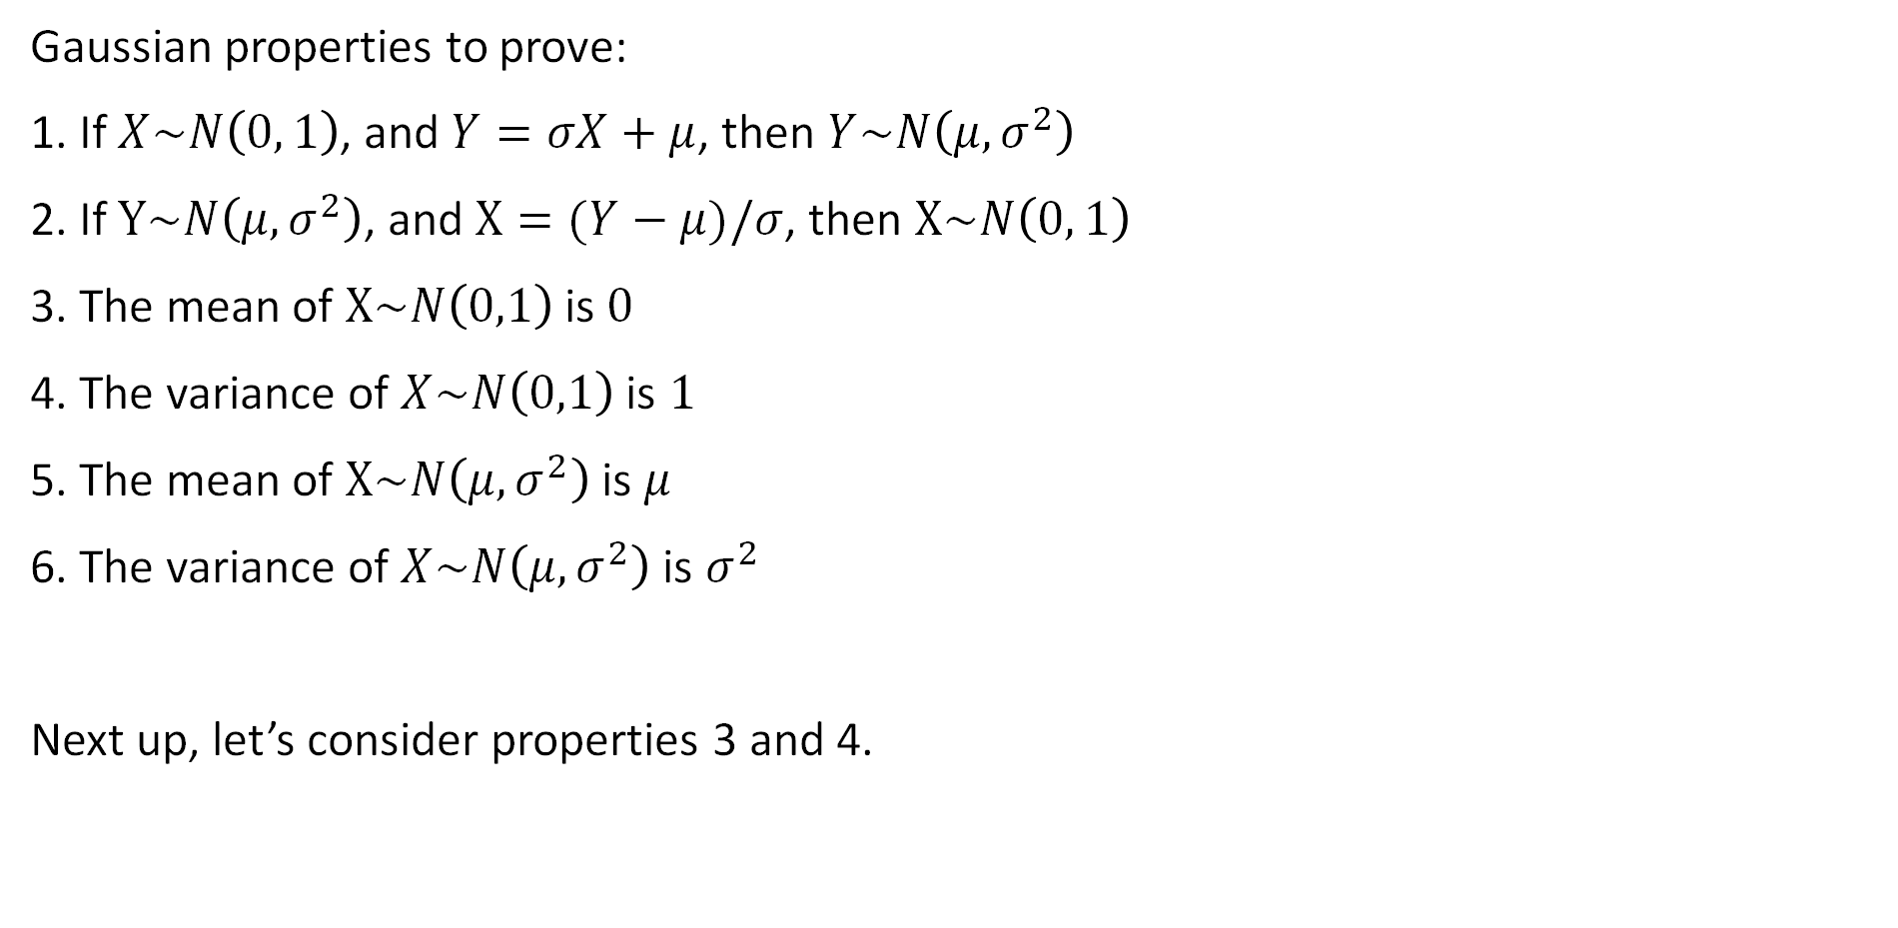
Gaussian
Gaussian properties to prove:
1. If $X\sim N\left(0, 1\right)$, and $Y=σX+μ$, then $Y\sim N\left(μ, σ^{2}\right)$
2. If $Y\sim N\left(μ,σ^{2}\right)$, and $X=(Y−μ)/σ$, then $X\sim N\left(0, 1\right)$
3. The mean of $X\sim N\left(0,1\right)$ is $0$
4. The variance of $X\sim N\left(0,1\right)$ is $1$
5. The mean of $X\sim N\left(μ,σ^{2}\right)$ is $μ$
6. The variance of $X\sim N\left(μ,σ^{2}\right)$ is $σ^{2}$
Next up, let’s consider properties 3 and 4.

Slide 16
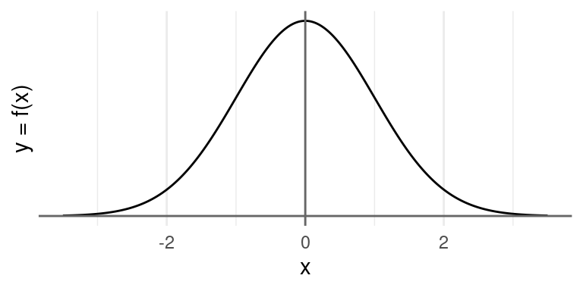
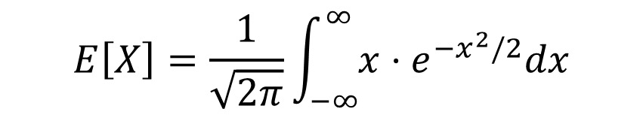
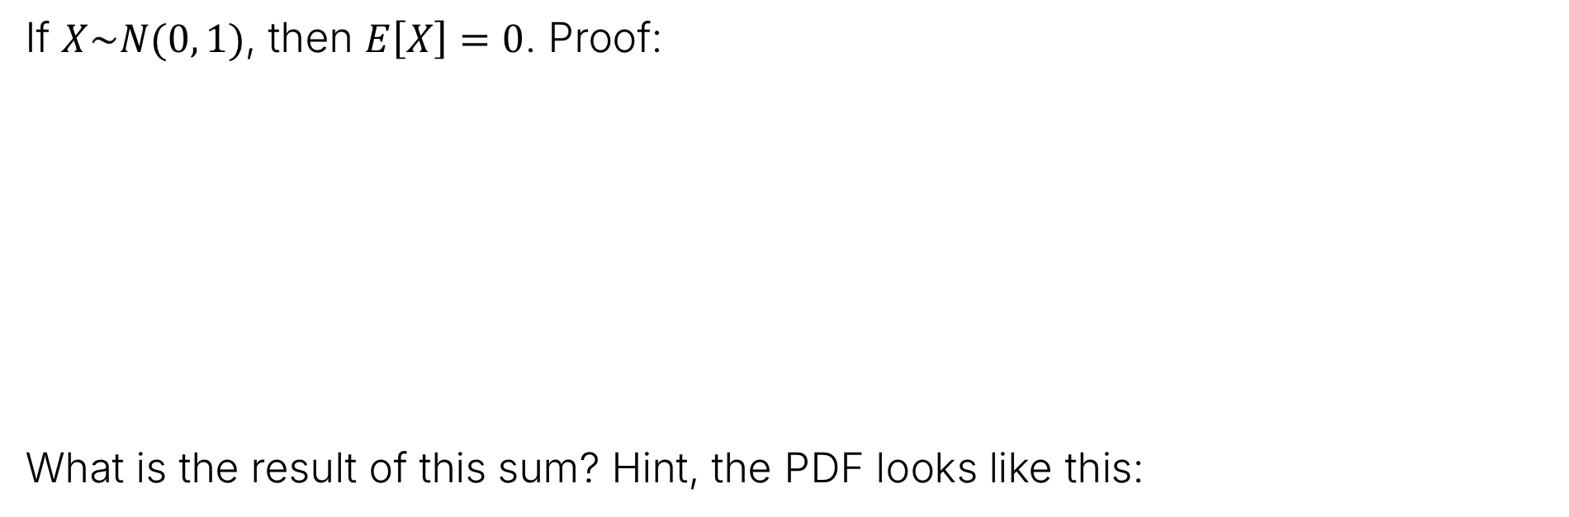
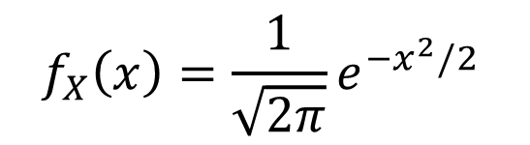

Expectation of a Standard Gaussian Random Variable
$$f_{X}\left(x\right)=\frac{1}{\sqrt{2π}}e^{{−x}^{2}/2 }$$
If $X\sim N(0, 1)$, then $E\left[X\right]=0$. Proof:
What is the result of this sum? Hint, the PDF looks like this:
$$E\left[X\right]=\frac{1}{\sqrt{2π}}\int_{−∞}^{∞}{x⋅e^{−x^{2}/2}dx}$$
$$=\frac{1}{\sqrt{2π}}\int_{−∞}^{0}{x⋅e^{−x^{2}/2}dx}+\frac{1}{\sqrt{2π}}\int_{0}^{∞}{x⋅e^{−x^{2}/2}dx}$$

Slide 17
Expectation of a Standard Gaussian Random Variable
$$f_{X}\left(x\right)=\frac{1}{\sqrt{2π}}e^{{−x}^{2}/2 }$$
If $X\sim N(0, 1)$, then $E\left[X\right]=0$. Proof:
$$E\left[X\right]=\frac{1}{\sqrt{2π}}\int_{−∞}^{∞}{x⋅e^{−x^{2}/2}dx}$$
Cancel out exactly!
$$=\frac{1}{\sqrt{2π}}\int_{−∞}^{0}{x⋅e^{−x^{2}/2}dx}+\frac{1}{\sqrt{2π}}\int_{0}^{∞}{x⋅e^{−x^{2}/2}dx}$$
$$=0$$
Another view: The expected value of any distribution symmetric around zero is zero. The PDF of a standard Gaussian looks like this:
Figure from Stat 20

Slide 18
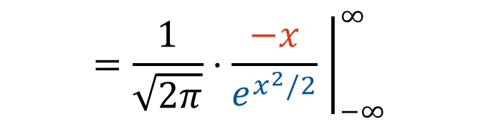
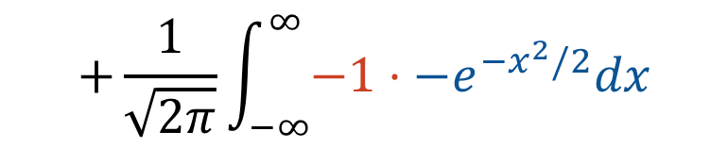
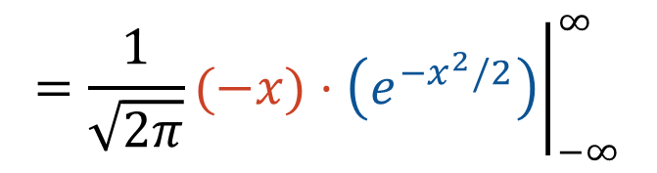
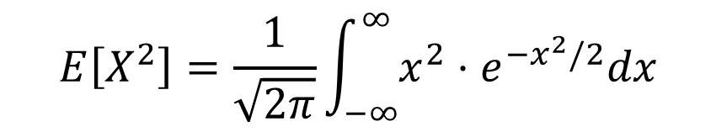

Variance of a Standard Gaussian Random Variable
$$f_{X}\left(x\right)=\frac{1}{\sqrt{2π}}e^{−x^{2}/2 }$$
If $X\sim N(0, 1)$, then $var\left(X\right)=E\left[X^{2}\right]=1$. Proof:
$var\left(X\right)=E\left[X^{2}\right]−E{\left[X\right]}^{2}$, and we already know $E{\left[X\right]}^{2}=0$
$$E\left[X^{2}\right]=\frac{1}{\sqrt{2π}}\int_{−∞}^{∞}{x^{2}⋅e^{−x^{2}/2}dx}$$
Integrate by parts where $u\left(x\right)=−x$ and $v^{′}\left(x\right)=−xe^{−x^{2}/2}$
$${\left.=\frac{1}{\sqrt{2π}}(−x)⋅\left(e^{−x^{2}/2}\right)\right|}_{−∞}^{∞}$$
$$+\frac{1}{\sqrt{2π}}\int_{−∞}^{∞}{−1⋅−e^{−x^{2}/2}dx}$$
$${\left.=\frac{1}{\sqrt{2π}}⋅\frac{−x}{e^{x^{2}/2}} \right|}_{−∞}^{∞}$$
$$+\int_{−∞}^{∞}{f\left(x\right) dx}$$

Slide 19

Variance of a Standard Gaussian Random Variable
$$f_{X}\left(x\right)=\frac{1}{\sqrt{2π}}e^{−x^{2}/2 }$$
If $X\sim Gaussian(0, 1)$, then $var\left(X\right)=E\left[X^{2}\right]=1$. Proof:
$var\left(X\right)=E\left[X^{2}\right]−E{\left[X\right]}^{2}$, and we already know $E{\left[X\right]}^{2}=0$
$$E\left[X^{2}\right]=\frac{1}{\sqrt{2π}}\int_{−∞}^{∞}{x^{2}⋅e^{−x^{2}/2}dx}$$
Integrate by parts where $u\left(x\right)=−x$ and $v^{′}\left(x\right)=−xe^{−x^{2}/2}$
$${\left.=\frac{1}{\sqrt{2π}}(−x)⋅\left(e^{−x^{2}/2}\right)\right|}_{−∞}^{∞}$$
$$+\frac{1}{\sqrt{2π}}\int_{−∞}^{∞}{−1⋅−e^{−x^{2}/2}dx}$$
$${\left.=\frac{1}{\sqrt{2π}}⋅\frac{−x}{e^{x^{2}/2}} \right|}_{−∞}^{∞}$$
$$+\int_{−∞}^{∞}{f\left(x\right) dx}$$
$$=0+1$$
This is just the PDF of a Gaussian, which must integrate to 1.
Intuition or L'Hôpital

Slide 20
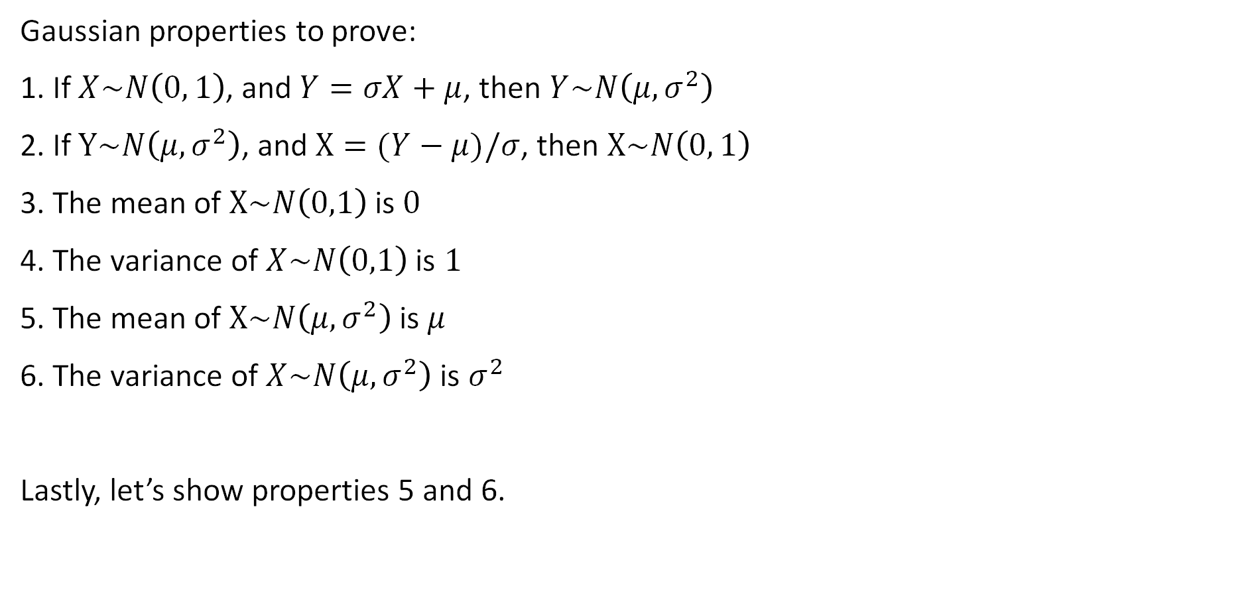
Gaussian
Gaussian properties to prove:
1. If $X\sim N\left(0, 1\right)$, and $Y=σX+μ$, then $Y\sim N\left(μ, σ^{2}\right)$
2. If $Y\sim N\left(μ,σ^{2}\right)$, and $X=(Y−μ)/σ$, then $X\sim N\left(0, 1\right)$
3. The mean of $X\sim N\left(0,1\right)$ is $0$
4. The variance of $X\sim N\left(0,1\right)$ is $1$
5. The mean of $X\sim N\left(μ,σ^{2}\right)$ is $μ$
6. The variance of $X\sim N\left(μ,σ^{2}\right)$ is $σ^{2}$
Lastly, let’s show properties 5 and 6.

Slide 21



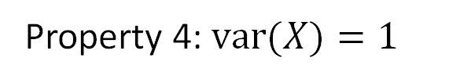
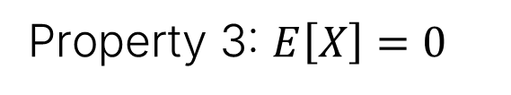
Proof of Properties 5 and 6
Suppose $X\sim N\left(0, 1\right)$, and $Y=σX+μ$.
That means that $E\left[Y\right]=E\left[σX+μ\right]=σE\left[X\right]+μ$
And $var\left(Y\right)=var\left(σX+μ\right)=σ^{2}var\left(X\right)$
$$=0+μ=μ$$
Property 3: $E\left[X\right]=0$
$$=σ^{2}$$
Property 4: $var(X)=1$

Slide 22

Gaussian
Gaussian properties to prove:
1. If $X\sim N\left(0, 1\right)$, and $Y=σX+μ$, then $Y\sim N\left(μ, σ^{2}\right)$
2. If $Y\sim N\left(μ,σ^{2}\right)$, and $X=(Y−μ)/σ$, then $X\sim N\left(0, 1\right)$
3. The mean of $X\sim N\left(0,1\right)$ is $0$
4. The variance of $X\sim N\left(0,1\right)$ is $1$
5. The mean of $X\sim N\left(μ,σ^{2}\right)$ is $μ$
6. The variance of $X\sim N\left(μ,σ^{2}\right)$ is $σ^{2}$

Slide 23
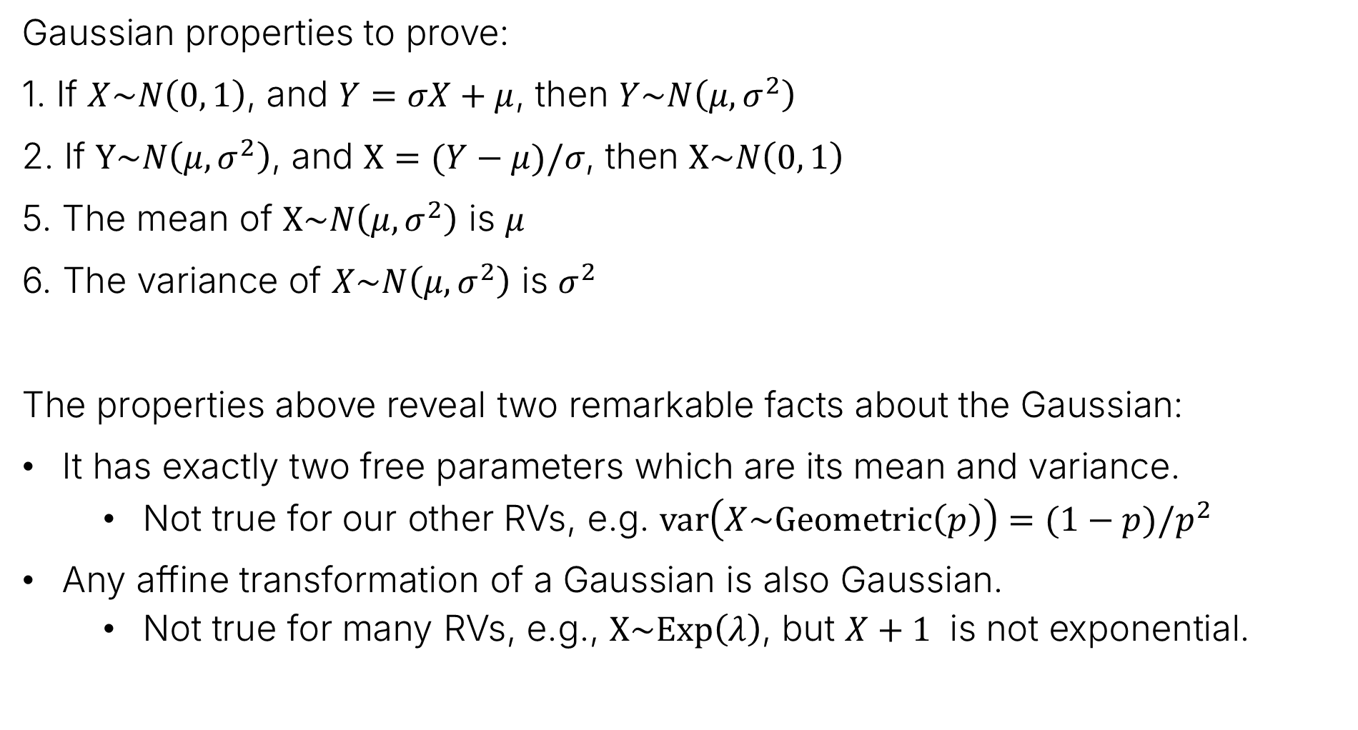
Reflection on Gaussian Properties
Gaussian properties to prove:
1. If $X\sim N\left(0, 1\right)$, and $Y=σX+μ$, then $Y\sim N\left(μ, σ^{2}\right)$
2. If $Y\sim N\left(μ,σ^{2}\right)$, and $X=(Y−μ)/σ$, then $X\sim N\left(0, 1\right)$
5. The mean of $X\sim N\left(μ,σ^{2}\right)$ is $μ$
6. The variance of $X\sim N\left(μ,σ^{2}\right)$ is $σ^{2}$
The properties above reveal two remarkable facts about the Gaussian:
It has exactly two free parameters which are its mean and variance.
  Not true for our other RVs, e.g. $var\left(X\sim Geometric\left(p\right)\right)=(1−p)/p^{2}$
Any affine transformation of a Gaussian is also Gaussian.
  Not true for many RVs, e.g., $X\sim Exp\left(λ\right)$, but $X+1$ is not exponential.

Slide 24
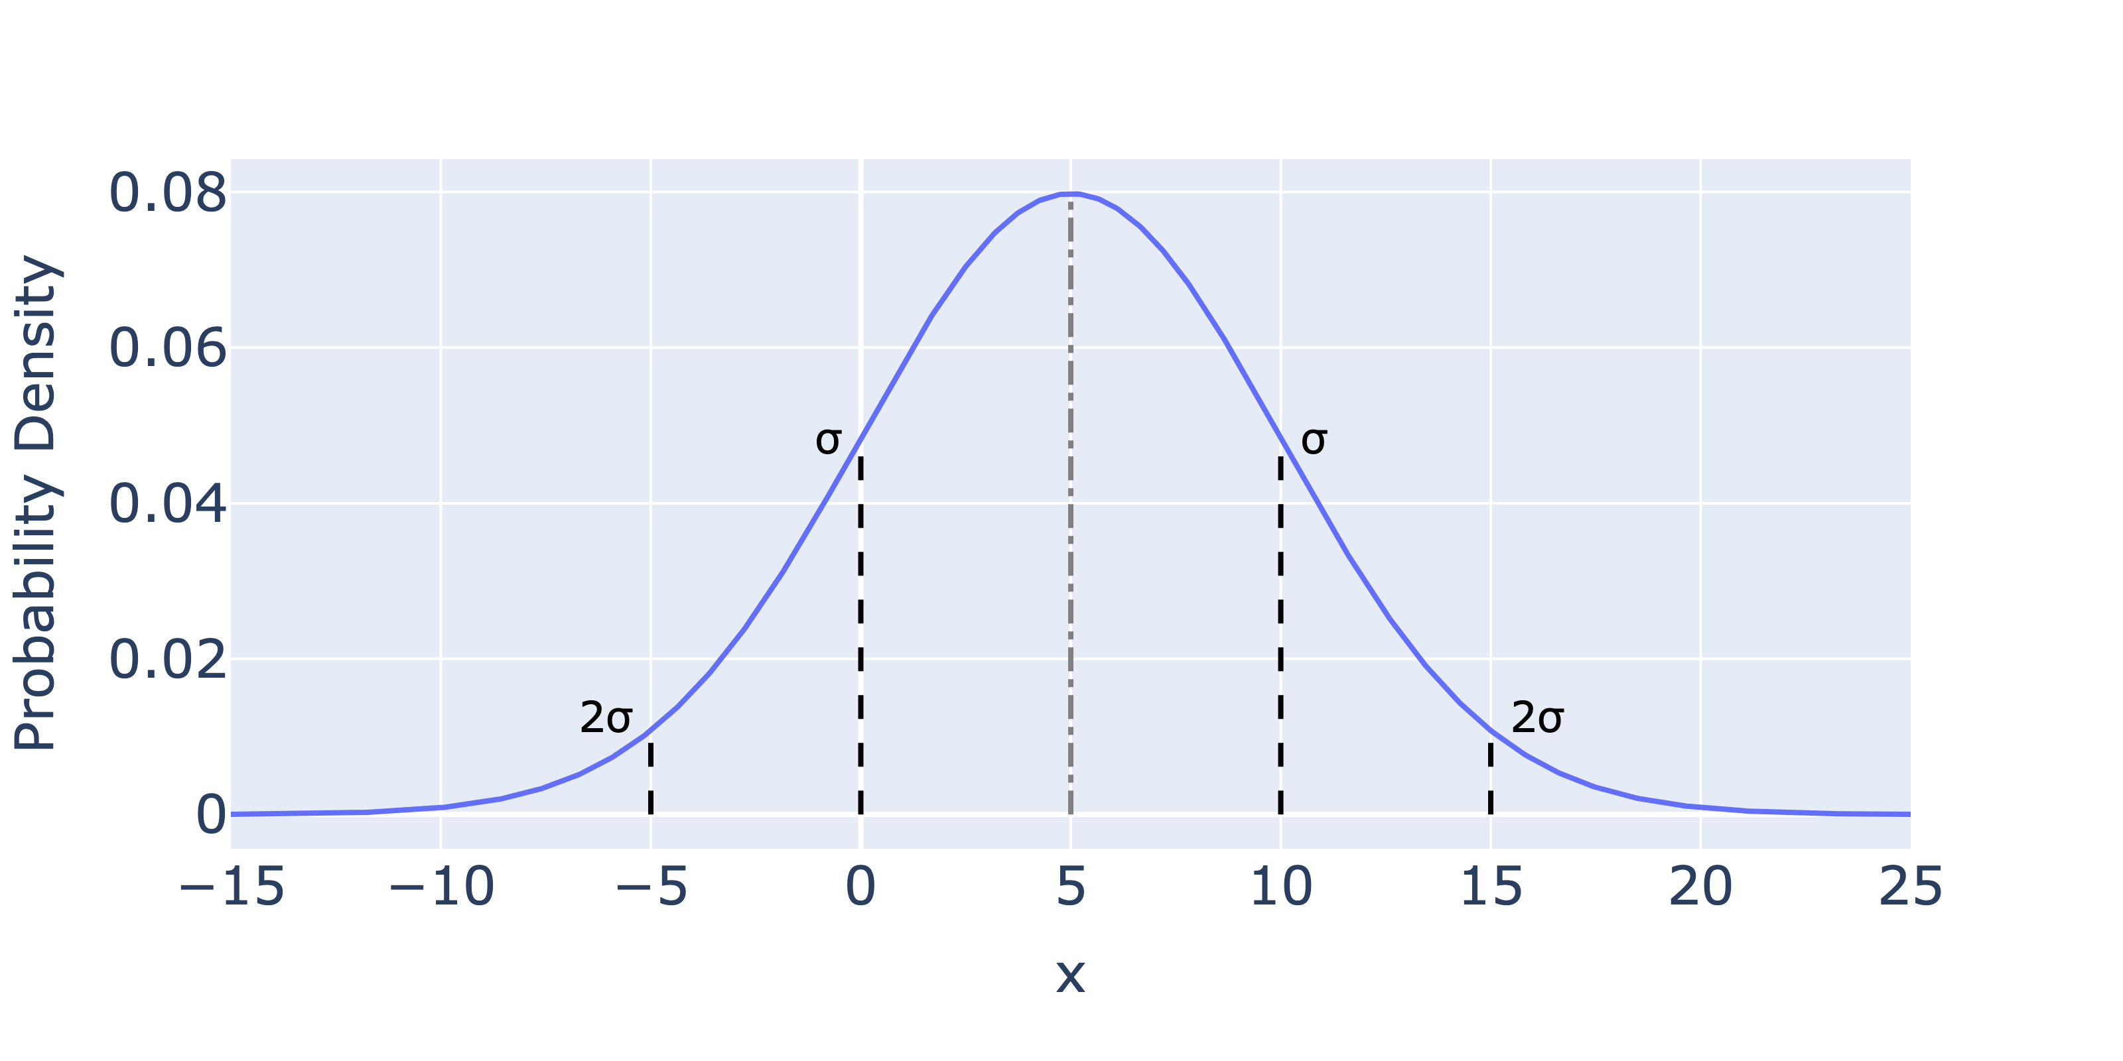

The Gaussian PDF Visually
If we have a random variable $X\sim N(5, 25)$, we have the PDF below:

Slide 25




Computing the Probability of an Event
If we have a random variable $X\sim N(5, 25)$, what is $P(X≤0)$?
$$\int_{−∞}^{0}{\frac{1}{\sqrt{50π}}e^{{\left(x−5\right)}^{2}/50}}$$
$$≈$$
$$0.1587$$

Slide 26
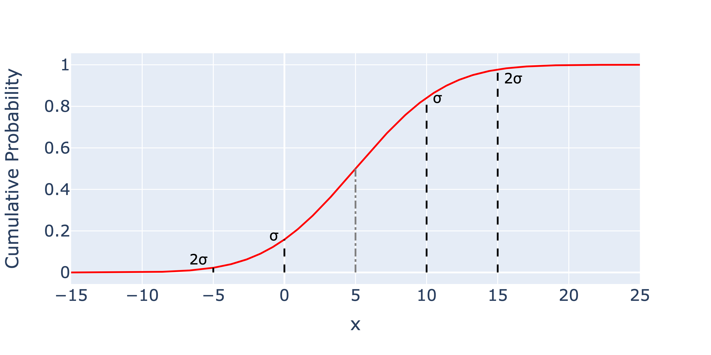

The CDF of a Gaussian
The CDF of $X\sim N(5, 25)$ is given below.
$P\left(X≤0\right)≈0.1587$
Note: There is no closed-form expression for the CDF.

Slide 27

The CDF of a Gaussian
Or symbolically we can write
$P\left(X≤0\right)=F_{X}\left(μ−σ\right)≈0.1587$
Other quantities: $F_{X}\left(μ\right)=0.5$, $F_{X}\left(μ+2σ\right)≈0.977$

Slide 28
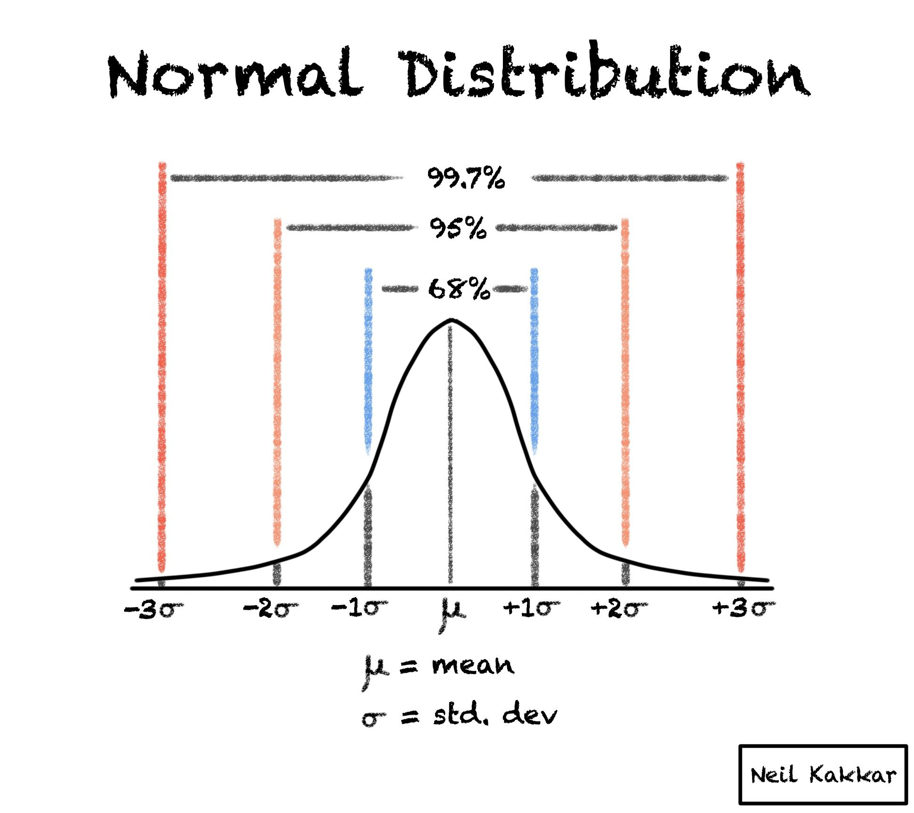
The 68–95–99.7 rule
The 68-95-99.7 rule tells us that for a normally distributed random variable:
~68% of the mass is within one standard deviation.
95% of the mass is within two standard deviations.
99.7% of the mass is within three standard deviations.
The “Z-score” is the number of standard deviations you are from the mean.
Link to blog

Slide 29
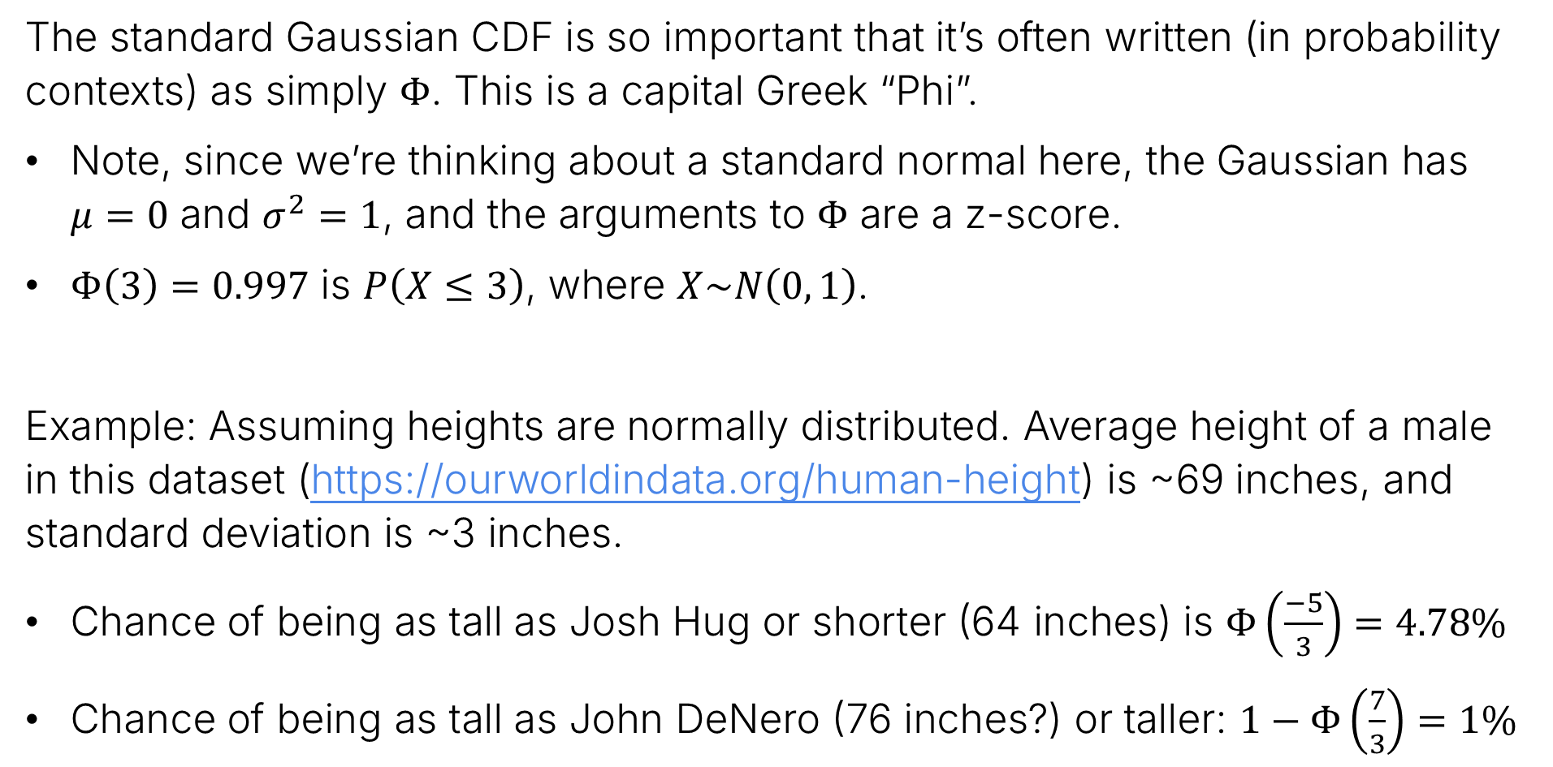
The Gaussian CDF $Φ$
The standard Gaussian CDF is so important that it’s often written (in probability contexts) as simply $Φ$. This is a capital Greek “Phi”.
Note, since we’re thinking about a standard normal here, the Gaussian has $μ=0$ and $σ^{2}=1$, and the arguments to $Φ$ are a z-score.
$Φ\left(3\right)=0.997$ is $P\left(X≤3\right)$, where $X\sim N\left(0, 1\right)$.
Example: Assuming heights are normally distributed. Average height of a male in this dataset (https://ourworldindata.org/human-height) is ~69 inches, and standard deviation is ~3 inches.
Chance of being as tall as Josh Hug or shorter (64 inches) is $Φ\left(\frac{−5}{3}\right)=4.78\%$
Chance of being as tall as John DeNero (76 inches?) or taller: $1−Φ\left(\frac{7}{3}\right)=1\%$

Slide 30
Summing Gaussians
Lecture 25, CS70 Summer 2025

Slide 31
The Sum of Independent Gaussians is Gaussian
Another remarkable property of the Gaussian distribution is that the sum of two independent Gaussians is always also Gaussian.
Before we get there, which of the following distributions have this property?
Bernoulli
Binomial
Uniform
This is a tricky question!

Slide 32
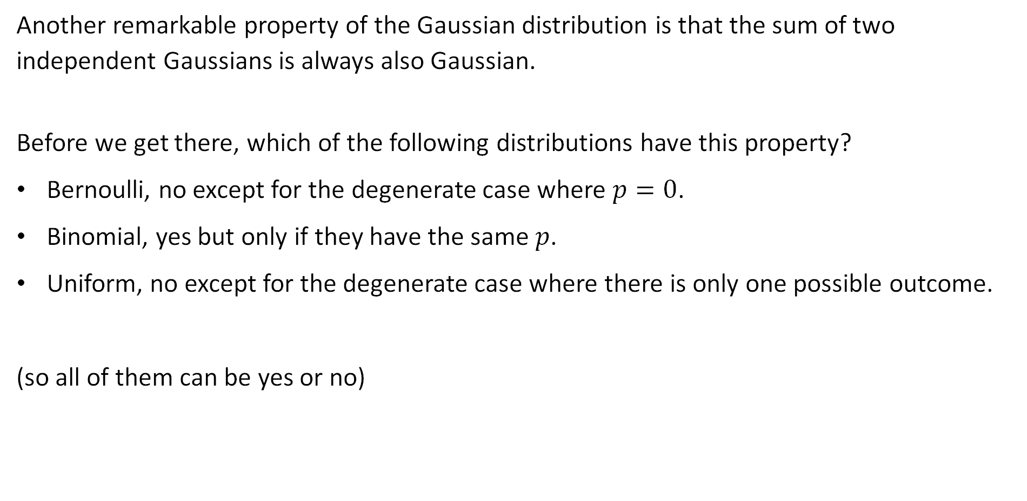
The Sum of Independent Gaussians is Gaussian
Another remarkable property of the Gaussian distribution is that the sum of two independent Gaussians is always also Gaussian.
Before we get there, which of the following distributions have this property?
Bernoulli, no except for the degenerate case where $p=0$.
Binomial, yes but only if they have the same $p$.
Uniform, no except for the degenerate case where there is only one possible outcome.
(so all of them can be yes or no)

Slide 33
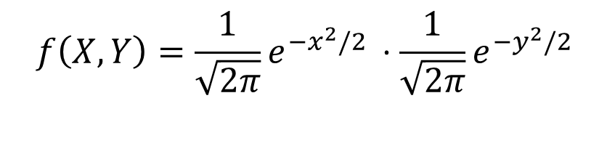


Detour: Joint Distribution of Two Independent Standard Normals
Earlier, we saw that if $X$ and $Y$ are independent, then $f\left(X, Y\right)=f\left(x\right)⋅f\left(y\right)$.
Thus, the joint distribution of two standard normal (a.k.a. Gaussian) RVs is:
$$f\left(X,Y\right)=\frac{1}{\sqrt{2π}}e^{{−x}^{2}/2 }⋅\frac{1}{\sqrt{2π}}e^{{−y}^{2}/2 }$$
$$=\frac{1}{2π}e^{{−(x}^{2}+y^{2})/2 }$$

Slide 34
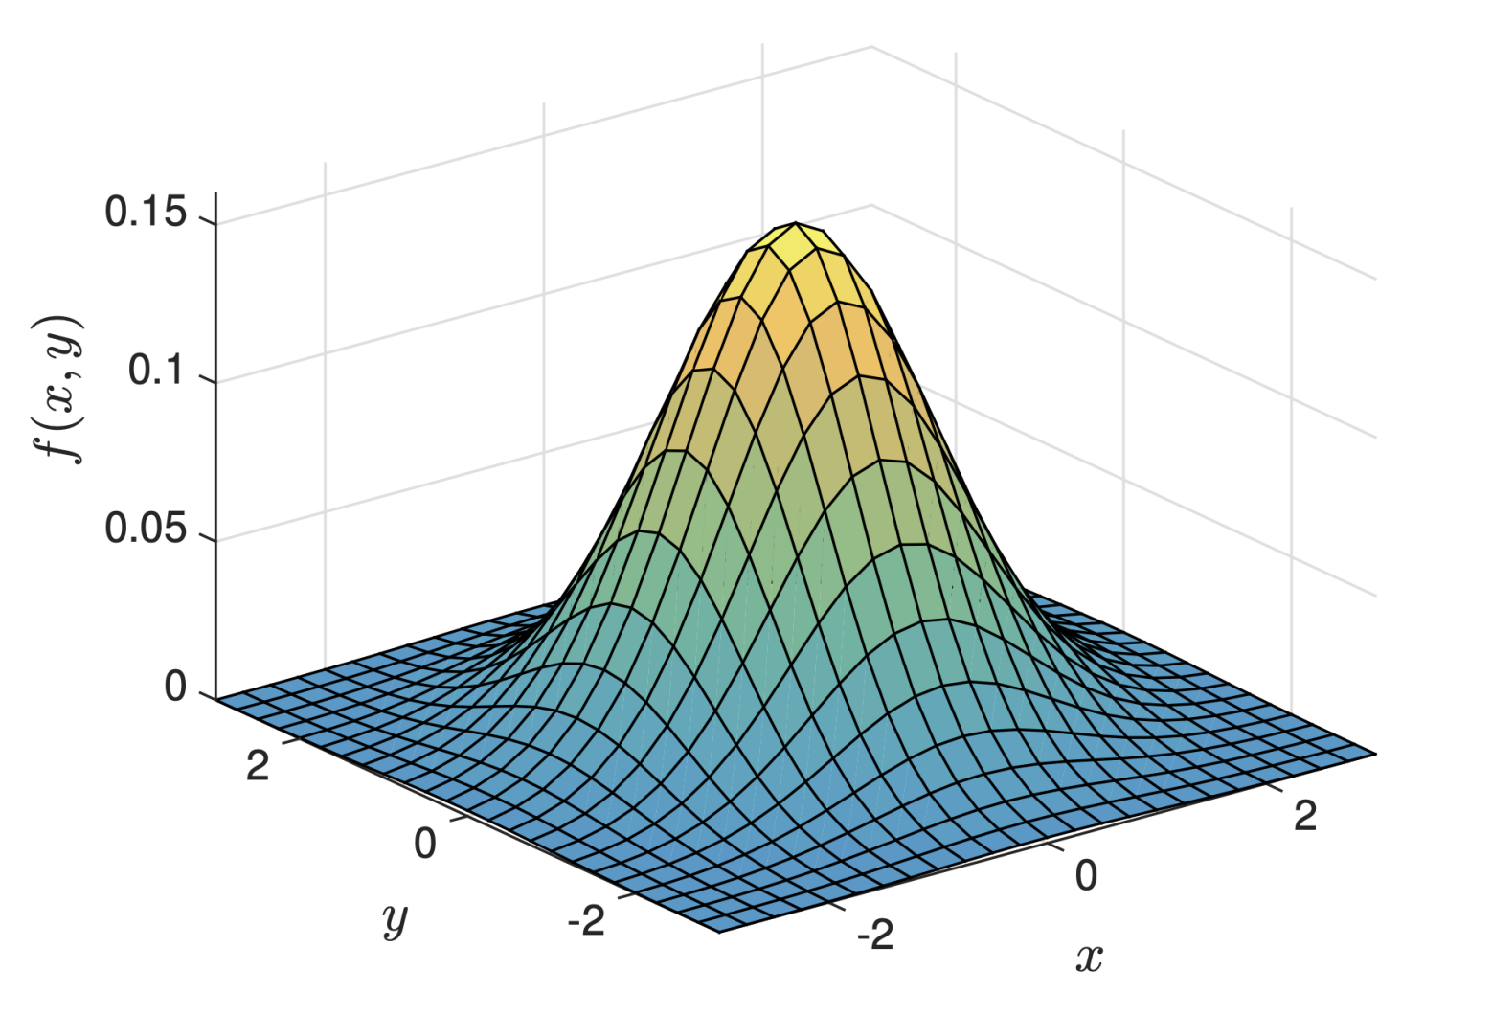
Detour: Visualizing the Joint Distribution of Two Independent Standard Normals
Below we see a plot of the joint PDF (from the notes*).
Interactive version: https://joshh.ug/cs70/joint_gaussian_pdf.html
*: Figure ultimately comes from “Why Is the Sum of Independent Normal Random Variables Normal” by by B. Eisenberg and R. Sullivan, Mathematics Magazine, Vol. 81, No. 5.

Slide 35



Rotational Symmetry of Joint Normals
To prove the sum of two independent standard gaussians is also gaussian, we’ll rely on the rotational symmetry of the joint distribution of two normals.
By rotational symmetry, we mean the probability depends only on the radius, not on the angle. Example: The two events $A$ and $B$ below have the same probability.
$$A$$
$$B$$

Slide 36
Rotational Symmetry of Joint Normals
To prove the sum of two independent standard gaussians is also gaussian, we’ll rely on the rotational symmetry of the joint distribution of two normals.
By rotational symmetry, we mean the probability depends only on the radius, not on the angle. Example: The two events $A$ and $B$ below have the same probability.
$$A$$
$$B$$

Slide 37


Rotational Symmetry of Joint Normals
To prove the sum of two independent standard gaussians is also gaussian, we’ll rely on the rotational symmetry of the joint distribution of two normals.
By rotational symmetry, we mean the probability depends only on the radius, not on the angle. Example: The two events $A$ and $B$ below have the same probability.
$$A$$
$$B$$

Slide 38



Rotational Symmetry of Joint Normals
To prove the sum of two independent standard gaussians is also gaussian, we’ll rely on the rotational symmetry of the joint distribution of two normals.
By rotational symmetry, we mean the probability depends only on the radius, not on the angle. Example: The two events $A$ and $B$ below have the same probability.
$$A$$
$$(z/2, z/2)$$
$$B$$
$$(?, 0)$$

Slide 39



Rotational Symmetry of Joint Normals
To prove the sum of two independent standard gaussians is also gaussian, we’ll rely on the rotational symmetry of the joint distribution of two normals.
By rotational symmetry, we mean the probability depends only on the radius, not on the angle. Example: The two events $A$ and $B$ below have the same probability.
$$A$$
$$d=\sqrt{\frac{z^{2}}{4}+\frac{z^{2}}{4}}=\sqrt{\frac{z^{2}}{2}}=\frac{z}{\sqrt{2}}$$
$$d$$
$$d$$
$$(z/2, z/2)$$
$$B$$
$$(z/\sqrt{2}, 0)$$

Slide 40




Proof: Sum of Two Independent Standard Gaussians is Gaussian
Theorem: If $X\sim N\left(0,1\right)$ and $Y\sim N\left(0, 1\right)$ are independent, then $Z=X+Y\sim N\left(0, 2\right)$
Let $Z=X+Y$, then
$$P\left(Z≤z\right)=P(X+Y≤z)$$
$$=P(\left(X,Y\right)∈A)$$
$$x+y≤z$$
$$A$$
$$(z/2, z/2)$$

Slide 41








Proof: Sum of Two Independent Standard Gaussians is Gaussian
Theorem: If $X\sim N\left(0,1\right)$ and $Y\sim N\left(0, 1\right)$ are independent, then $Z=X+Y\sim N\left(0, 2\right)$
Let $Z=X+Y$, then
$$P\left(Z≤z\right)=P(X+Y≤z)$$
$$=P(\left(X,Y\right)∈A)$$
$$=P(\left(X,Y\right)∈B)$$
$$=P\left(X≤\frac{z}{\sqrt{2}}\right)$$
$$x+y≤z$$
$$=P\left(\sqrt{2}X≤z\right)$$
$$⇒$$
$$Z=\sqrt{2}X$$
$$A$$
$$(z/2, z/2)$$
$$Z\sim N(0,2)$$
$$B$$
$$(z/\sqrt{2}, 0)$$
Note: If this seems confusing, maybe consider a specific $z$, e.g., $P\left(Z≤3\right)=P\left(X≤3/\sqrt{2}\right)$. Then consider how this also works for any choice of $z$.

Slide 42










Proof: Sum of Two Scaled Independent Standard Gaussians is Gaussian
Theorem: If $X\sim N\left(0,1\right)$ and $Y\sim N\left(0, 1\right)$ are independent, $Z=aX+bY\sim N\left(0, a^{2}+b^{2}\right)$
Let $Z=X+Y$, then
$$P\left(Z≤z\right)=P(X+Y≤z)$$
$$=P(\left(X,Y\right)∈A)$$
$$=P(\left(X,Y\right)∈B)$$
$$=P\left(X≤\frac{z}{\sqrt{a^{2}+b^{2}}}\right)$$
$$ax+by≤z$$
$$=P\left(\sqrt{a^{2}+b^{2}}X≤z\right)$$
$$d=\frac{z}{\sqrt{a^{2}+b^{2}}}$$
$$⇒$$
$$Z=\sqrt{a^{2}+b^{2}}X$$
$$d$$
$$B$$
$$Z\sim N(0,a^{2}+b^{2})$$
$$(z/\sqrt{a^{2}+b^{2}}, 0)$$
$$A$$

Slide 43

Proof: Sum of Two Scaled Independent Standard Gaussians is Gaussian
Theorem: If $X\sim N\left(0,1\right)$ and $Y\sim N\left(0, 1\right)$ are independent, $Z=aX+bY\sim N\left(0, a^{2}+b^{2}\right)$
Great! The sum of two zero mean gaussians with variance $a^{2}$ and $b^{2}$ is easy to understand.
It is also Gaussian.
Its variance is just the sum of the variances, i.e., $a^{2}+b^{2}$.
What if it’s not zero mean?
This is straightforward (next slide).

Slide 44




Proof: Sum of Independent Gaussians is Gaussian (general case)
Corollary: If we have independent Gaussian random variables $X_{1}\sim N(μ_{1},σ_{1}^{2})$ and $X_{2}\sim N\left(μ_{2},σ_{2}^{2}\right)$, and define $Z=X_{1}+X_{2}$, then $Z\sim N\left(μ_{1}+μ_{2},σ_{1}^{2}+σ_{2}^{2}\right)$
Proof: Let
We have that
$$\tilde{X}=\frac{X_{1}−μ_{1}}{σ_{1}}=\frac{X_{2}−μ_{2}}{σ_{2}}$$
$$Z=X_{1}+X_{2}=σ_{1}\tilde{X}+μ_{1}+σ_{2}\tilde{X}+μ_{2}$$
$$=(μ_{1}+μ_{2})+σ_{1}\tilde{X}+σ_{2}\tilde{X}$$
$$N\left(0,σ_{1}^{2}+σ_{2}^{2}\right)$$
$$N\left(μ_{1}+μ_{2},σ_{1}^{2}+σ_{2}^{2}\right)$$

Slide 45

Whew… We’re Done!
So far we’ve shown that:
A Gaussian is characterized by its mean and standard deviation alone.
Adding two Gaussians gives us another Gaussian with a nice relationship. The resulting Gaussian just has mean $μ_{1}+μ_{2}$ and variance $σ_{1}^{2}+σ_{2}^{2}$.
These are handy properties that you’ll see again in future classes.
Admittedly, not the most important thing today, but hopefully you enjoyed the novel proof technique we used to get there (proofs is the main point of 70!)
Next up, let’s finally talk about some applications of Gaussian RVs, including experimental error (or even fraud) detection.

Slide 46
The Central Limit Theorem
Lecture 25, CS70 Summer 2025

Slide 47

Summing Dice
It’s not a coincidence that summing four dice looks kind of Gaussian!

Slide 48


The Binomial Distribution
We’ve also seen the Binomial distribution, which is the sum of Bernoulli random variables. For example, the Binomial distribution for $n=100$, $p=0.5$ is given below.
Again, it looks kinda Gaussian.

Slide 49
This Trend Holds
Amazingly, it doesn’t matter what you start with!
The sum of a bunch of i.i.d. exponentials, geometrics, that weird distribution where you hand back homeworks, etc. is always going to look Gaussian!
We’ve already seen a similar phenomenon once called the weak law of large numbers. Let’s review.

Slide 50

Review: Weak Law of Large Numbers
Recall the Weak Law of Large Numbers.
If $X_{1}, X_{2}, X_{3},…$ are independent and identically distributed (i.i.d.) random variables with $E\left[X_{i}\right]=μ$, and $var\left(X_{i}\right)=σ^{2}<∞$, then for every $ε>0$, we have that:
$$\lim_{n→∞}{P\left(\left|\frac{x_{1}+x_{2}+…+x_{n} }{n}−μ\right|≥ε\right)=0}$$
Informal interpretation: As we run the same experiment over and over, the difference between the empirical average and the expectation converges to zero.

Slide 51

The Central Limit Theorem
Our new idea is the The Central Limit Theorem.
If $X_{1}, X_{2}, X_{3},…$ are independent and identically distributed (i.i.d.) random variables with $E\left[X_{i}\right]=μ<∞$, and $var\left(X_{i}\right)=σ^{2}<∞$, then as $n→∞$, we have that:
$$\frac{X_{1}+X_{2}+…+X_{n}−μn}{σ⋅\sqrt{n}}{→N\left(0,1\right)}$$
Informal interpretation: If we add a bunch of i.i.d. random variables, the resulting sum looks like a normal distribution.
By subtracting out $μ⋅n$, the mean becomes zero.
By dividing by $σ⋅$ $\sqrt{n}$, the standard deviation becomes one.

Slide 52

The Central Limit Theorem
Our new idea is the The Central Limit Theorem.
If $X_{1}, X_{2}, X_{3},…$ are independent and identically distributed (i.i.d.) random variables with $E\left[X_{i}\right]=μ<∞$, and $var\left(X_{i}\right)=σ^{2}<∞$, then as $n→∞$, we have that:
$$\frac{X_{1}+X_{2}+…+X_{n}−μn}{σ⋅\sqrt{n}}{→N\left(0,1\right)}$$
What if we don’t subtract out the mean and divide out the $σ\sqrt{n}$, then:
$$S=X_{1}+X_{2}+…+X_{n}\sim N(μn, σ^{2}n)$$

Slide 53

Example Usage of the Central Limit Theorem
Suppose we run our classic CS70 experiment: We take all students’ homework, shuffle it, and hand it back randomly. Let $X_{i}$ be the number of students who get their homework back on the $i$th experiment.
Suppose that the sum we get back from 1000 high schools is $S=X_{1}+X_{2}+…+X_{1000}=1,231$. What is the Z-score for this result?
Recall: $E\left[X_{i}\right]=1$ and $var\left(X_{i}\right)=1$

Slide 54

Example Usage of the Central Limit Theorem
Suppose we run our classic CS70 experiment: We take all students’ homework, shuffle it, and hand it back randomly. Let $X_{i}$ be the number of students who get their homework back on the $i$th experiment.
Suppose that the sum we get back from 1000 high schools is $S=X_{1}+X_{2}+…+X_{1000}=1,231$. What is the Z-score for this result?
Recall: $E\left[X_{i}\right]=1$ and $var\left(X_{i}\right)=1$
First, we compute $E\left[S\right]=1000$ and $var\left(S\right)=1000$. This works since the RVs are uncorrelated and independent.
To compute the Z-score, we have $\frac{1231−μ}{σ}=\frac{1231−1000}{31.6}=7.31$
This is an outrageously high Z-score!

Slide 55

Example Usage of the Central Limit Theorem
Suppose we run our classic CS70 experiment: We take all students’ homework, shuffle it, and hand it back randomly. Let $X_{i}$ be the number of students who get their homework back on the $i$th experiment.
Suppose that the sum we get back from 1000 high schools is $S=X_{1}+X_{2}+…+X_{1000}=1,231$. What is the Z-score for this result? 7.31.
$P\left(S≥1,231 \right| nothing weird happened)=1−Φ\left(7.31\right)≈1.33×{10}^{−13}$
In other words, there is about a 1 in 10 trillion chance that this was just a coincidence.
This is known in experimental science as a “p-value”.
The “null hypothesis” that this nothing weird happened is correct with probability $p=1.33×{10}^{−13}$.

