Slide 1

xkcd of the day
https://xkcd.com/2169/

Slide 2
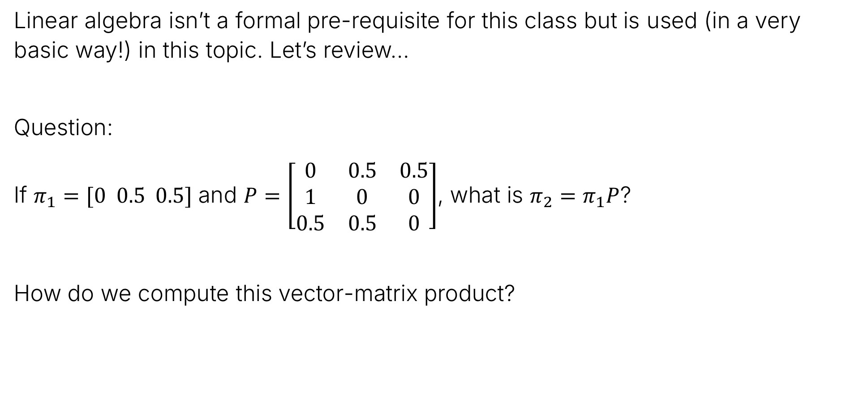
Linear Algebra Check
Linear algebra isn’t a formal pre-requisite for this class but is used (in a very basic way!) in this topic. Let’s review…
Question:
If $π_{1}=[0 0.5 0.5]$ and $P=\left[\begin{matrix}0 & 0.5 & 0.5 \\ 1 & 0 & 0 \\ 0.5 & 0.5 & 0\end{matrix}\right]$, what is $π_{2}=π_{1}P$?
How do we compute this vector-matrix product?

Slide 3
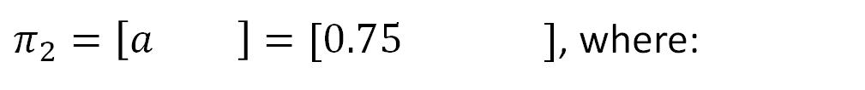

Linear Algebra Query
Linear algebra isn’t a formal pre-requisite for this class but is used (in a very basic way!) in this topic. Let’s review…
Question:
If $π_{1}=[0 0.5 0.5]$ and $P=\left[\begin{matrix}0 & 0.5 & 0.5 \\ 1 & 0 & 0 \\ 0.5 & 0.5 & 0\end{matrix}\right]$, what is $π_{2}=π_{1}P$?
$π_{2}=\left[a b c\right]=[0.75 0.25 0]$, where:
$$a=0×0+0.5×1+0.5×0.5=0.75$$

Slide 4
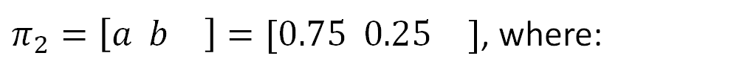

Linear Algebra Query
Linear algebra isn’t a formal pre-requisite for this class but is used (in a very basic way!) in this topic. Let’s review…
Question:
If $π_{1}=[0 0.5 0.5]$ and $P=\left[\begin{matrix}0 & 0.5 & 0.5 \\ 1 & 0 & 0 \\ 0.5 & 0.5 & 0\end{matrix}\right]$, what is $π_{2}=π_{1}P$?
$π_{2}=\left[a b c\right]=[0.75 0.25 0]$, where:
$$a=0×0+0.5×1+0.5×0.5=0.75$$
$$b=0×0.5+0.5×0+0.5×0.5=0.25$$

Slide 5
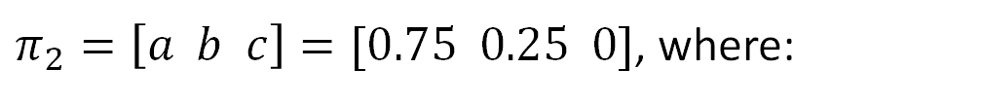

Linear Algebra Query
Linear algebra isn’t a formal pre-requisite for this class but is used (in a very basic way!) in this topic. Let’s review…
Question:
If $π_{1}=[0 0.5 0.5]$ and $P=\left[\begin{matrix}0 & 0.5 & 0.5 \\ 1 & 0 & 0 \\ 0.5 & 0.5 & 0\end{matrix}\right]$, what is $π_{2}=π_{1}P$?
$π_{2}=\left[a b c\right]=[0.75 0.25 0]$, where:
$$a=0×0+0.5×1+0.5×0.5=0.75$$
$$b=0×0.5+0.5×0+0.5×0.5=0.25$$
$$c=0×0.5+0.5×0+0.5×0=0$$

Slide 6
Markov Chain Introduction
Lecture 26, CS70 Summer 2025

Slide 7
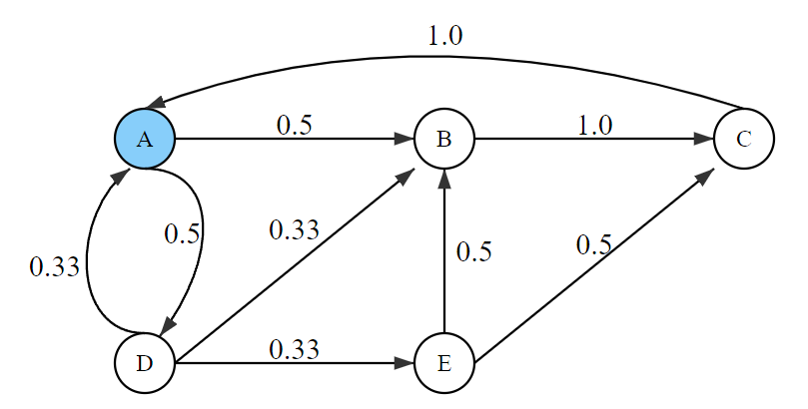
Example Markov Chain Samples
Let’s see an example of samples generated by a Markov Chain.
This is the same Markov Chain in page 3 of the notes.
System is initially in state A.
From A it can go to B with probability 0.5, and to D with probability 0.5.
From B it can only go to C (with probability 1).
…
Simulator at https://joshh.ug/cs70/markov_simulator_g5.html

Slide 8
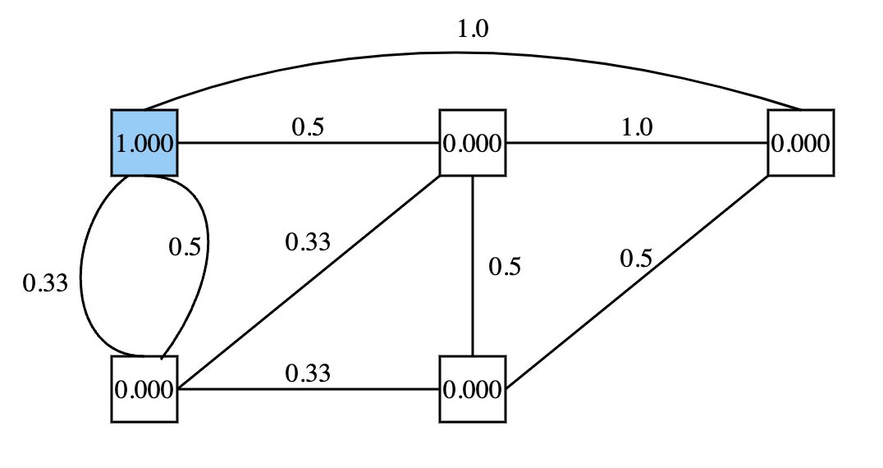
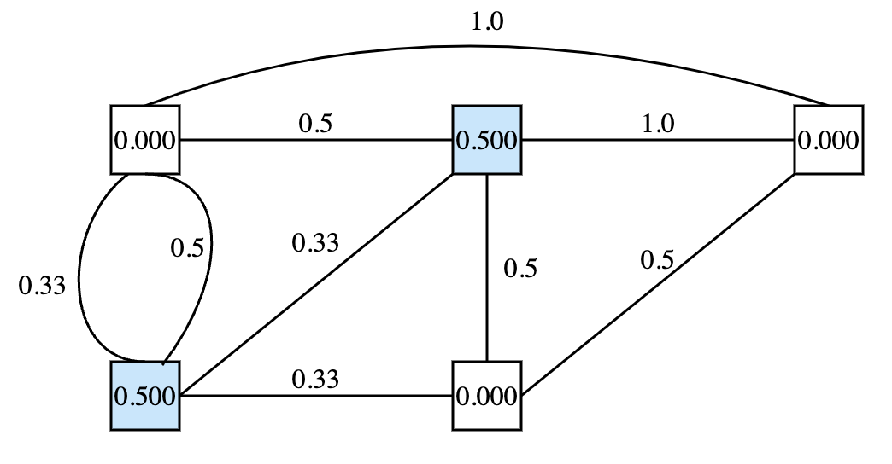
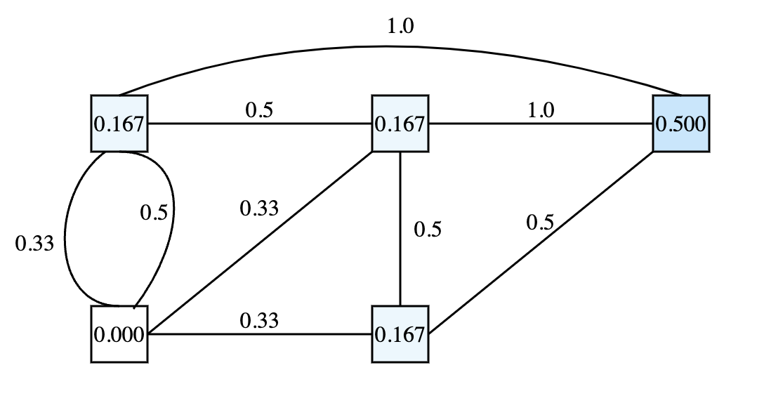




Markov Chain: Informal Definition
Before we saw samples generated by a Markov Chain.
A Markov Chain is a sequence of random variables – $X_{t}=$ state at time $t$:
$$X_{0}$$
$$X_{1}$$
Click this link to run a simulation.
$$X_{2}$$

Slide 9
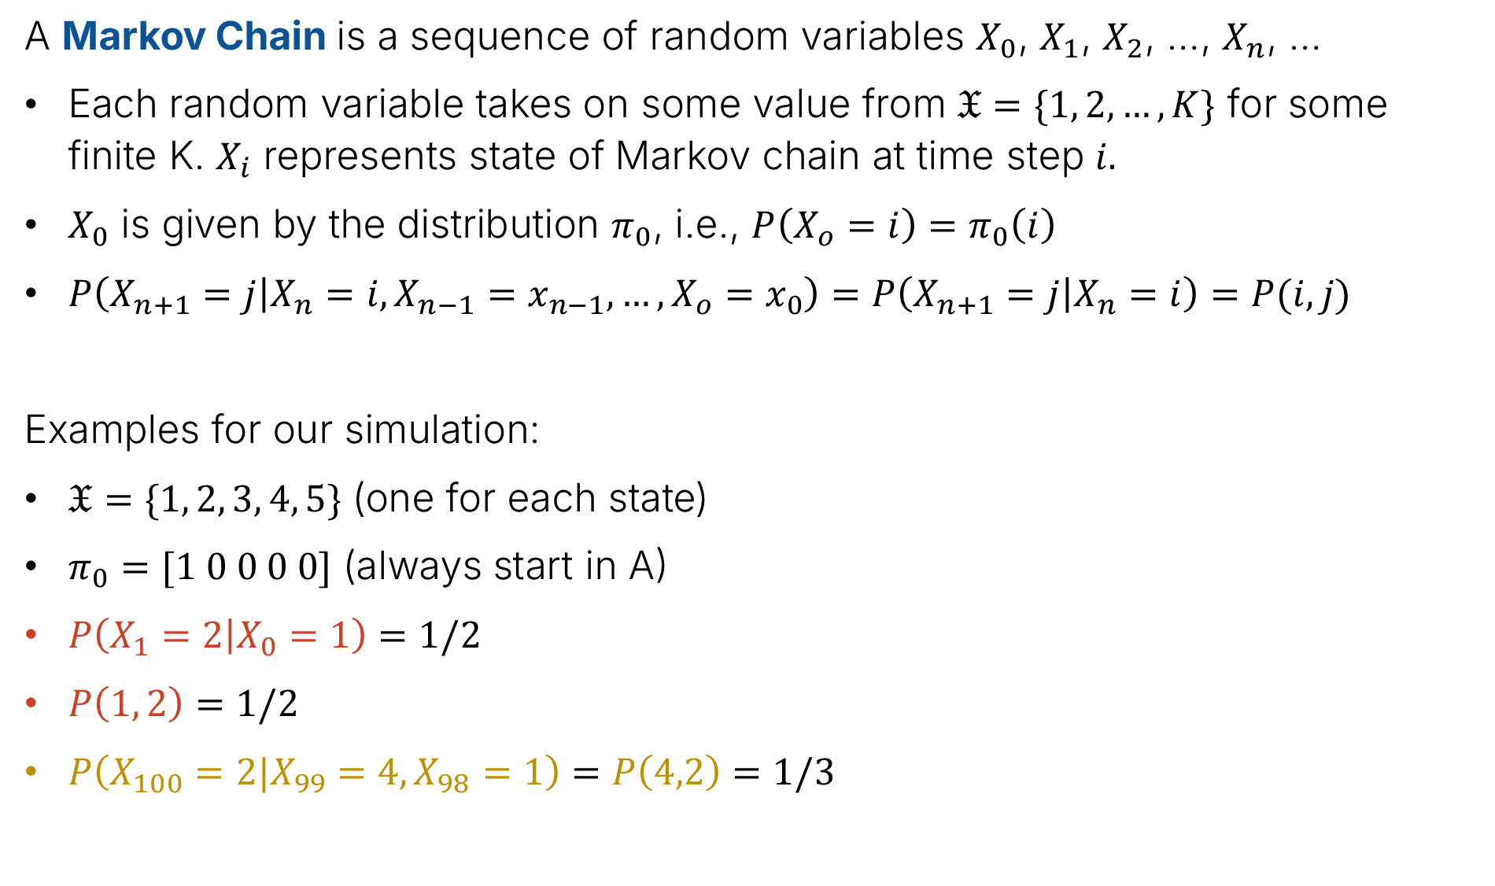


Markov Chain: Formal Definition
A Markov Chain is a sequence of random variables $X_{0}$, $X_{1}$, $X_{2}$, …, $X_{n}$, …
Each random variable takes on some value from $𝔛=\{1, 2, …, K\}$ for some finite K. $X_{i}$ represents state of Markov chain at time step $i$.
$X_{0}$ is given by the distribution $π_{0}$, i.e., $P\left(X_{o}=i\right)=π_{0}\left(i\right)$
$P\left(X_{n+1}=j | X_{n}=i, X_{n−1}=x_{n−1},…,X_{o}=x_{0}\right)=P\left(X_{n+1}=j | X_{n}=i\right)=P(i,j)$
Examples for our simulation:
$𝔛=\{1, 2, 3, 4, 5\}$ (one for each state)
$π_{0}=[1 0 0 0 0]$ (always start in A)
$P\left(X_{1}=2 | X_{0}=1\right)=1/2$
$P\left(1, 2\right)=1/2$
$P\left(X_{100}=2|X_{99}=4, X_{98}=1\right)=P\left(4,2\right)=1/3$
$$P(1,2)$$
$$P(4,2)$$

Slide 10
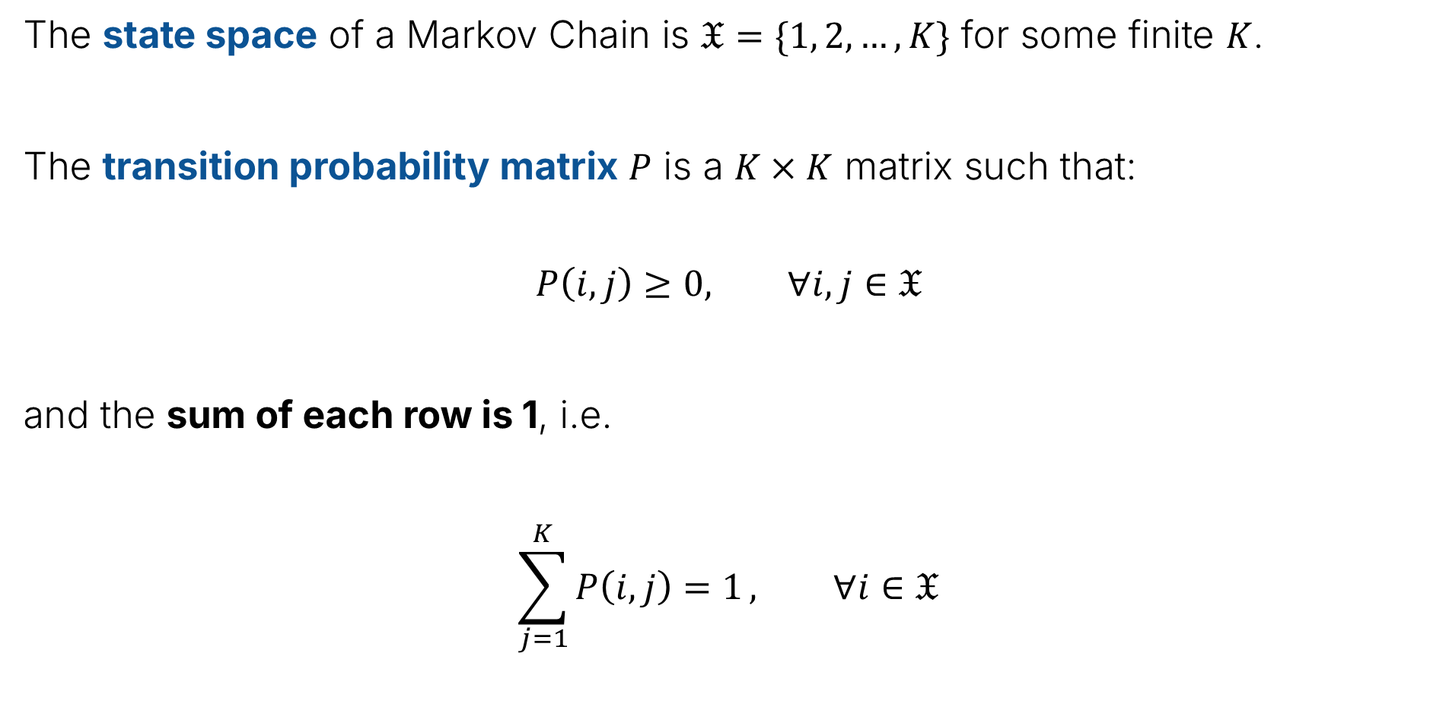
Markov Chain: State Space and Transition Probability Matrix
The state space of a Markov Chain is $𝔛=\{1, 2, …, K\}$ for some finite $K$.
The transition probability matrix $P$ is a $K×K$ matrix such that:
$$P\left(i, j\right)≥0, ∀i,j∈𝔛$$
and the sum of each row is 1, i.e.
$$\sum_{j=1}^{K}{P\left(i, j\right)=1}, ∀i∈𝔛$$

Slide 11


Markov Chain: Terminology
The state space of a Markov Chain is $𝔛=\{1, 2, …, K\}$ for some finite K.
The transition probability matrix $P$ is a $K×K$ matrix such that:
$$P\left(i, j\right)≥0, ∀i,j∈𝔛$$
$$\sum_{j=1}^{K}{P\left(i, j\right)=1}, ∀i∈𝔛$$
Probability of going from A to B and A to D
$$\left[\begin{matrix}0 & 0.5 & 0 & 0.5 & 0 \\ 0 & 0 & 1 & 0 & 0 \\ 1 & 0 & 0 & 0 & 0 \\ 0.33 & 0.33 & 0 & 0 & 0.33 \\ 0 & 0.5 & 0.5 & 0 & 0\end{matrix}\right]$$

Slide 12
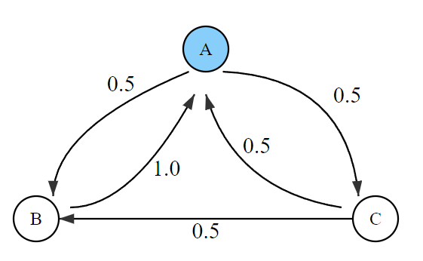
Test Your Understanding
What is the first row of the transition probability matrix for the Markov Chain below?

Slide 13
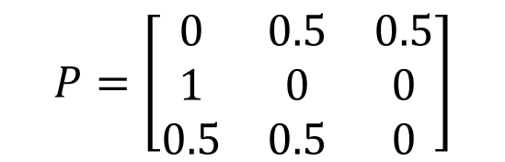
Test Your Understanding
What is the first row of the transition probability matrix for the Markov Chain below?
$$P=\left[\begin{matrix}0 & 0.5 & 0.5 \\ 1 & 0 & 0 \\ 0.5 & 0.5 & 0\end{matrix}\right]$$

Slide 14
Markov Chain
Some questions we might ask:
What is the probability that we’re at a given node after a long time?
In the long run, does the starting state matter?
How long do we expect it to take before we reach E for the first time?
What is the probability that we visit state E before state C?
We’ll see that many questions can be framed in terms of questions about Markov Chains.

Slide 15
The Invariant Distribution
Lecture 26, CS70 Summer 2025

Slide 16
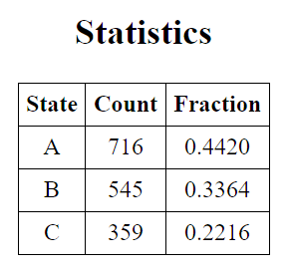
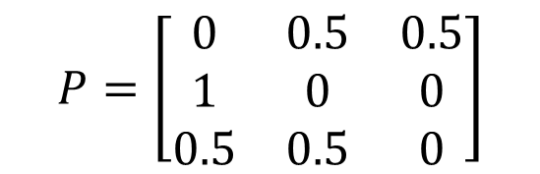
Long Term Behavior of Three State Markov Chain
As a smaller running example, let’s consider the three state Markov Chain below. Simulation yields counts shown “Count” column below.
If we generate samples, we end up with around:
44% of the time in state A.
33% of the time in state B.
22% of the time in state C.
$$P=\left[\begin{matrix}0 & 0.5 & 0.5 \\ 1 & 0 & 0 \\ 0.5 & 0.5 & 0\end{matrix}\right]$$

Slide 17

Long Term Behavior of Three State Markov Chain
We can use basic linear algebra to show why we always end up with this 44%/33%/22% pattern.
Let $π_{0}$ be a vector giving the probability that we’re in any given state. For our simulation, that means $π_{0}=[1 0 0]$, since we always start in state A.
What is the chance of being in each state at time step 1, i.e., what is $π_{1}$?
$$P=\left[\begin{matrix}0 & 0.5 & 0.5 \\ 1 & 0 & 0 \\ 0.5 & 0.5 & 0\end{matrix}\right]$$

Slide 18
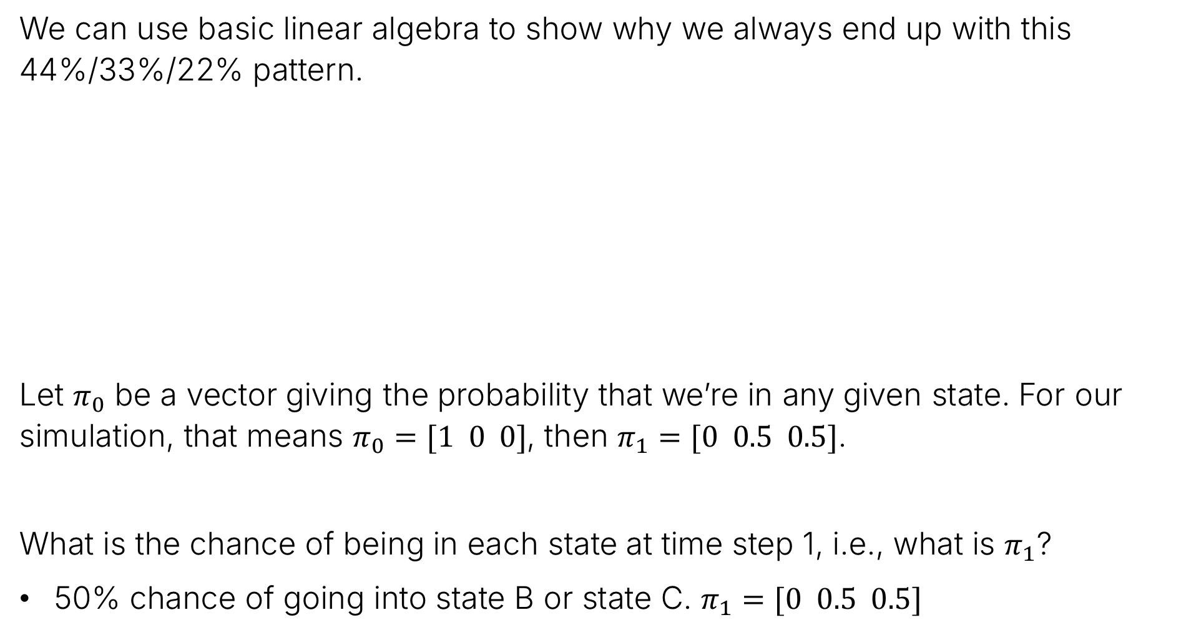
Long Term Behavior of Three State Markov Chain
We can use basic linear algebra to show why we always end up with this 44%/33%/22% pattern.
Let $π_{0}$ be a vector giving the probability that we’re in any given state. For our simulation, that means $π_{0}=[1 0 0]$, then $π_{1}=[0 0.5 0.5]$.
What is the chance of being in each state at time step 1, i.e., what is $π_{1}$?
50% chance of going into state B or state C. $π_{1}=[0 0.5 0.5]$
$$P=\left[\begin{matrix}0 & 0.5 & 0.5 \\ 1 & 0 & 0 \\ 0.5 & 0.5 & 0\end{matrix}\right]$$

Slide 19
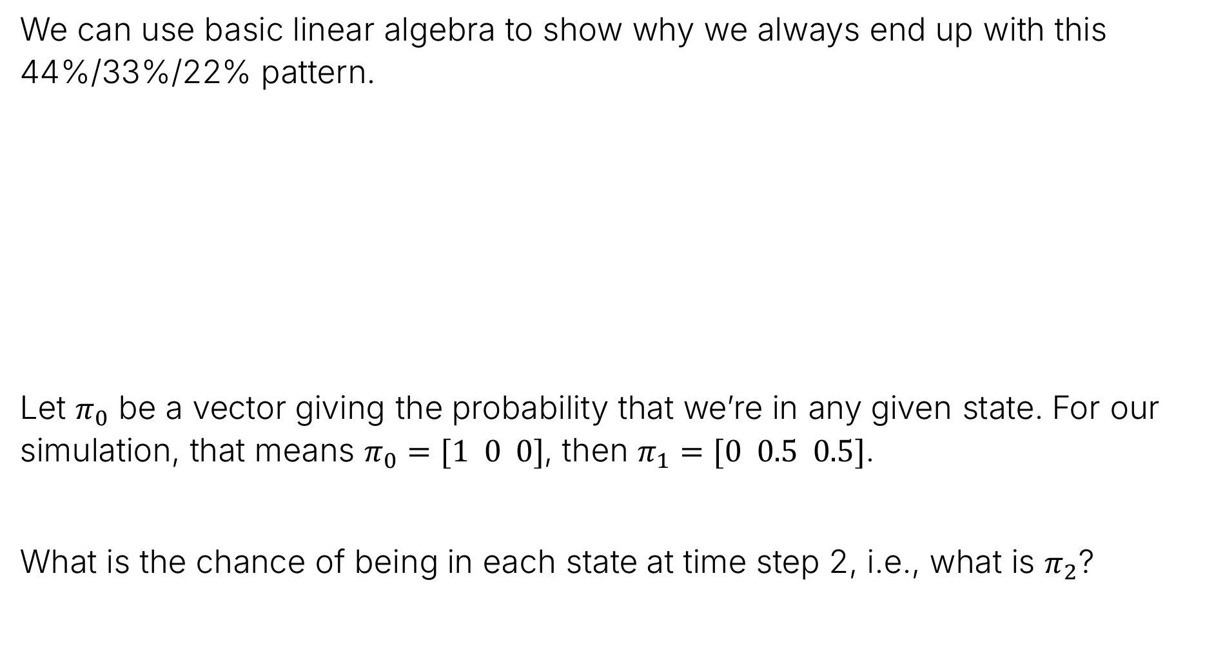
Long Term Behavior of Three State Markov Chain
We can use basic linear algebra to show why we always end up with this 44%/33%/22% pattern.
Let $π_{0}$ be a vector giving the probability that we’re in any given state. For our simulation, that means $π_{0}=[1 0 0]$, then $π_{1}=[0 0.5 0.5]$.
What is the chance of being in each state at time step 2, i.e., what is $π_{2}$?
$$P=\left[\begin{matrix}0 & 0.5 & 0.5 \\ 1 & 0 & 0 \\ 0.5 & 0.5 & 0\end{matrix}\right]$$

Slide 20
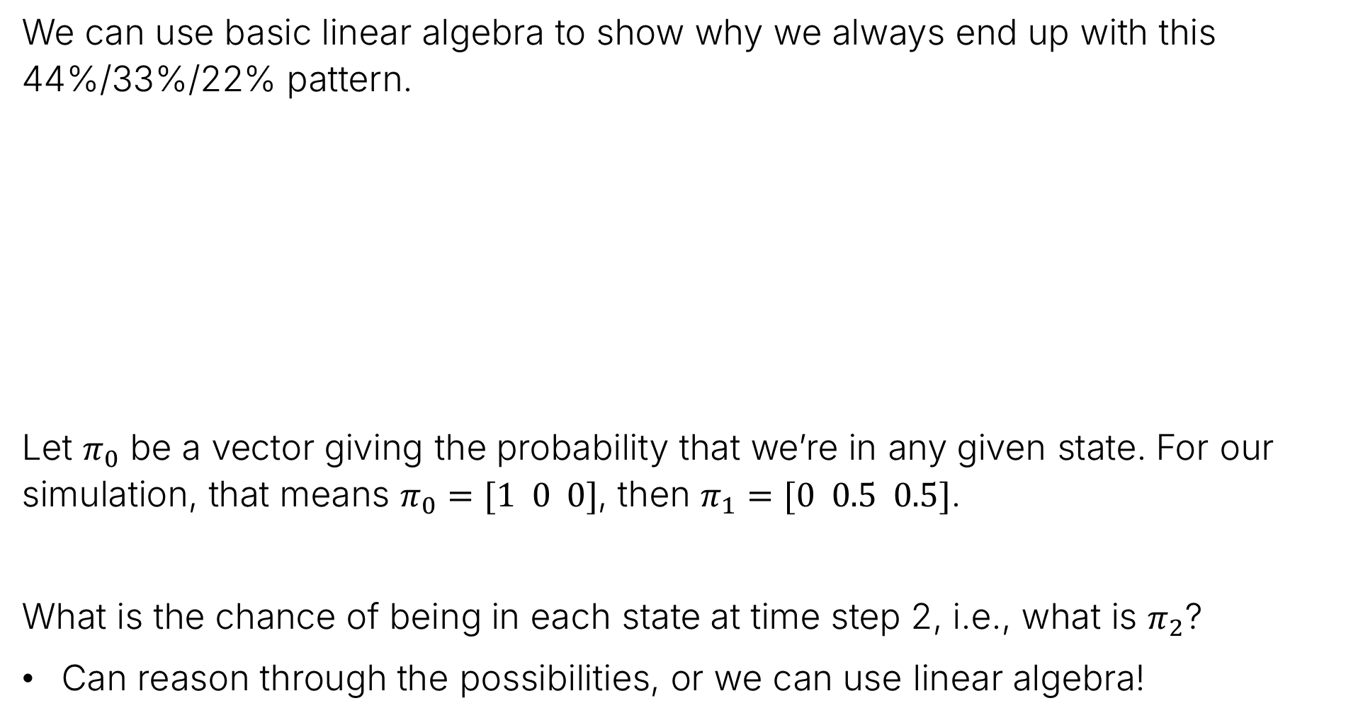
Long Term Behavior of Three State Markov Chain
We can use basic linear algebra to show why we always end up with this 44%/33%/22% pattern.
Let $π_{0}$ be a vector giving the probability that we’re in any given state. For our simulation, that means $π_{0}=[1 0 0]$, then $π_{1}=[0 0.5 0.5]$.
What is the chance of being in each state at time step 2, i.e., what is $π_{2}$?
Can reason through the possibilities, or we can use linear algebra!
$$P=\left[\begin{matrix}0 & 0.5 & 0.5 \\ 1 & 0 & 0 \\ 0.5 & 0.5 & 0\end{matrix}\right]$$

Slide 21
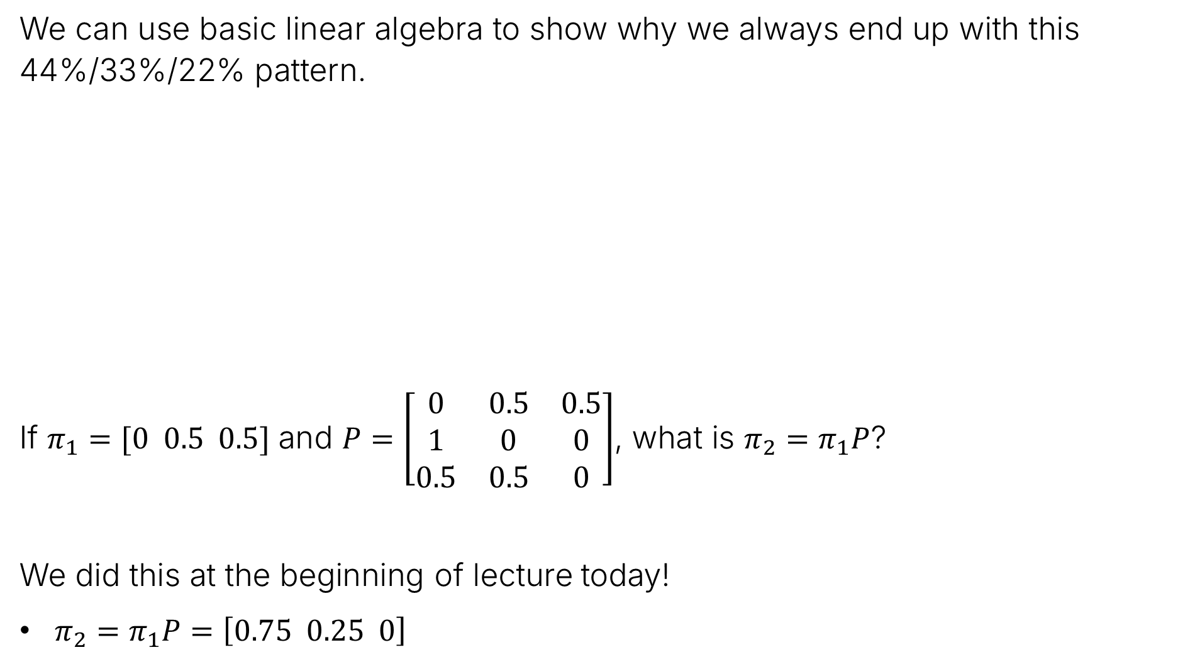
Long Term Behavior of Three State Markov Chain
We can use basic linear algebra to show why we always end up with this 44%/33%/22% pattern.
If $π_{1}=[0 0.5 0.5]$ and $P=\left[\begin{matrix}0 & 0.5 & 0.5 \\ 1 & 0 & 0 \\ 0.5 & 0.5 & 0\end{matrix}\right]$, what is $π_{2}=π_{1}P$?
We did this at the beginning of lecture today!
$π_{2}=π_{1}P=\left[0.75 0.25 0\right]$
$$P=\left[\begin{matrix}0 & 0.5 & 0.5 \\ 1 & 0 & 0 \\ 0.5 & 0.5 & 0\end{matrix}\right]$$

Slide 22
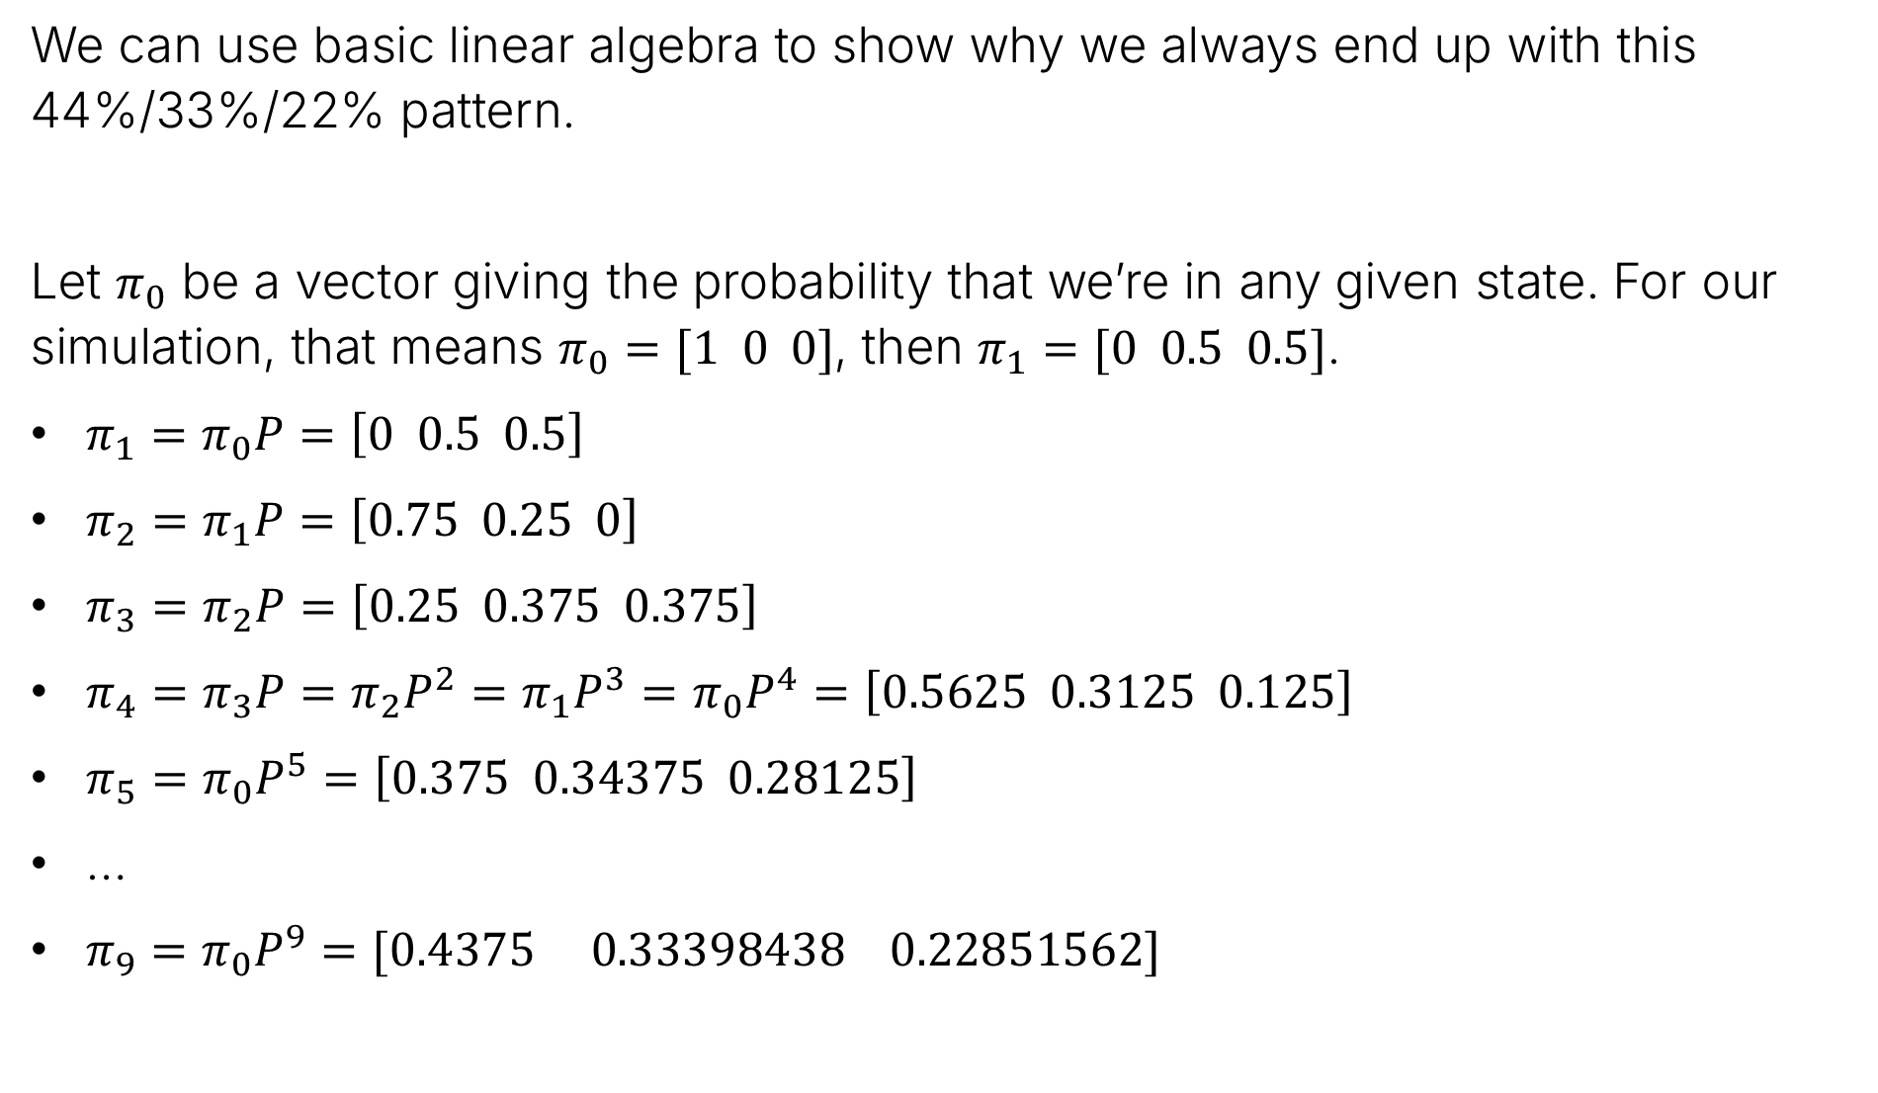
Long Term Behavior of Three State Markov Chain using Linear Algebra
We can use basic linear algebra to show why we always end up with this 44%/33%/22% pattern.
Let $π_{0}$ be a vector giving the probability that we’re in any given state. For our simulation, that means $π_{0}=[1 0 0]$, then $π_{1}=[0 0.5 0.5]$.
$π_{1}=π_{0}P=\left[0 0.5 0.5\right]$
$π_{2}=π_{1}P=\left[0.75 0.25 0\right]$
$π_{3}=π_{2}P=\left[0.25 0.375 0.375\right]$
$π_{4}=π_{3}P=π_{2}P^{2}=π_{1}P^{3}=π_{0}P^{4}=\left[0.5625 0.3125 0.125\right]$
$π_{5}=π_{0}P^{5}=\left[0.375 0.34375 0.28125\right]$
…
$π_{9}=π_{0}P^{9}=[0.4375 0.33398438 0.22851562]$

Slide 23
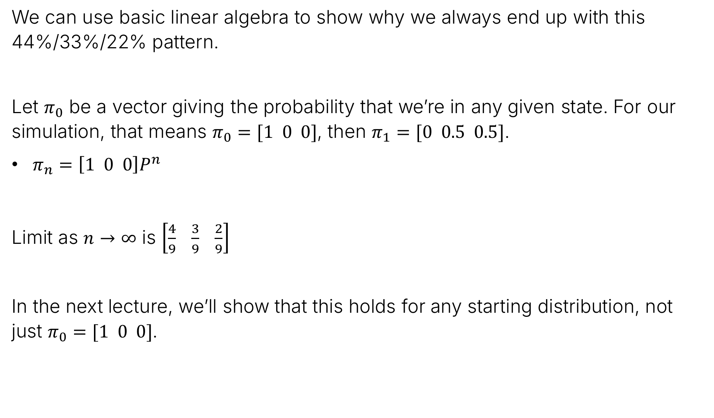
Long Term Behavior of Three State Markov Chain using Linear Algebra
We can use basic linear algebra to show why we always end up with this 44%/33%/22% pattern.
Let $π_{0}$ be a vector giving the probability that we’re in any given state. For our simulation, that means $π_{0}=[1 0 0]$, then $π_{1}=[0 0.5 0.5]$.
$π_{n}=\left[1 0 0\right]P^{n}$
Limit as $n→∞$ is $\left[\frac{4}{9} \frac{3}{9} \frac{2}{9}\right]$
In the next lecture, we’ll show that this holds for any starting distribution, not just $π_{0}=[1 0 0]$.

Slide 24


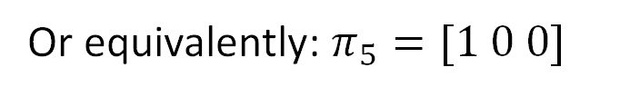


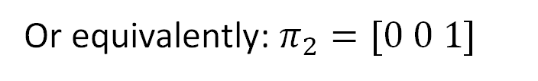




Long Term Behavior of Three State Markov Chain – using observations
Note: If we have information about the Markov Chain at some point other than time zero, we can update probabilities accordingly.
Example: Suppose we know $π_{0}=\left[0.3 0.2 0.5\right]$, we know that $X_{2}=3$, and $X_{5}=1$, then:
$$π_{0}=[0.3 0.2 0.5]$$
$$π_{1}=\left[0.3 0.2 0.5\right]P$$
$$X_{2}=3$$
Or equivalently: $π_{2}=[0 0 1]$
$$π_{3}=\left[0 0 1\right]P$$
$$π_{4}=\left[0 0 1\right]P^{2}$$
$$X_{5}=1$$
Or equivalently: $π_{5}=[1 0 0]$
$$X_{6}=\left[1 0 0\right]P$$

Slide 25


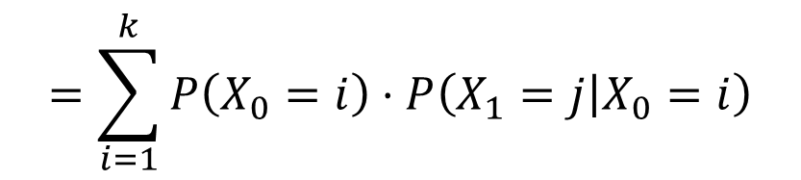
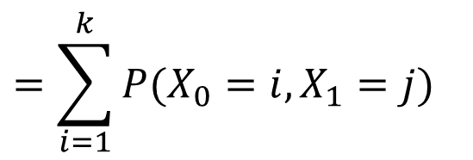

Alternate View: Distribution of $X_{1}$
Denote the distribution of $X_{1}$ by $π_{1}$
$$=\sum_{i=1}^{k}{P(X_{0}=i,X_{1}=j)}$$
$$π_{1}\left(j\right)=P\left(X_{1}=j\right)$$
$$=\sum_{i=1}^{k}{P\left(X_{0}=i\right)⋅P\left(X_{1}=j | X_{0}=i\right)}$$
$$=\sum_{i=1}^{k}{π_{0}\left(i\right)⋅P\left(i,j\right)}$$
Or in linear algebra notation: $π_{0}$ and $π_{1}$ are row vectors, and $P$ is a matrix of transition probabilities. We have that $π_{1}=π_{0}P$.

Slide 26
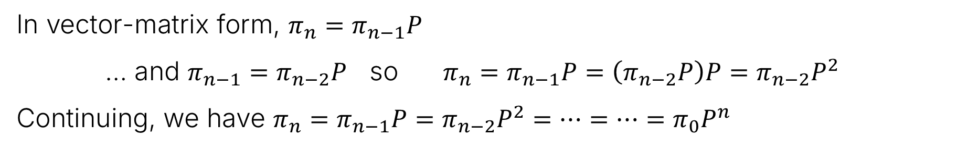


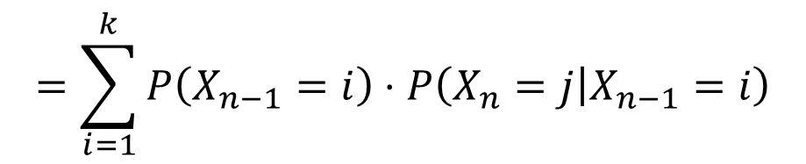
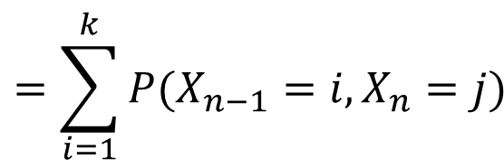

Alternate View: The Distribution of $X_{n}$
Denote the distribution of $X_{n}$ by $π_{n}$
$$=\sum_{i=1}^{k}{P(X_{n−1}=i,X_{n}=j)}$$
$$π_{n}\left(j\right)=P\left(X_{n}=j\right)$$
$$=\sum_{i=1}^{k}{P\left(X_{n−1}=i\right)⋅P\left(X_{n}=j | X_{n−1}=i\right)}$$
$$=\sum_{i=1}^{k}{π_{n−1}\left(i\right)⋅P\left(i,j\right)}$$
In vector-matrix form, $π_{n}=π_{n−1}P$
… and $π_{n−1}=π_{n−2}P$ so $π_{n}=π_{n−1}P=\left(π_{n−2}P\right)P=π_{n−2}P^{2}$
Continuing, we have $π_{n}=π_{n−1}P=π_{n−2}P^{2}=…=…=π_{0}P^{n}$

Slide 27
Hitting Time
Lecture 26, CS70 Summer 2025

Slide 28

Hitting Time
Another question we might ask ourselves: If we start in state $i$, how many time steps $β\left(i\right)$ do we expect it to take before we hit end state $𝔈$?
For example, if our desired end state is $𝔈=E$, we want to find $β\left(A\right)$, $β\left(B\right)$, $β\left(C\right)$, $β\left(D\right)$, and $β\left(E\right)$.

Slide 29
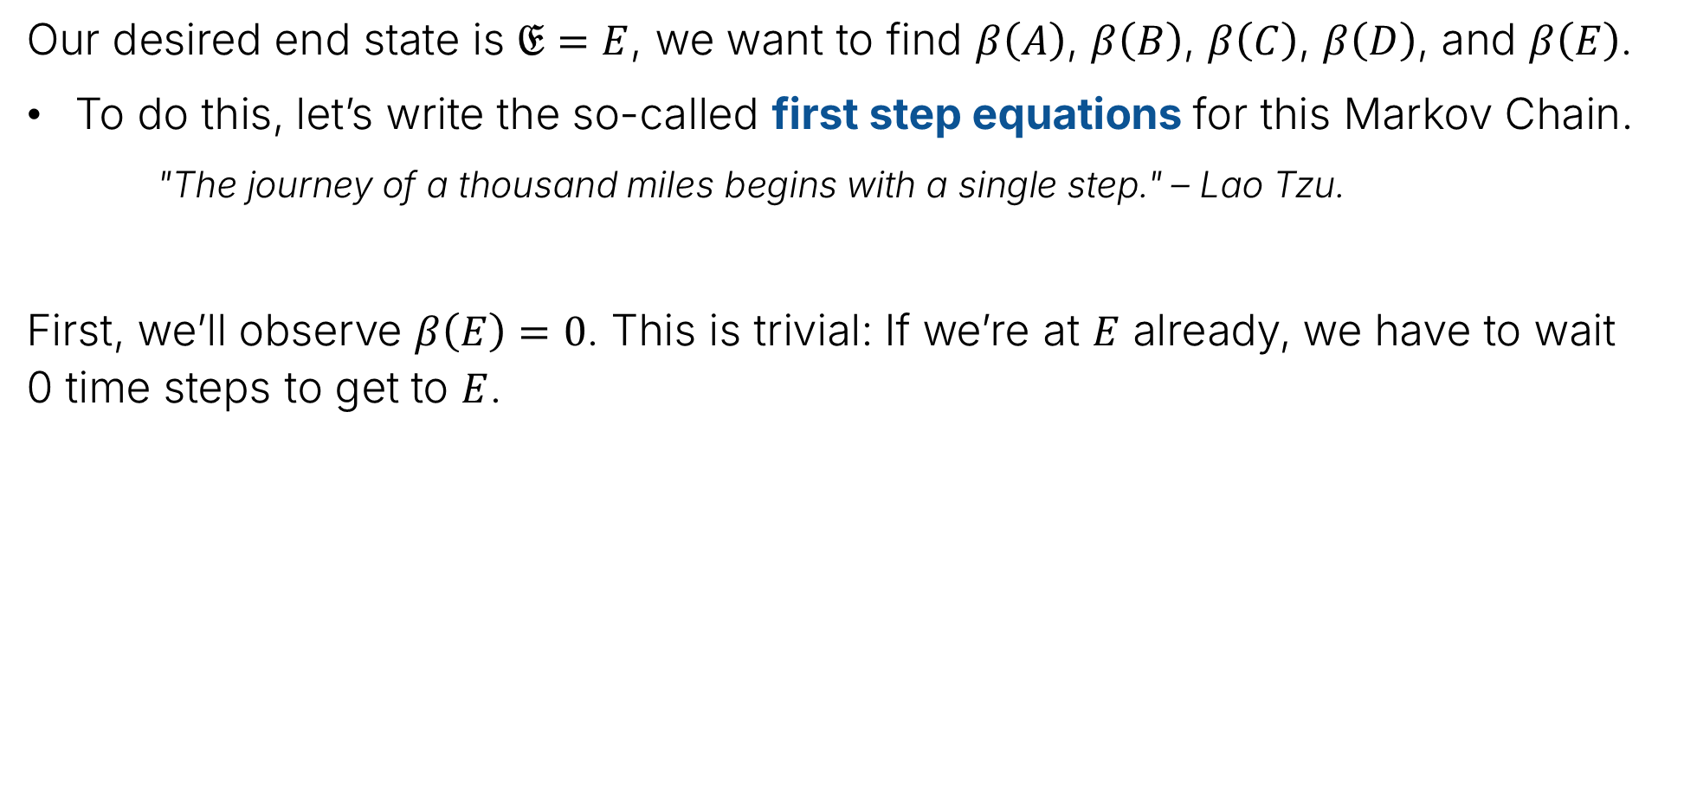
Hitting Time
Our desired end state is $𝔈=E$, we want to find $β\left(A\right)$, $β\left(B\right)$, $β\left(C\right)$, $β\left(D\right)$, and $β\left(E\right)$.
To do this, let’s write the so-called first step equations for this Markov Chain.
"The journey of a thousand miles begins with a single step." – Lao Tzu.
First, we’ll observe $β\left(E\right)=0$. This is trivial: If we’re at $E$ already, we have to wait 0 time steps to get to $E$.

Slide 30
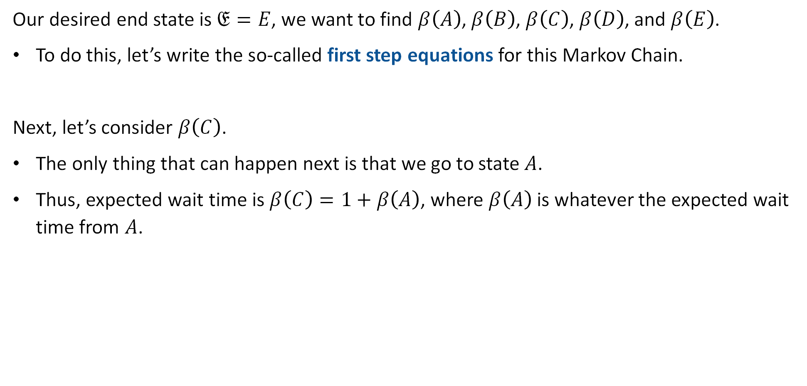

Hitting Time
Our desired end state is $𝔈=E$, we want to find $β\left(A\right)$, $β\left(B\right)$, $β\left(C\right)$, $β\left(D\right)$, and $β\left(E\right)$.
To do this, let’s write the so-called first step equations for this Markov Chain.
Next, let’s consider $β\left(C\right)$.
The only thing that can happen next is that we go to state $A$.
Thus, expected wait time is $β\left(C\right)=1+β\left(A\right)$, where $β\left(A\right)$ is whatever the expected wait time from $A$.
$$β\left(E\right)=0$$

Slide 31


Hitting Time
Our desired end state is $𝔈=E$, we want to find $β\left(A\right)$, $β\left(B\right)$, $β\left(C\right)$, $β\left(D\right)$, and $β\left(E\right)$.
To do this, let’s write the so-called first step equations for this Markov Chain.
What is $β\left(B\right)$?
$$β\left(C\right)=1+β\left(A\right)$$
$$β\left(E\right)=0$$

Slide 32


Hitting Time
Our desired end state is $𝔈=E$, we want to find $β\left(A\right)$, $β\left(B\right)$, $β\left(C\right)$, $β\left(D\right)$, and $β\left(E\right)$.
To do this, let’s write the so-called first step equations for this Markov Chain.
What is $β\left(B\right)$?
$β\left(B\right)=1+β\left(C\right)$
$$β\left(B\right)=1+β\left(C\right)$$
$$β\left(C\right)=1+β\left(A\right)$$
$$β\left(E\right)=0$$

Slide 33

Hitting Time
Our desired end state is $𝔈=E$, we want to find $β\left(A\right)$, $β\left(B\right)$, $β\left(C\right)$, $β\left(D\right)$, and $β\left(E\right)$.
To do this, let’s write the so-called first step equations for this Markov Chain.
What is $β\left(A\right)$?
$$β\left(B\right)=1+β\left(C\right)$$
$$β\left(C\right)=1+β\left(A\right)$$
$$β\left(E\right)=0$$

Slide 34


Hitting Time
Our desired end state is $𝔈=E$, we want to find $β\left(A\right)$, $β\left(B\right)$, $β\left(C\right)$, $β\left(D\right)$, and $β\left(E\right)$.
To do this, let’s write the so-called first step equations for this Markov Chain.
What is $β\left(A\right)$?
$1+0.5β\left(D\right)+0.5β\left(B\right)$ $←$ nothing new… just conditional expectation
$$1+0.5β\left(D\right)+0.5β\left(B\right)$$
$$β\left(B\right)=1+β\left(C\right)$$
$$β\left(C\right)=1+β\left(A\right)$$
$$β\left(E\right)=0$$

Slide 35

Hitting Time
Our desired end state is $𝔈=E$, we want to find $β\left(A\right)$, $β\left(B\right)$, $β\left(C\right)$, $β\left(D\right)$, and $β\left(E\right)$.
To do this, let’s write the so-called first step equations for this Markov Chain.
What is $β\left(D\right)$?
$$1+0.5β\left(D\right)+0.5β\left(B\right)$$
$$β\left(B\right)=1+β\left(C\right)$$
$$β\left(C\right)=1+β\left(A\right)$$
$$β\left(E\right)=0$$

Slide 36

Hitting Time
Our desired end state is $𝔈=E$, we want to find $β\left(A\right)$, $β\left(B\right)$, $β\left(C\right)$, $β\left(D\right)$, and $β\left(E\right)$.
To do this, let’s write the so-called first step equations for this Markov Chain.
What is $β\left(D\right)$?
$1+1/3β\left(A\right)+1/3β\left(B\right)+1/3β\left(E\right)$
$$1+0.5β\left(D\right)+0.5β\left(B\right)$$
$$β\left(B\right)=1+β\left(C\right)$$
$$β\left(C\right)=1+β\left(A\right)$$
$$β\left(E\right)=0$$

Slide 37

Hitting Time
Our desired end state is $𝔈=E$, we want to find $β\left(A\right)$, $β\left(B\right)$, $β\left(C\right)$, $β\left(D\right)$, and $β\left(E\right)$.
The first step equations for this Markov Chain are:
  $β\left(A\right)=1+0.5β\left(D\right)+0.5β\left(B\right)$
  $β\left(B\right)=1+β\left(C\right)$
  $β\left(C\right)=1+β\left(A\right)$
  $β\left(D\right)=1+1/3β\left(A\right)+1/3β\left(B\right)+1/3β\left(E\right)$
  $β\left(E\right)=0$
$$1+0.5β\left(D\right)+0.5β\left(B\right)$$
$$β\left(B\right)=1+β\left(C\right)$$
$$β\left(C\right)=1+β\left(A\right)$$
$$β\left(E\right)=0$$
$$β\left(D\right)=1+1/3β\left(A\right)+1/3β\left(B\right)+1/3β\left(E\right)$$

Slide 38
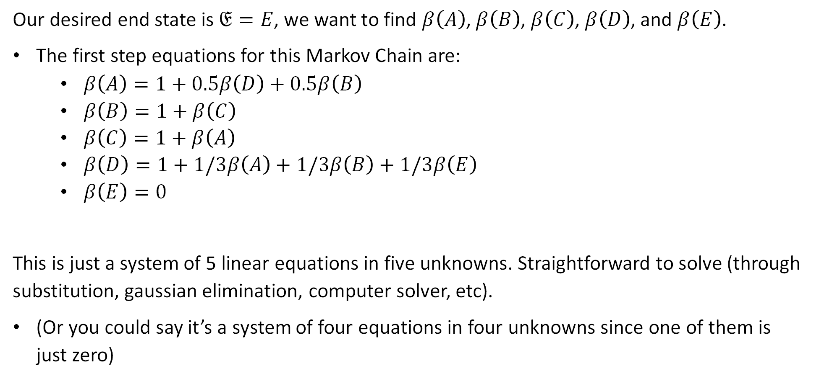
Hitting Time
Our desired end state is $𝔈=E$, we want to find $β\left(A\right)$, $β\left(B\right)$, $β\left(C\right)$, $β\left(D\right)$, and $β\left(E\right)$.
The first step equations for this Markov Chain are:
  $β\left(A\right)=1+0.5β\left(D\right)+0.5β\left(B\right)$
  $β\left(B\right)=1+β\left(C\right)$
  $β\left(C\right)=1+β\left(A\right)$
  $β\left(D\right)=1+1/3β\left(A\right)+1/3β\left(B\right)+1/3β\left(E\right)$
  $β\left(E\right)=0$
This is just a system of 5 linear equations in five unknowns. Straightforward to solve (through substitution, gaussian elimination, computer solver, etc).
(Or you could say it’s a system of four equations in four unknowns since one of them is just zero)

Slide 39
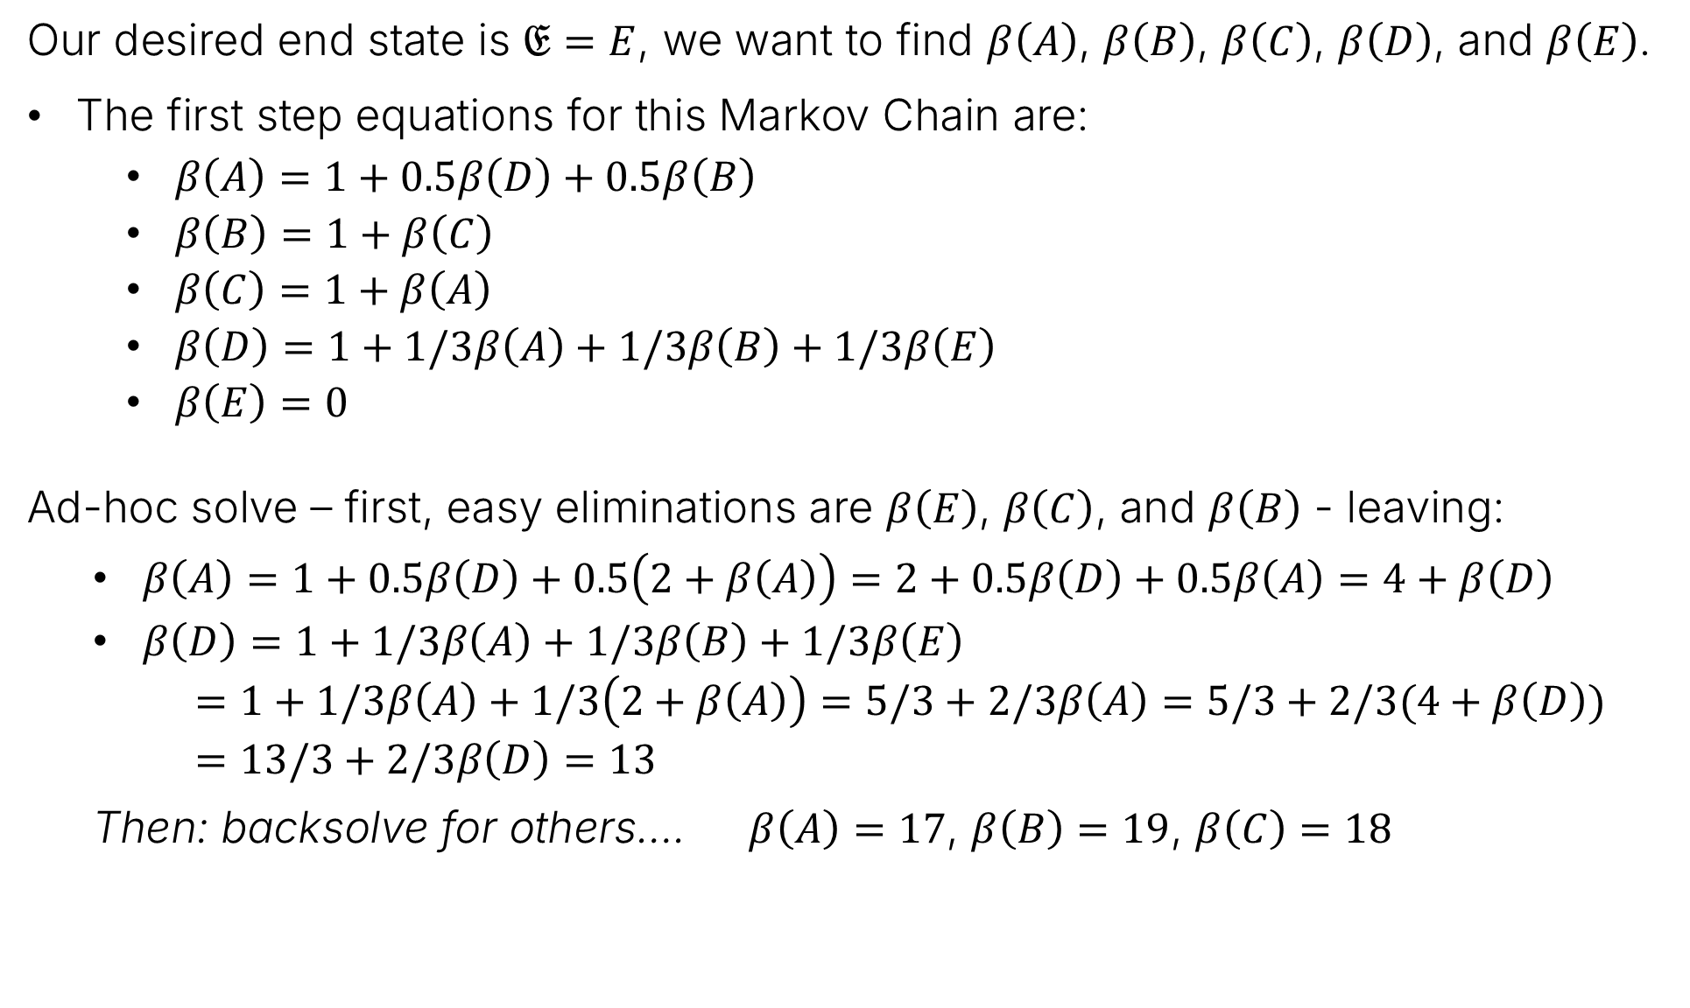
Hitting Time
Our desired end state is $𝔈=E$, we want to find $β\left(A\right)$, $β\left(B\right)$, $β\left(C\right)$, $β\left(D\right)$, and $β\left(E\right)$.
The first step equations for this Markov Chain are:
  $β\left(A\right)=1+0.5β\left(D\right)+0.5β\left(B\right)$
  $β\left(B\right)=1+β\left(C\right)$
  $β\left(C\right)=1+β\left(A\right)$
  $β\left(D\right)=1+1/3β\left(A\right)+1/3β\left(B\right)+1/3β\left(E\right)$
  $β\left(E\right)=0$
Ad-hoc solve – first, easy eliminations are $β\left(E\right)$, $β\left(C\right)$, and $β\left(B\right)$ - leaving:
$β\left(A\right)=1+0.5β\left(D\right)+0.5\left(2+β\left(A\right)\right)=2+0.5β\left(D\right)+0.5β\left(A\right)=4+β\left(D\right)$
  $β\left(D\right)=1+1/3β\left(A\right)+1/3β\left(B\right)+1/3β\left(E\right)$
  $=1+1/3β\left(A\right)+1/3\left(2+β\left(A\right)\right)$ $=5/3+2/3β\left(A\right)=5/3+2/3(4+β\left(D\right))$
  $=13/3+2/3β\left(D\right)=13$
  Then: backsolve for others…. $β\left(A\right)=17$, $β\left(B\right)=19$, $β\left(C\right)=18$

Slide 40
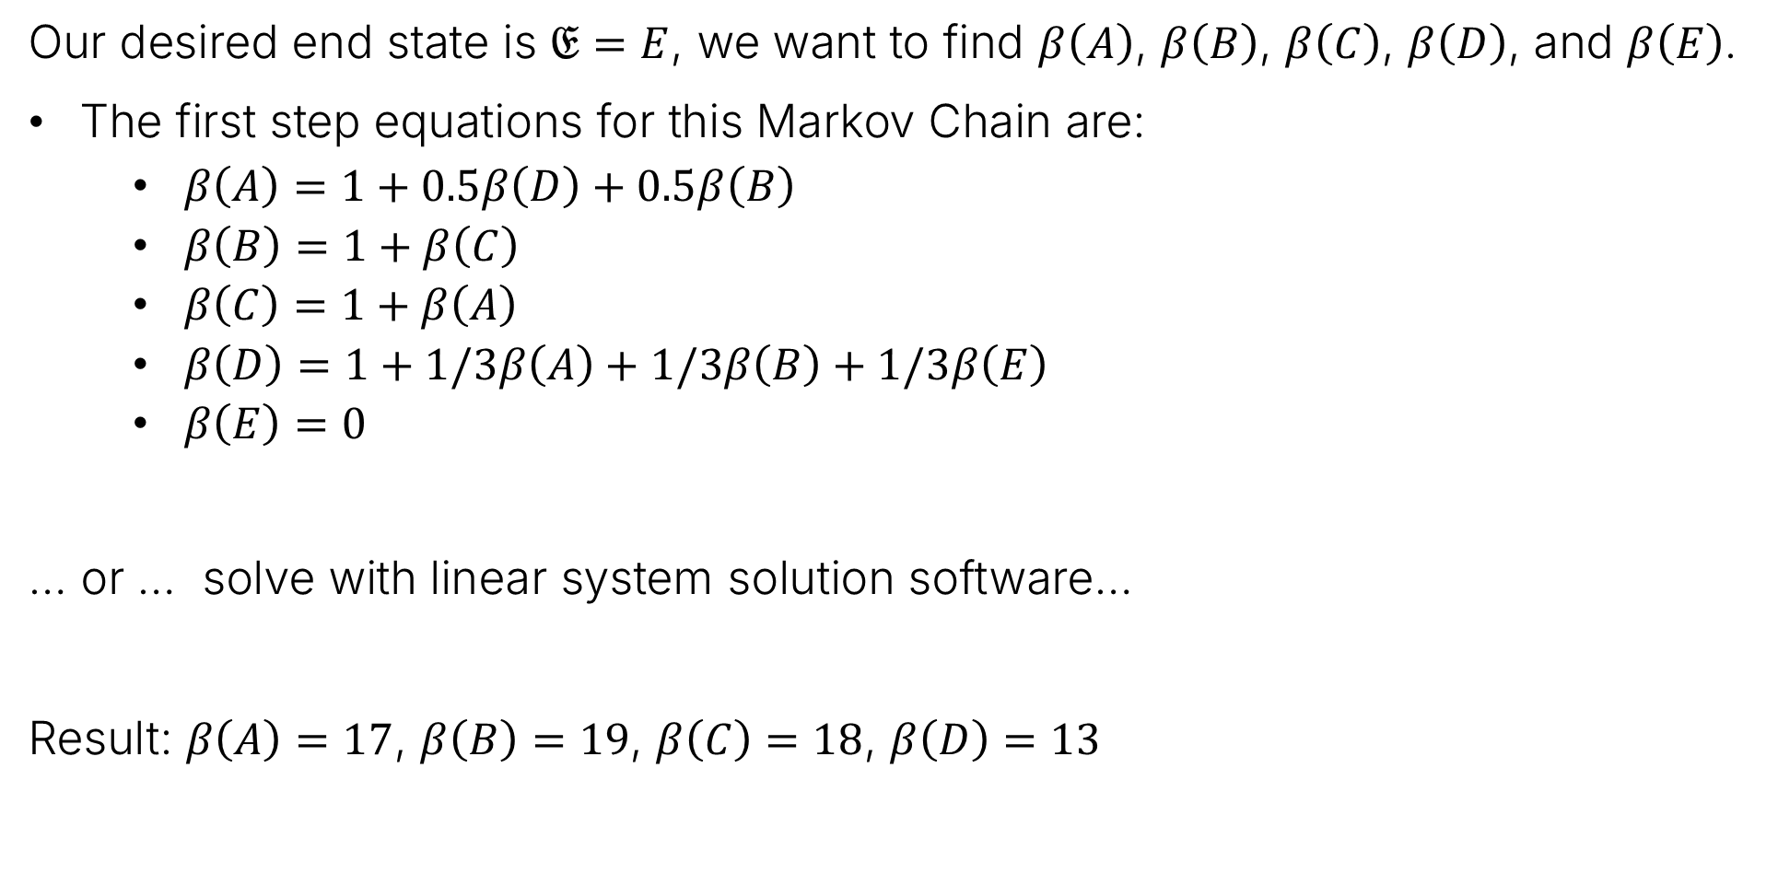
Hitting Time
Our desired end state is $𝔈=E$, we want to find $β\left(A\right)$, $β\left(B\right)$, $β\left(C\right)$, $β\left(D\right)$, and $β\left(E\right)$.
The first step equations for this Markov Chain are:
  $β\left(A\right)=1+0.5β\left(D\right)+0.5β\left(B\right)$
  $β\left(B\right)=1+β\left(C\right)$
  $β\left(C\right)=1+β\left(A\right)$
  $β\left(D\right)=1+1/3β\left(A\right)+1/3β\left(B\right)+1/3β\left(E\right)$
  $β\left(E\right)=0$
… or … solve with linear system solution software…
Result: $β\left(A\right)=17$, $β\left(B\right)=19$, $β\left(C\right)=18$, $β\left(D\right)=13$

Slide 41
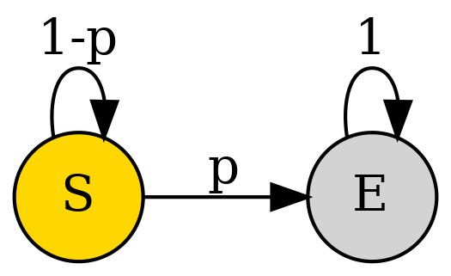
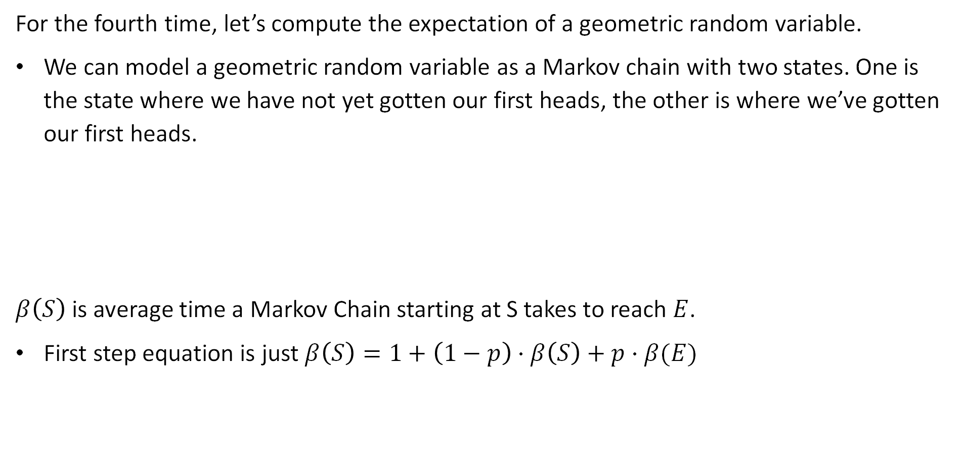
Example 2: Expectation of a Geometric Random Variable
For the fourth time, let’s compute the expectation of a geometric random variable.
We can model a geometric random variable as a Markov chain with two states. One is the state where we have not yet gotten our first heads, the other is where we’ve gotten our first heads.
$β\left(S\right)$ is average time a Markov Chain starting at S takes to reach $E$.
First step equation is just $β\left(S\right)=1+\left(1−p\right)⋅β\left(S\right)+p⋅β(E)$
This is just 0.
$$β\left(S\right)=1+β\left(S\right)−pβ\left(S\right)$$
$$β\left(S\right)=1/p$$

Slide 42

Example 3: Flipping Until Two Consecutive Heads.
Suppose we now want to model the process of flipping a coin until we get two consecutive heads.
Flips at times 2 and 3 not independent of flips at times 1 and 2 – not Bernoulli!
How many flips on average do you think it will take if coin is fair, i.e., $p=0.5$?
We can model with a Markov chain though - what does it look like?

Slide 43


Example 3: Flipping Until Two Consecutive Heads.
Suppose we now want to model the process of flipping a coin until we get two consecutive heads. What does the equivalent Markov Chain look like?
First step equations:
$β\left(S\right)=1+\left(1−p\right)β\left(S\right)+pβ\left(H\right)$
$β\left(H\right)=1+\left(1−p\right)β\left(S\right)+pβ\left(E\right)$
$β\left(E\right)=0$

Slide 44






Example 3: Flipping Until Two Consecutive Heads.
Suppose we now want to model the process of flipping a coin until we get two consecutive heads. What does the equivalent Markov Chain look like?
First step equations:
$β\left(S\right)=1+\left(1−p\right)β\left(S\right)+pβ\left(H\right)$
$β\left(H\right)=1+\left(1−p\right)β\left(S\right)$
$=1+\left(1−p\right)β\left(S\right)+p(1+\left(1−p\right)β\left(S\right)$)
$$β\left(S\right)=1+β\left(S\right)−pβ\left(S\right)+p+pβ\left(S\right)−p^{2}β\left(S\right)$$
$$p^{2}β\left(S\right)=1+p$$
$$β\left(S\right)=\frac{3/2}{1/4}=6$$
$$β\left(S\right)=\frac{1+p}{p^{2}}$$
If $p=0.5$:

Slide 45
Probability of A Before B
Lecture 26, CS70 Summer 2025

Slide 46


Probability of A Before B
Another problem we might ask about Markov Chains: What is the probability that if we start at state $i$, that we reach state $A$ before state $B$?
Example: You’re gambling, have a 50/50 chance of winning. Every round:
50% chance you win $1
50% chance you lose $1
Your plan is to keep playing until you make $100.
If you start with $10 dollars, what’s the chance you get to $100 before you get to $0?

Slide 47

Probability of A Before B
Another problem we might ask about Markov Chains: What is the probability that if we start at state $i$, that we reach state $A=100$ before state $B=0$?
For $i∈\left\{0, 1, …, 100\right\}$. Let $α\left(i\right)$ be the probability of reaching 100 before 0 starting at $i$. Which of these are true?
$α\left(0\right)=1$
$α\left(0\right)=0$
$α\left(100\right)=1$
$α\left(100\right)=0$

Slide 48

Probability of A Before B
Another problem we might ask about Markov Chains: What is the probability that if we start at state $i$, that we reach state $A=100$ before state $B=0$?
For $i∈\left\{0, 1, …, 100\right\}$. Let $α\left(i\right)$ be the probability of reaching 100 before 0 starting at $i$. Which of these are true?
$α\left(0\right)=1$
$α\left(0\right)=0$
$α\left(100\right)=1$
$α\left(100\right)=0$

Slide 49

Probability of A Before B
Another problem we might ask about Markov Chains: What is the probability that if we start at state $i$, that we reach state $A=100$ before state $B=0$?
For $i∈\left\{0, 1, …, 100\right\}$. Let $α\left(i\right)$ be the probability of reaching 100 before 0 starting at $i$. We know that $α\left(0\right)=1$, $α\left(100\right)=0$. Which of the two statements below are true?
$α\left(i\right)=1+0.5α\left(i−1\right)+0.5α\left(i+1\right)$
$α\left(i\right)=0.5α\left(i−1\right)+0.5α\left(i+1\right)$

Slide 50

Probability of A Before B
Another problem we might ask about Markov Chains: What is the probability that if we start at state $i$, that we reach state $A=100$ before state $B=0$?
For $i∈\left\{0, 1, …, 100\right\}$. Let $α\left(i\right)$ be the probability of reaching 100 before 0 starting at $i$. We know that $α\left(0\right)=1$, $α\left(100\right)=0$. Which of the two statements below are true?
$α\left(i\right)=1+0.5α\left(i−1\right)+0.5α\left(i+1\right)$ remember: these are probabilities!
$α\left(i\right)=0.5α\left(i−1\right)+0.5α\left(i+1\right)$

Slide 51

Probability of A Before B
Another problem we might ask about Markov Chains: What is the probability that if we start at state $i$, that we reach state $A=100$ before state $B=0$?
For $i∈\left\{0, 1, …, 100\right\}$. Let $α\left(i\right)$ be the probability of reaching 100 before 0 starting at $i$. We know that $α\left(0\right)=1$, $α\left(100\right)=0$, and $α\left(i\right)=0.5α\left(i−1\right)+0.5α\left(i+1\right)$
Why is this true? The event that the Markov chain gets to $100$ before $0$ is partitioned into two events:
  Go to $i−1$, then later get to 100: $P\left(go left\right)⋅P\left(100 before 0 \right| go left)$
  Go to $i+1$, then later get to 100: $P\left(go right\right)⋅P\left(100 before 0 \right| go right)$

Slide 52

Probability of A Before B
Another problem we might ask about Markov Chains: What is the probability that if we start at state $i$, that we reach state $A=100$ before state $B=0$?
For $i∈\left\{0, 1, …, 100\right\}$. Let $α\left(i\right)$ be the probability of reaching 100 before 0 starting at $i$. We know that $α\left(0\right)=1$, $α\left(100\right)=0$, and $α\left(i\right)=0.5α\left(i−1\right)+0.5α\left(i+1\right)$
Now we have a system of 99 linear equations in 99 unknowns.
Could solve with a computer.
Or we can be clever!

Slide 53

Probability of A Before B
Another problem we might ask about Markov Chains: What is the probability that if we start at state $i$, that we reach state $A=100$ before state $B=0$?
For $i∈\left\{0, 1, …, 100\right\}$. Let $α\left(i\right)$ be the probability of reaching 100 before 0 starting at $i$. We know that $α\left(0\right)=1$, $α\left(100\right)=0$, and $α\left(i\right)=0.5α\left(i−1\right)+0.5α\left(i+1\right)$
Now we have a system of 99 linear equations in 99 unknowns.
Every $α\left(i\right)$ is the average of its left and right neighbor, except leftmost node is 0 and rightmost node is 1. So what is $α\left(i\right)$?

Slide 54



Probability of A Before B
Now we have a system of 99 linear equations in 99 unknowns.
Every $α\left(i\right)$ is the average of its left and right neighbor, except leftmost node is 0 and rightmost node is 1. So what is $α\left(i\right)$? Must be a straight line starting at $α\left(0\right)=0$ and ending $α\left(100\right)=1$.
Intuition is great: but verify afterwards!
$$α\left(i\right)=\frac{i}{100}$$

Slide 55

Probability of A Before B
Another problem we might ask about Markov Chains: What is the probability that if we start at state $i$, that we reach state $A=100$ before state $B=0$?
Example: If we start with $10, there is a 10/100=10% chance that we get to $100 before we get to $0.
$$α\left(i\right)=\frac{i}{100}$$
10%

Slide 56




Example 2: Casino with House Edge
Example: You’re gambling, have a p=48% chance of winning. Every round:
48% chance you win $1.
52% chance you lose $1.
Your plan is to keep playing until you make M=$100.
If you start with $10 dollars, what’s the chance you get to M=$100 before you get to $0?
  $α\left(i\right)=0.48⋅α\left(i+1\right)+0.52⋅α\left(i−1\right)$
  99 equations with 99 unknowns. Appendix of the notes gives solution.
$$α\left(i\right)=\frac{1−ρ^{i}}{1−ρ^{M}}$$
$$ρ=\frac{1−p}{p}$$
If $p≠0.5$

Slide 57


Example 2: Casino with House Edge
Example: You’re gambling, have a p=48% chance of winning. Every round:
48% chance you win $1.
52% chance you lose $1.
Your plan is to keep playing until you make M=$100.
If you start with $10 dollars, what’s the chance you get to M=$100 before you get to $0?
$$α\left(i\right)=\frac{1−ρ^{i}}{1−ρ^{100}}≈\frac{1}{2440}$$
$$ρ=\frac{1−p}{p}=0.52/0.48$$
i=10

Slide 58

50/50 Odds vs. 48/52 Odds
Visually, we can compare the two situations below.
The tiny house edge makes it extremely difficult to walk away as a winner.

Slide 59
Summary
Lecture 26, CS70 Summer 2025

Slide 60

First Step Equations
A Markov Chain is a series of random variables, such that
We know the distribution of $X_{0}$, denoted as $π_{0}$.
We know the transition probability matrix $P$.
$P\left(X_{next}=j | X_{prev}=i\right)=P\left(i,j\right)$
The distribution of $k$th random variable in the chain is $π_{k}=π_{0}P^{k}$
By modeling a problem as a Markov Chain, can solve using “first step analysis”.
Computations are often easier than other “lower level” techniques.
Examples:
  Finding the expected time to reach a given state (getting two tails in a row).
  Finding the probability of reaching one state before another (making $100 before running out of money).

